Slide 1

Does neuroscience work?
Notes:
This week we're going to cover what we consider to be open issues in neuroscience.
And I'm going to discuss the question does neuroscience work and how could we know?
Linker:
Through most of the course,

Slide 2
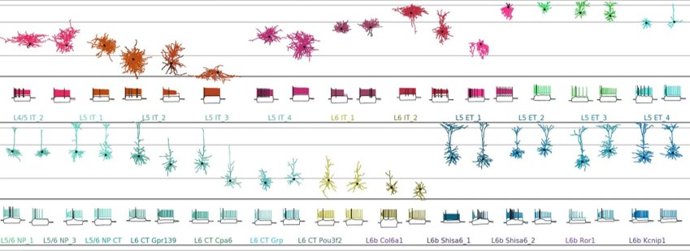
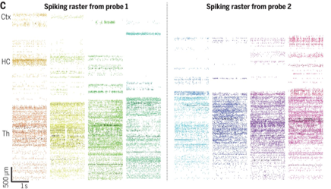
More data
Scala et al., 2021 (Nature)
Jun et al., 2017 (Nature)
Steinmetz et al., 2021 (Science)
Notes:
We've shown you how neuroscientists are collecting increasingly large datasets – of neuron morphology and activity, and we've discussed what we can learn from these datasets.
To some extent an implicit assumption behind these efforts, is that with more data will come more understanding, and that given enough data we would understand the brain.
Linker:
But is that true?
This is the question tackled by this paper entitled
Papers:
https://doi.org/10.1038/s41586-020-2907-3
https://doi.org/10.1038/nature24636
https://doi.org/10.1126/science.abf4588

Slide 3
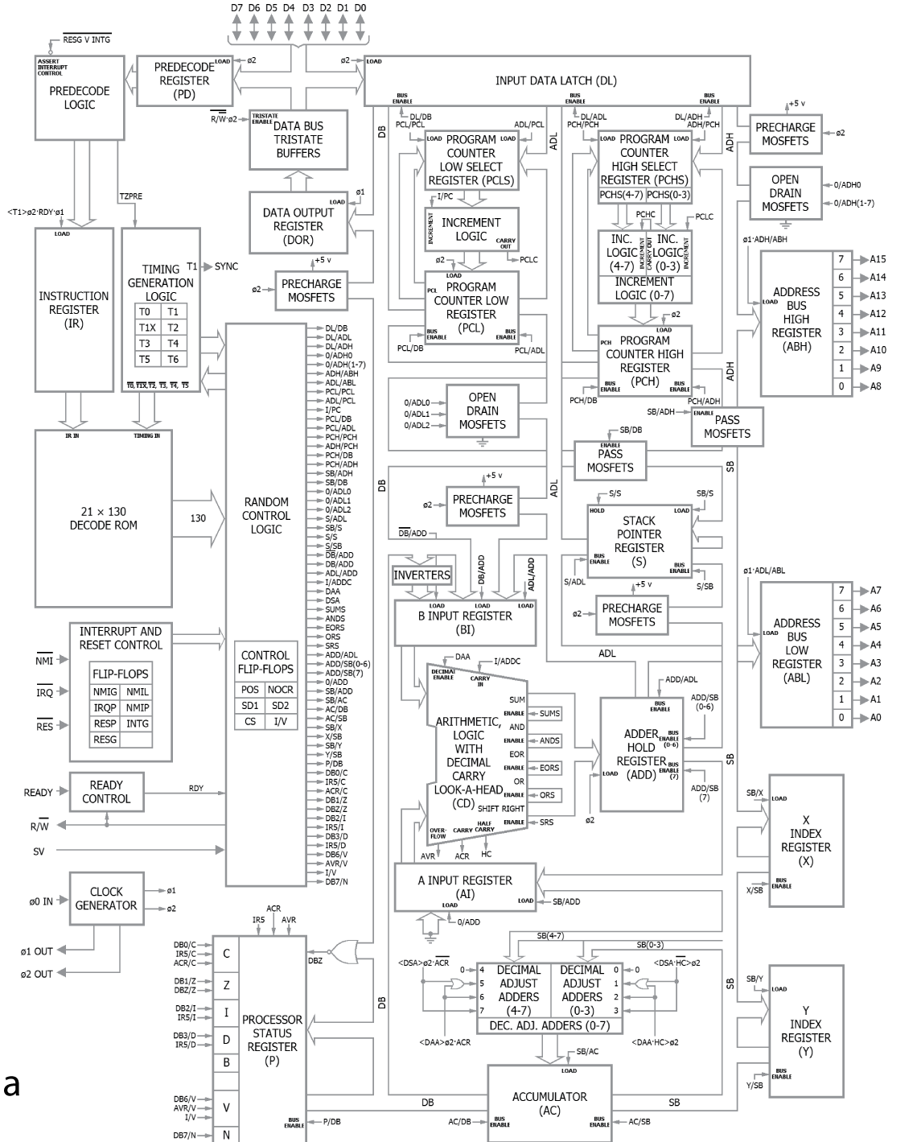
Could a neuroscientist understand a microprocessor?
Lazebnik, 2002 (Cancer Cell)
Jonas & Kording, 2017 (Plos CB)
Notes:
Could a neuroscientist understand a microprocessor?
Which was inspired by an earlier paper, called could a biologist fix a radio.
In this paper, the authors take an old microprocessor which runs three video games, and try to understand how it works by applying methods from neuroscience.
Critically, we know how the microprocessor works – so we can test how well these methods do at recovering that information.
While this may seem like an odd idea, the microprocessor is in some ways not that different from the brain. For example,
It's transistors and their connections resemble neurons, and
The time-varying activity of theses transistors transforms it's inputs to outputs.
Also, while there are many differences – like the fact the transistors are deterministic and easy to observe and manipulate, these differences should actually make the microprocessor easier to interpret than biological data.
If you've followed the rest of the course, I would encourage you to pause the video at this point and to try to think about how you would approach understanding the microprocessor – what data could you collect or experiments could you conduct to learn something about how it works?
Otherwise, let's see what the authors tried.
Papers:
https://doi.org/10.1016/s1535-6108(02)00133-2
https://doi.org/10.1371/journal.pcbi.1005268

Slide 4
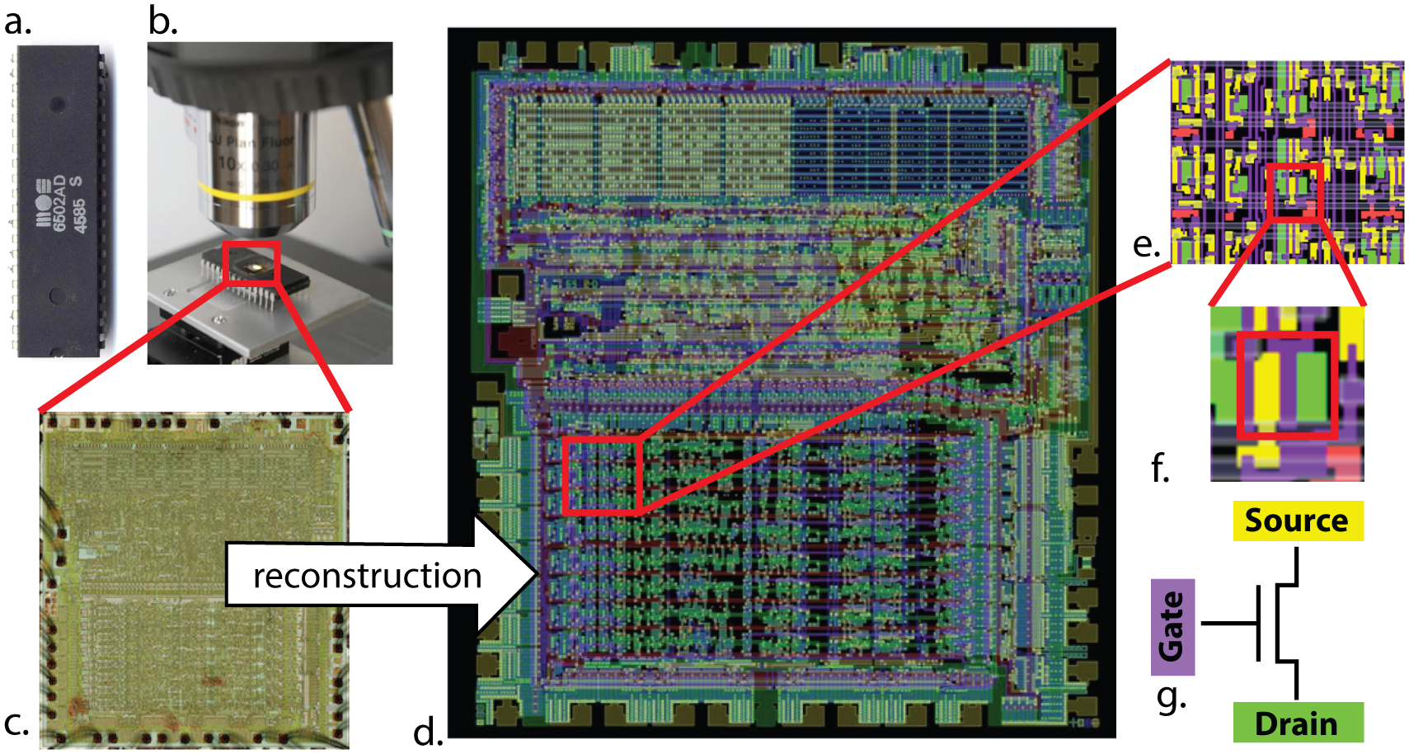
Connectome
Jonas & Kording, 2017 (Plos CB)
Notes:
First, the authors obtained the microprocessors connectome – i.e. a map describing how every transistor connects to every other transistor, and did some analysis of this.
While they find some interesting results, it's difficult to see how you could go straight from a networks structure to understanding it's function. And the authors highlight the fact that we don't have algorithms which can do this.
Linker:
So next,

Slide 5
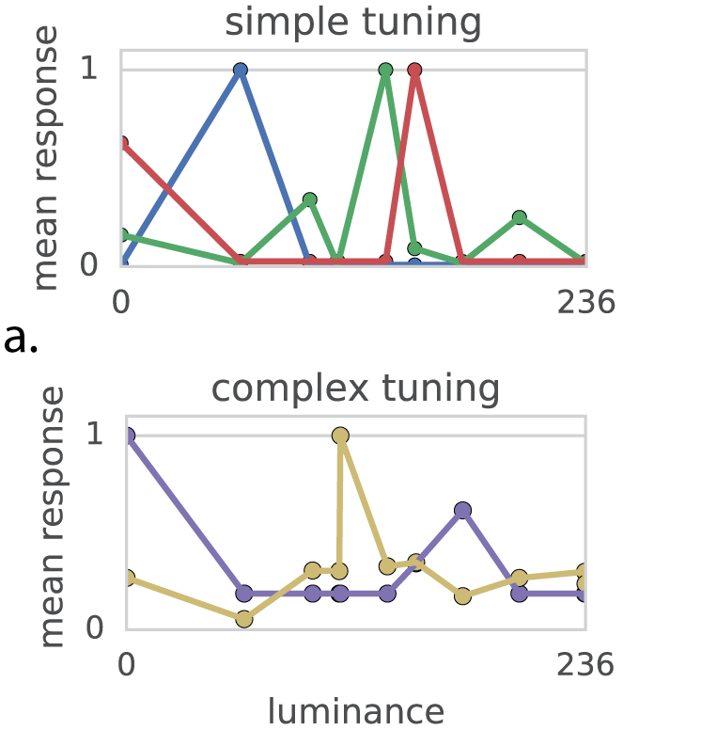
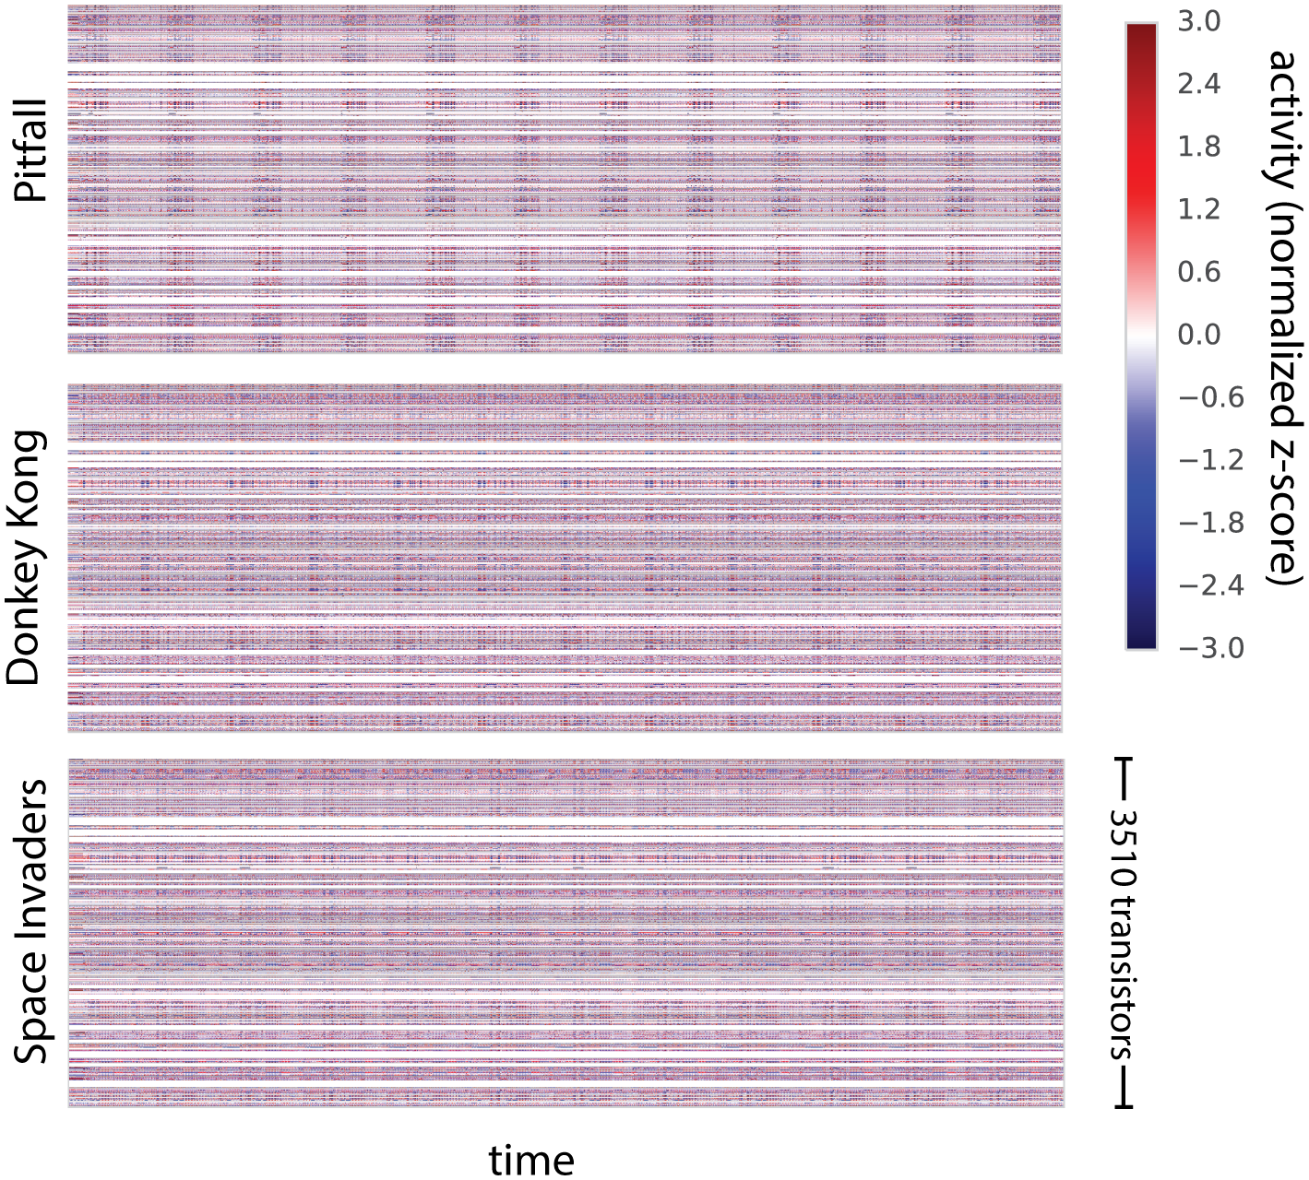
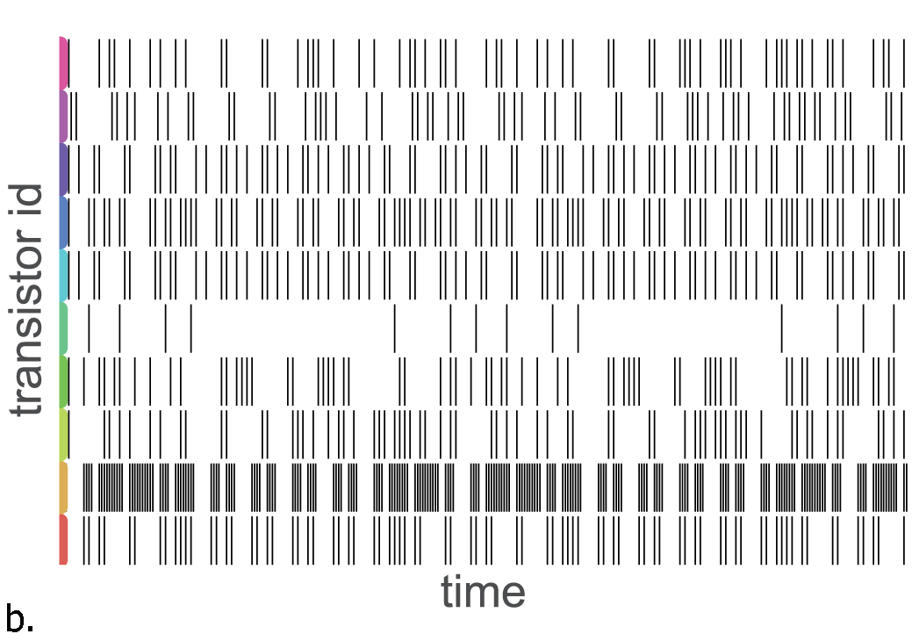
Observing and analysing
Jonas & Kording, 2017 (Plos CB)
Notes:
They simulate the microprocessor, and observe the activity patterns of it's transistors – much like a neuroscientist might record and analyze neural activity.
The figure on the left shows the off-to-on transitions of 10 transistors over time (which look surprisingly like spikes in a raster plot).
With these data, the authors then try to analyse the tuning properties of individual transistors. In this case, how their activity changes as a function of pixel luminance. The middle plot shows some of the results from this analysis – with:
Luminance on the x-axis
The transistors mean response on the y-axis
Different colored lines representing 5 different transistors.
Like neurons in the brain, some transistors seem to have simple tuning and are correlated with single luminance values. While others, seem to have more complex tuning.
So does this help us to understand how the microprocessor works?
Not really, as in truth, none of these transistors directly controls pixel luminance.
So maybe, instead of analyzing individual transistors we should try to identify functional ensembles – groups of transistors with correlated temporal dynamics?
To do that the authors, record the activity of all 3,510 transistors simultaneously over time – during the three different video games. The data is shown in the rightmost plot, with time on the x-axis and transistors on the y-axis per game, and again you can see that it resembles large-scale neural data.
They then analyze this with non-negative matrix factorization. This time they find, dynamics which match features of the microprocessor like the clock and read-write signal.
But again, this falls short of providing us with some substantial understanding of how the microprocessor works.
So what if instead of just observing the system we tried to manipulate it?

Slide 6
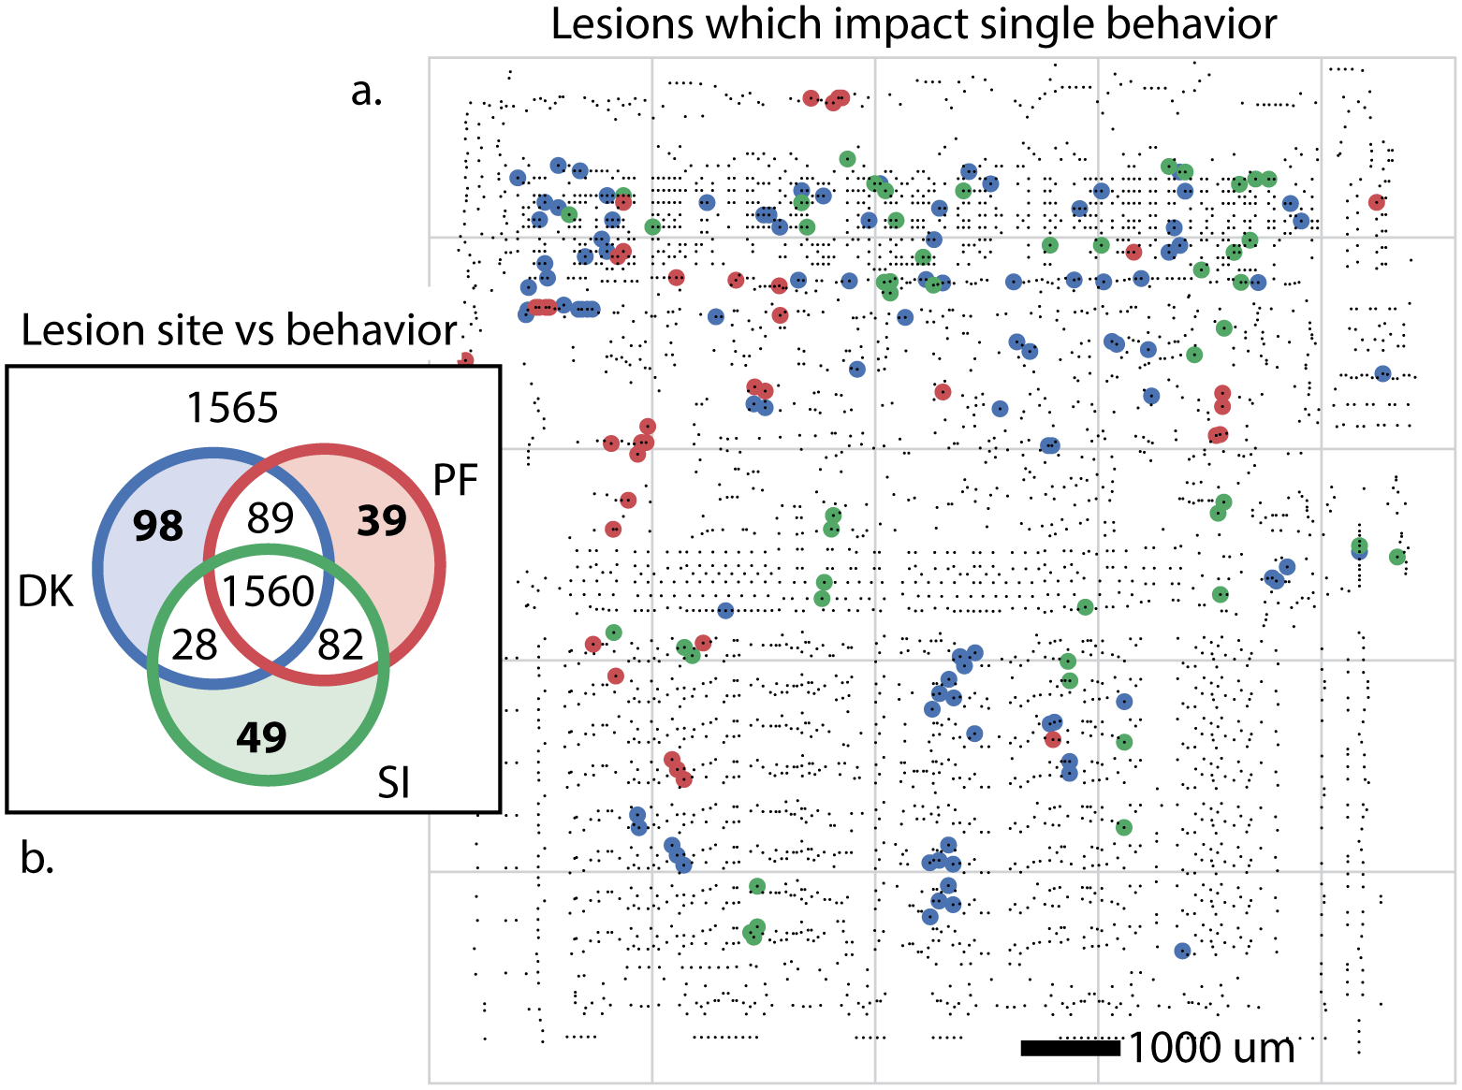
Single-element lesions
Jonas & Kording, 2017 (Plos CB)
Notes:
To do that the authors silence each transistor in turn, and check if each of the 3 video games will boot or not.
As the left of the figure shows:
Removing 1565 of the transistors had no impact.
Removing 1560 of them stopped the microprocessor from booting any games.
And then small subsets of the transistors prevented one or two games from booting. The locations of the transistors which were specific to one game are mapped onto the chip on the right of the diagram.
It's tempting to label these transistors as "Donkey Kong" or "Space Invaders" transistors – much like we may label a neuron as being visual or auditory.
But this is misleading here, as the transistors are not specific to single games, and instead implement simple functions (like full adders) which may be involved in other games we haven't considered or even these games if we looked beyond booting.
Linker:
So what would work?

Slide 7
What would work?
Better tasks
Better methods
Ground truth
Notes:
One suggestion from the authors is that they could have better designed their experiments to isolate individual behaviors or computations. For example, if you just recorded and manipulated the transistors while the player tried to move left – you could try to figure out how the microprocessor transforms a left controller input into a leftward movement on screen.
Another suggestion is that better methods could help. For example, in week 6 we covered why multi-element lesions may be more informative than single-element lesions.
But really how to understand complex networks is an open issue in neuroscience.
So does neuroscience work? This paper suggests that, our current approaches may not. So we need better methods and we need ground truth systems in which we can validate these.
With that thought, I'll leave you to Dan in the next video.

