Slide 1
Measures of Effect for Binary Variables

Slide 2
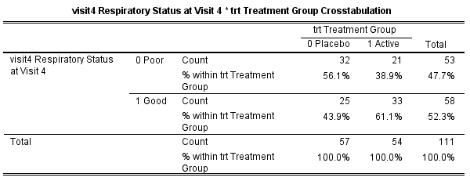
Dichotomous Outcomes
Risk of Good: 44% (Pcb) vs 61% (Act.)
Risk Difference = 61% - 44% = 17%
Relative Risk = 61%/44% = 1.39
Note: Ratio more common than difference!

Slide 3
Odds Ratio!
Odds of Good for Placebo: 44% /(1- 44%) = 0.78
Odds of Good for Active: 61% /(1- 61%) = 1.56
Odds Ratio: 1.56/0.78 = 2.00
Odds of good 2.00 times higher in the active group as compared to placebo group!
Odds Ratio for active is 2.

