Slide 1
Correlated Data
Caused by ‘Clustering’ in the data. 2 types:
Longitudinal – Clusters are subjects and data is collected over time.
Sampling Design: Sample Individuals, then time within individuals.
Clustered Data – Clusters are sampling features like schools, classes within schools, FSAs, Hospitals.
Sampling Design: Sample Schools, then within schools we sample students.
Clusters induce correlation in the data, which we need to take care of because usual stats models assume uncorrelated data.

Slide 2
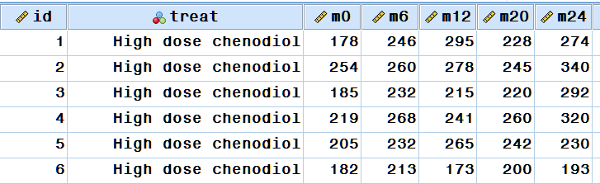
Repeated Measure Anova & Manova
Only for Data in Wide Format.
rmANOVA – Same measure repeated times.
MANOVA – Multiple Measures at the same Time.
rmANOVA can be replaced by MEM which has advantages (handle drop-outs and different covariance structures).

Slide 3
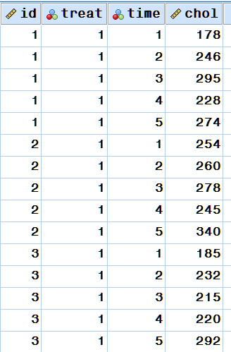
Mixed Effect Models
Data in Long Format.
Now we only have one dependent variable and we can just use a regression model!
Well, not so fast… Now we have a problem that the data is not independent. The top 5 lines are a single subject, but regression will think there are 5 subjects.

Slide 4
Correlation = Loss of information
If the second data point is correlated with the first, then the additional information provided by it may be small.
→ 2 points but sample size is not 2.

Slide 5
Data Analysis

Slide 6
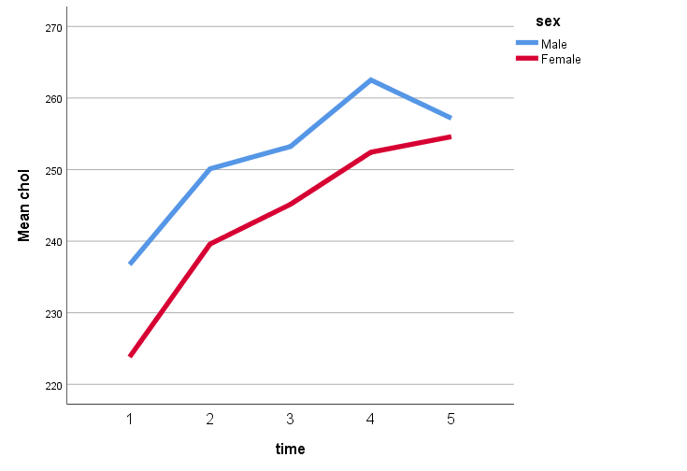
Research Question?
Model must be built to answer the research question.
Are the rate of change (Slopes) different?
Is the outcome different at the last time point?
Is there a difference in trajectory?
Difference Last – Baseline?

Slide 7
Usual Effect – Interaction group by time
Interaction = The effects depend on each other.
Time Effect = How outcome changes overtime (Trajectories).
Group Effect = How outcome differ across groups.
Interaction Effect = How outcome trajectories differ across groups

Slide 8
Let’s see how it works by doing it!

