Slide 1
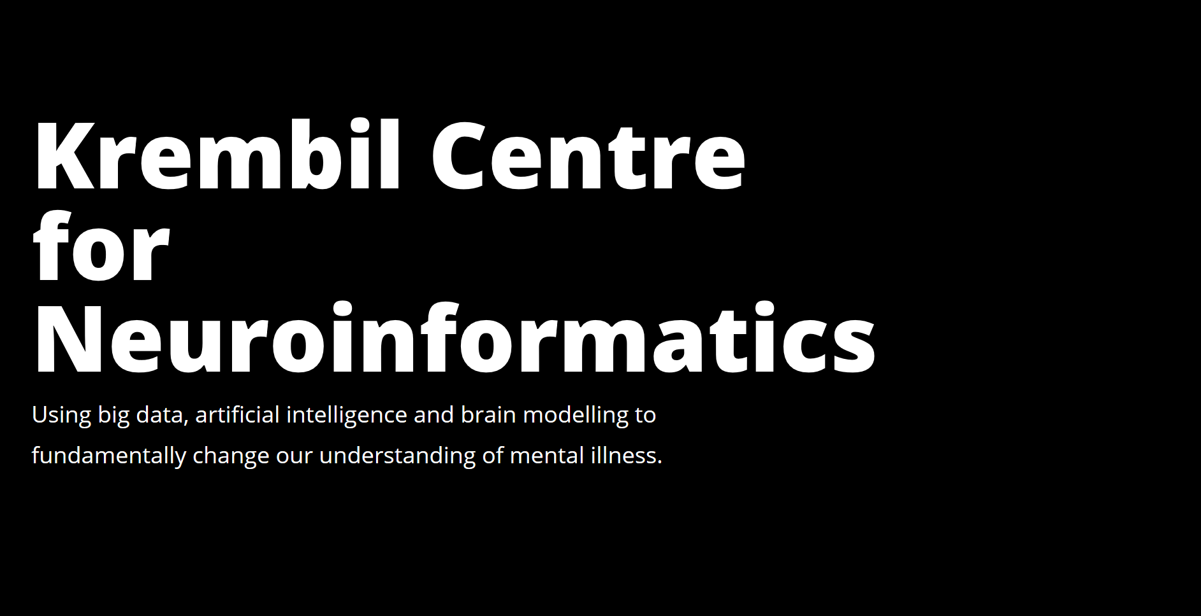

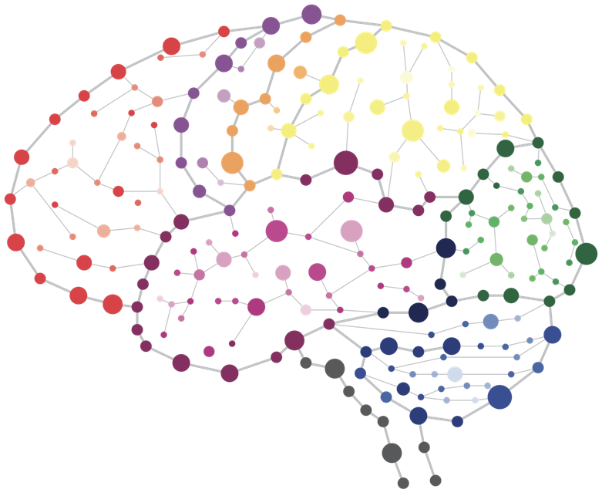
SUMMER SCHOOL 2020
Day 7 – Session 4
Introduction to Precision Medicine and Interactive Methods

Slide 2

Background
What is Precision Medicine?

Slide 3

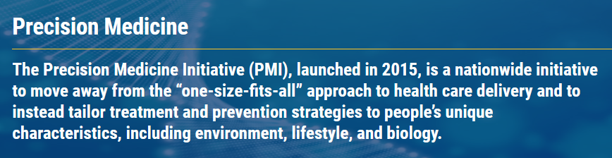
“To enable a new era of medicine through research, technology, and policies that empower patients, researchers, and providers to work together toward development of individualized care”
– PMI Mission statement (2015)
$215 Million in 2016 budget

Slide 4
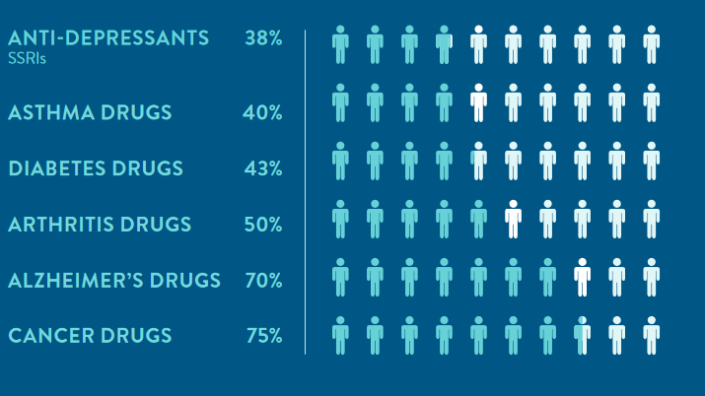
What is not precision medicine
(Personal Medicine Coalition, 2020)

Slide 5
What is precision medicine
“The underlying concept of precision medicine, in which health care is individually tailored on the basis of a person's genes, lifestyle and environment, is not new: transfusion patients have been matched with donors according to blood type for more than a century”
(Hodson, 2016, Nature)

Slide 6
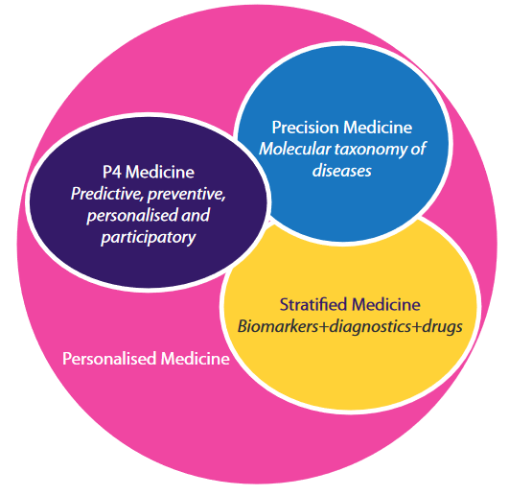
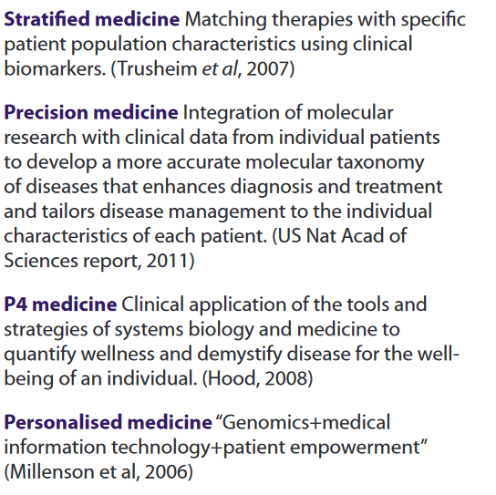
What is precision medicine
(University of Cambridge, PHG Foundation)

Slide 7
What is precision medicine
Precision Medicine
“stratified medicine”
“P4 medicine”
Many treatment options tailored to Disease “subtypes”
Personalized Medicine
“individualized care”
Unique treatments tailored to every person

Slide 8
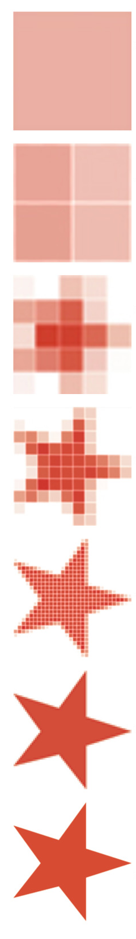
What is precision medicine
Precision Medicine
“stratified medicine”
“P4 medicine”
Many treatment options tailored to Disease “subtypes”
Personalized Medicine
“individualized care”
Unique treatments tailored to every person
“one size fits all”
precision
personalized

Slide 9
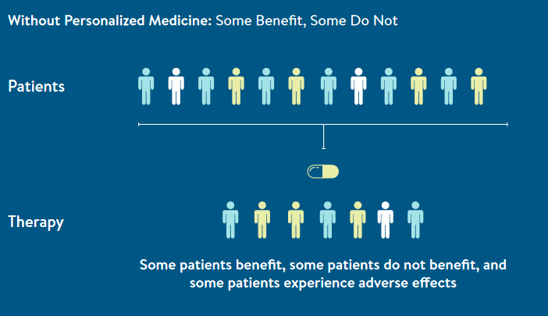
What is precision medicine
(Personal Medicine Coalition, 2020)

Slide 10
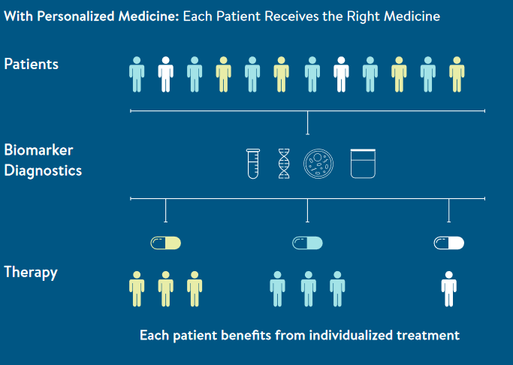
What is precision medicine
(Personal Medicine Coalition, 2020)

Slide 11
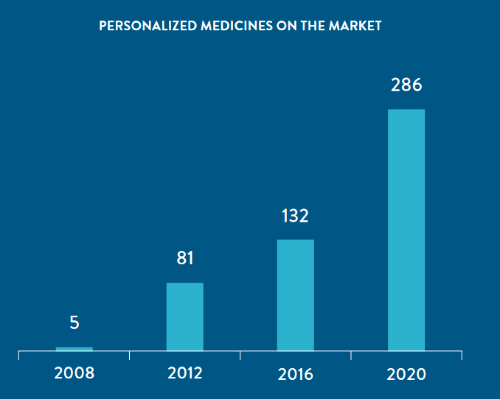
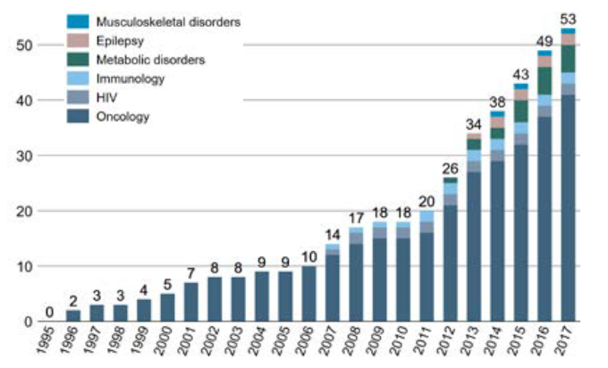
The future is already here
Germany
USA
“drugs that point to specific biomarker(s) in their labels to guide use”
(Stefan Kohler, ASSAF, 2018)
(Personal Medicine Coalition, 2020)

Slide 12
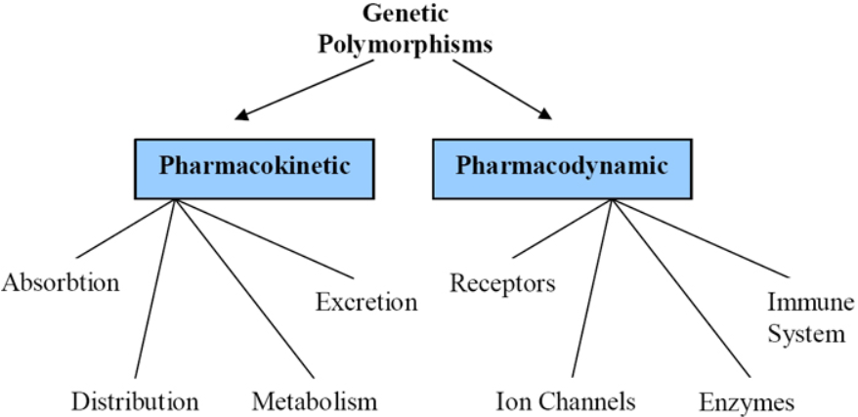
Pharmacogenetics
(Pirmohamed et al. Trends in Pharmaco. Sci., 2001)

Slide 13
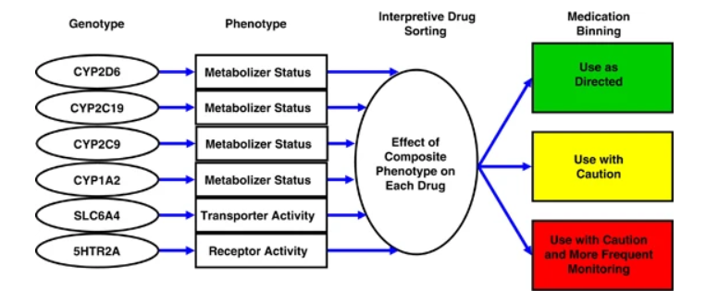

Example: psychiatric pharmacogenetics
(Winner et al., Trans. Psych., 2013)

Slide 14
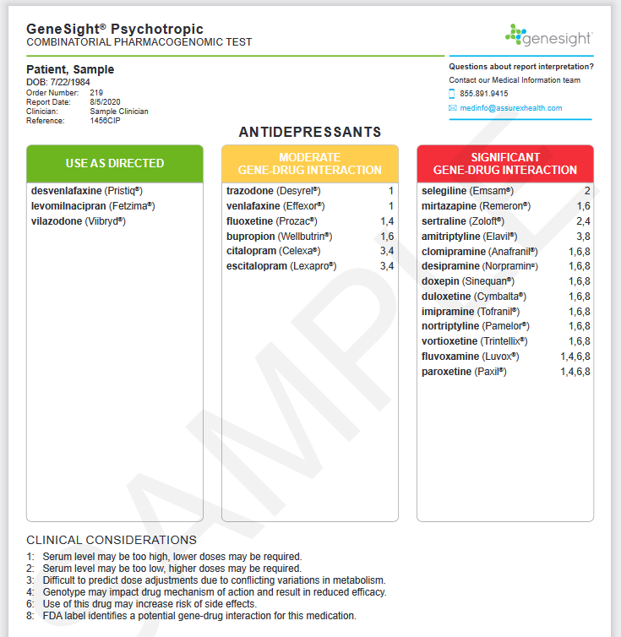
Example: psychiatric pharmacogenetics

Slide 15
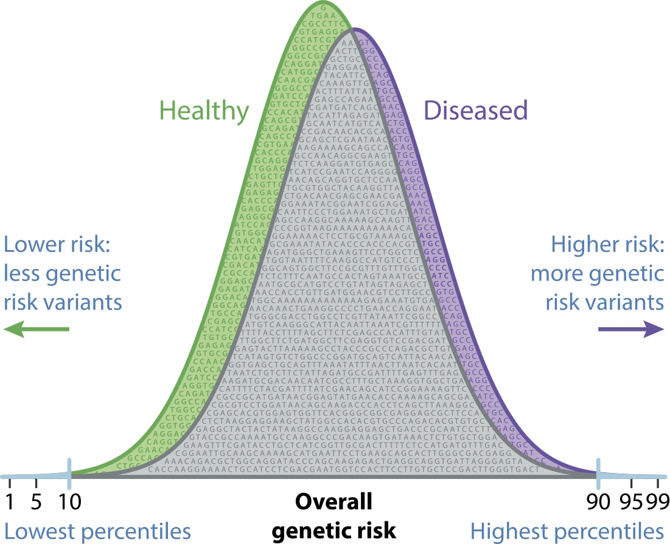
Polygenic Scores
(Andlauer and Nöthen, 2020)

Slide 16
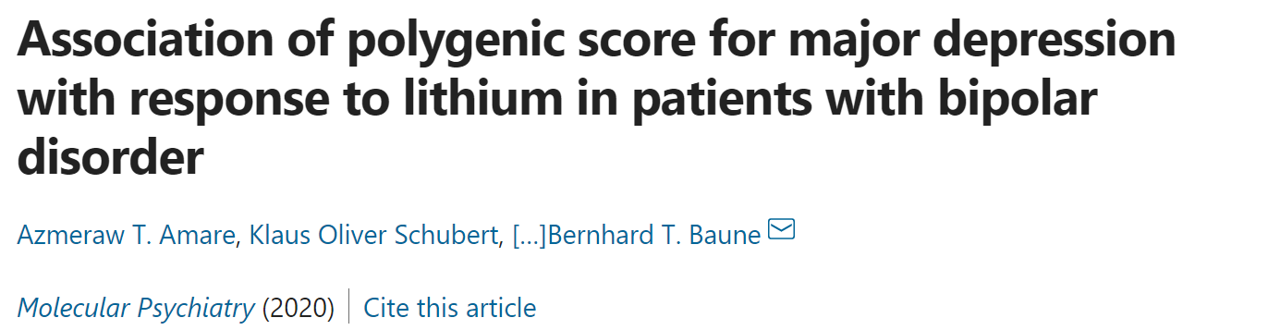
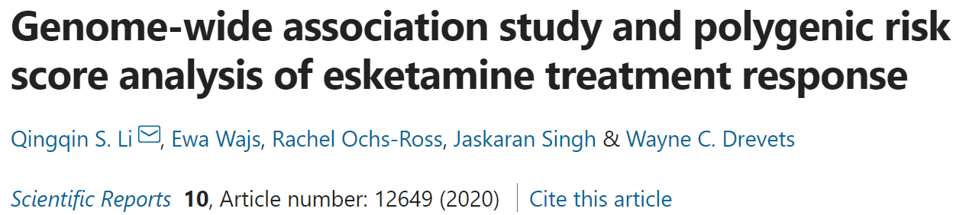
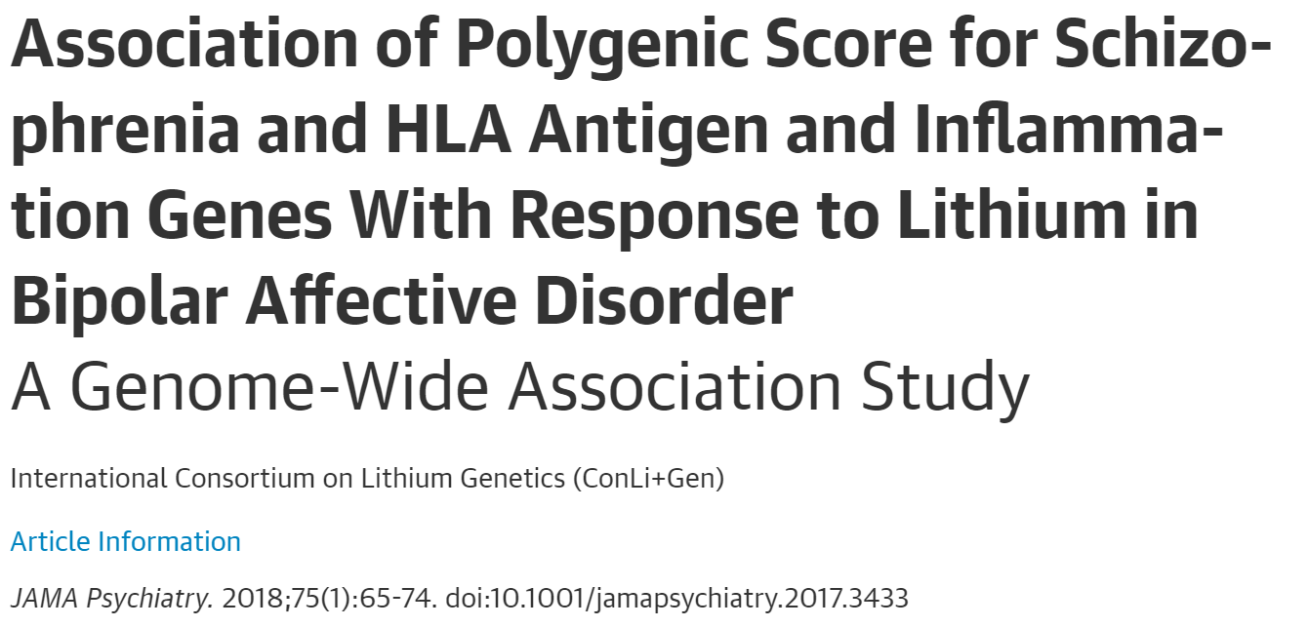
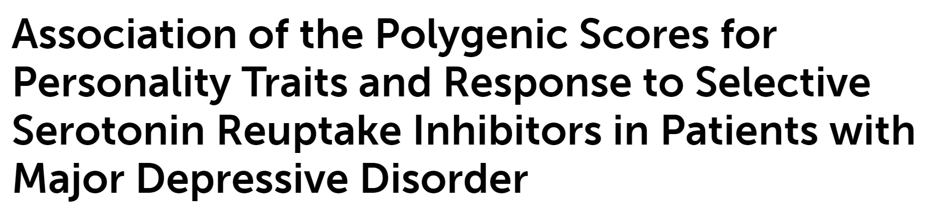
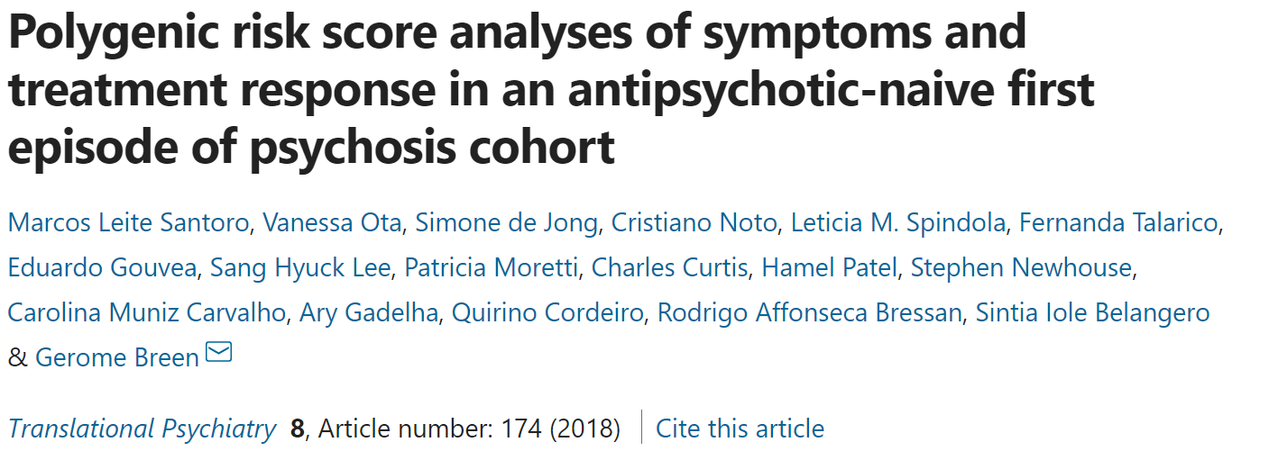
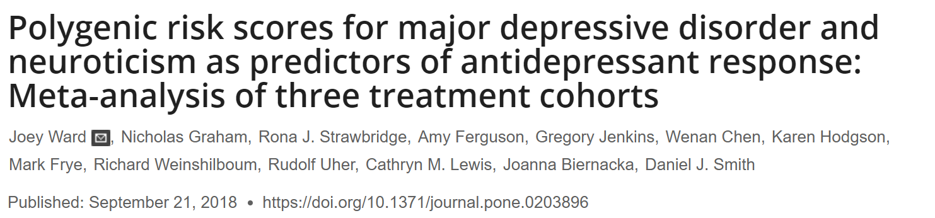
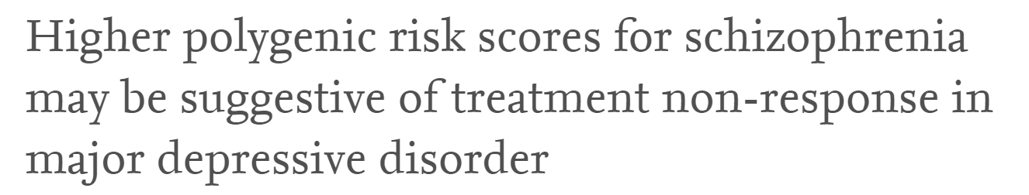
Predicting treatment response?

Slide 17
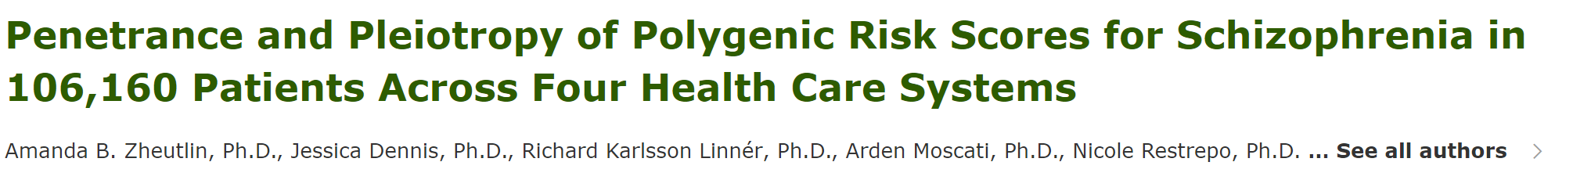
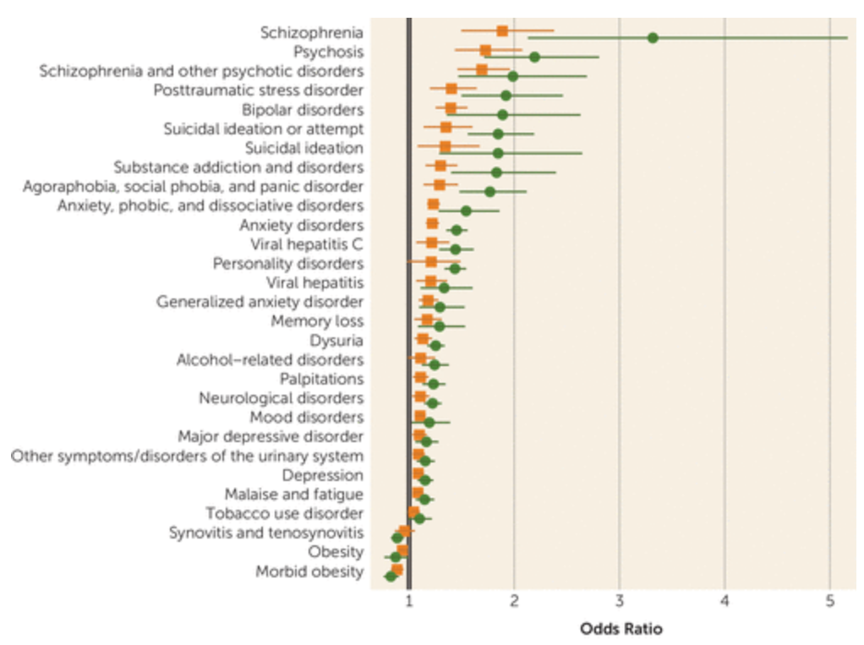
meta-analytical O.R.=1.55 [1.4,1.7]

Slide 18
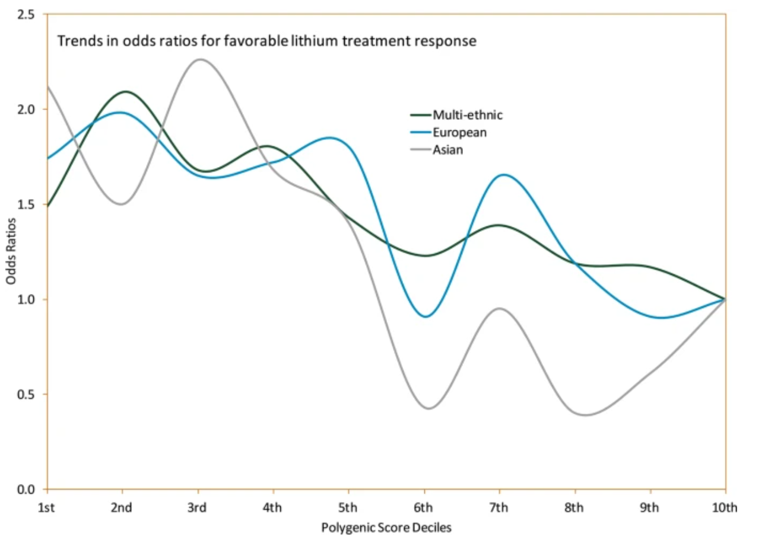
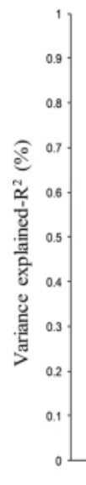
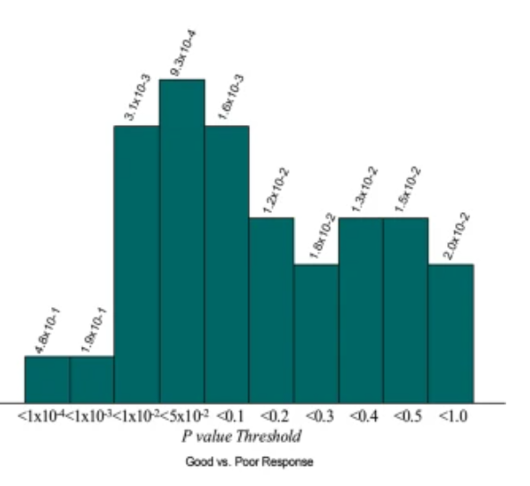
Small effect sizes in isolation

Slide 19
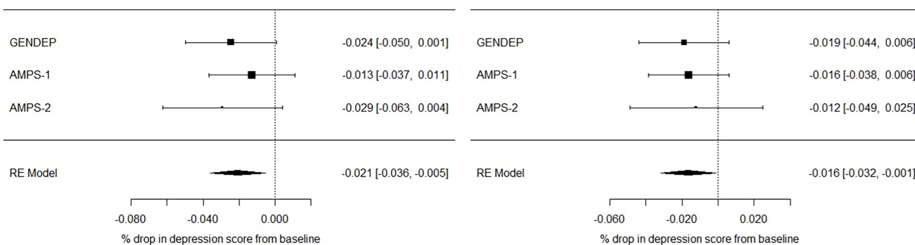
Small effect sizes in isolation
PRS for MDD
PRS for Neuroticism
(Ward et al., 2018)

Slide 20
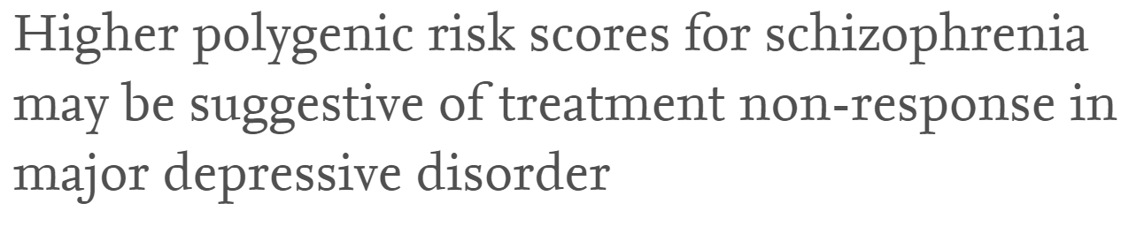
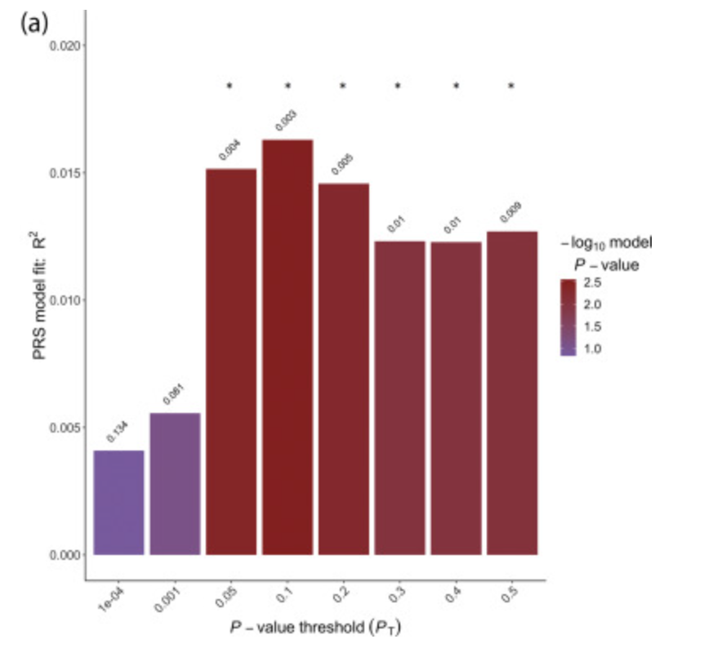
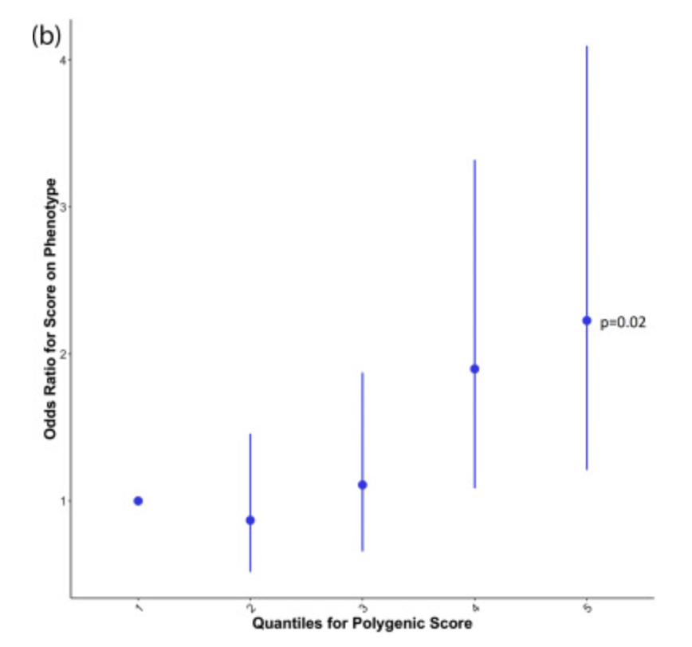
Small effect sizes in isolation
n=1,148 with MDD
MDD PRS not informative
SCZ-PRS
(Fanelli et al, 2021)

Slide 21
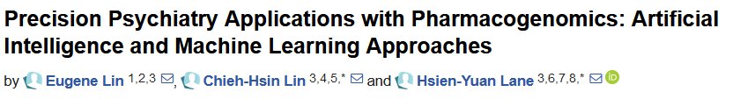
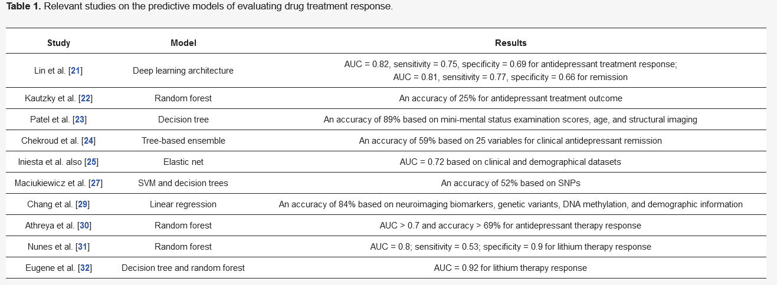
2020, Int J Mol Sci

Slide 22
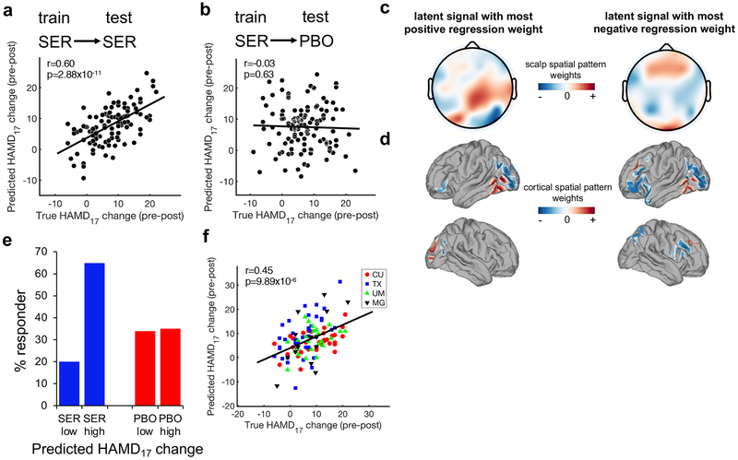
Electroencephalography
(Wu et al., 2020)

Slide 23
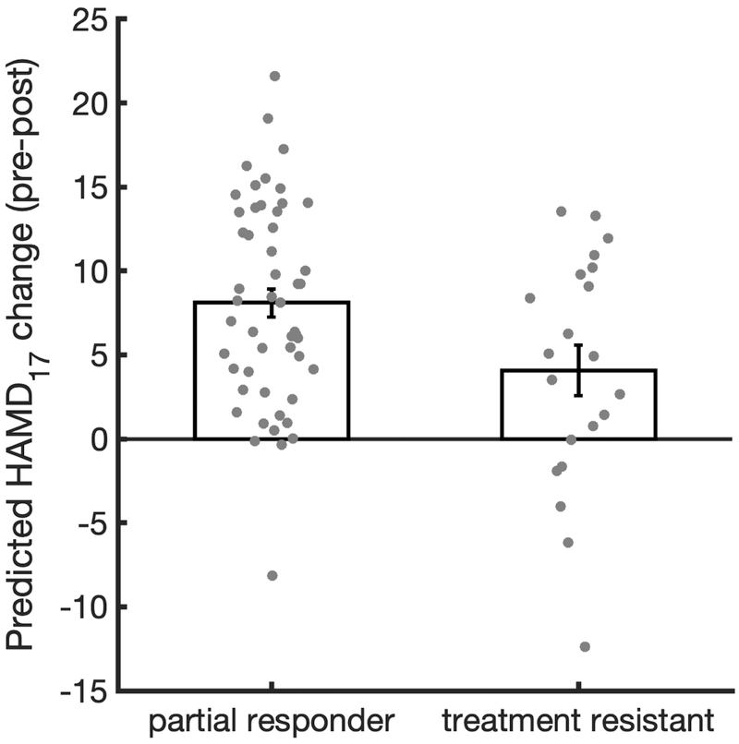
Electroencephalography
(Wu et al., 2020)

Slide 24
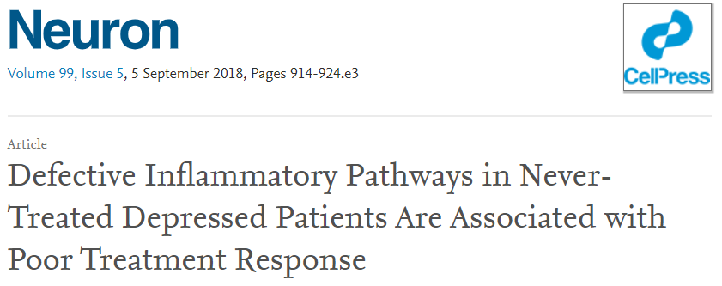
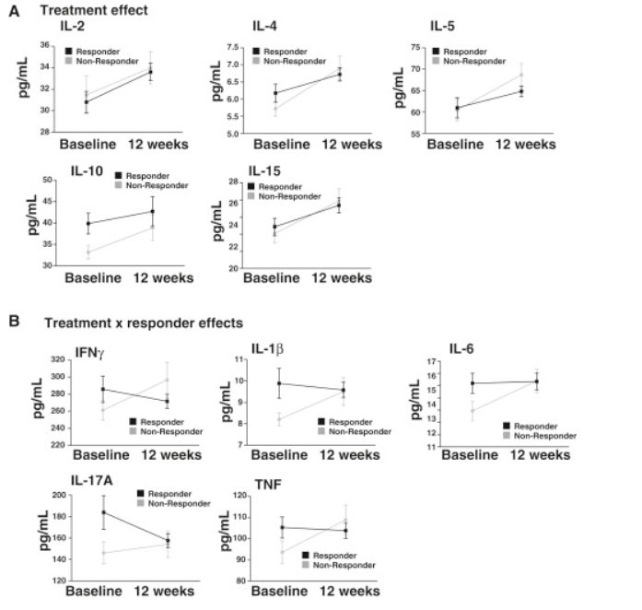
Anti-inflammatory
n_{resp}=71
n_{non-resp}=33
Pro-inflammatory
(Syed et al, 2018)

Slide 25
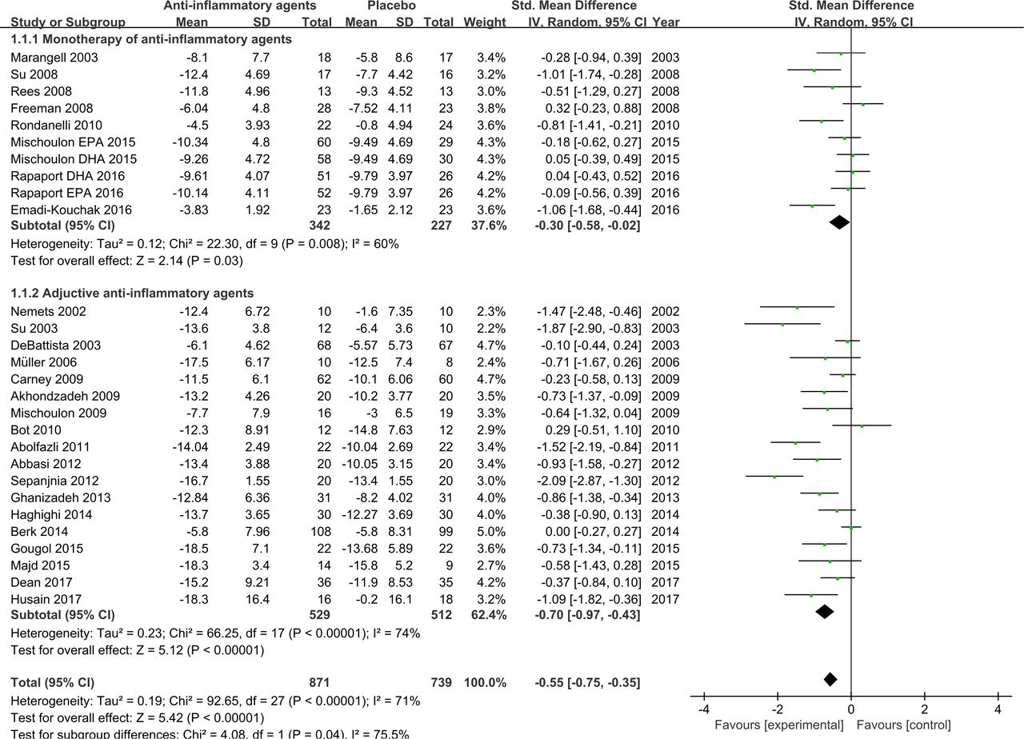
(Bai et al., 2020)

Slide 26
Methods
Recognizing diversity

Slide 27
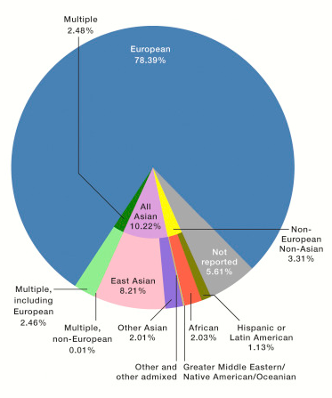
Diversity: lacking in research
(Sirugo et al., ell, 2019; GWAS Catalog data)

Slide 28
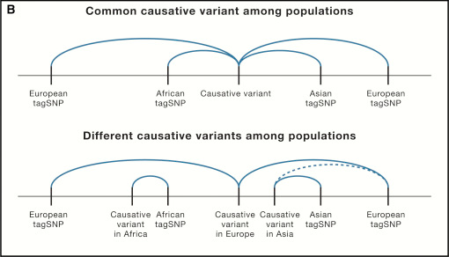
Diversity: lacking in research
(Sirugo et al., ell, 2019; GWAS Catalog data)

Slide 29
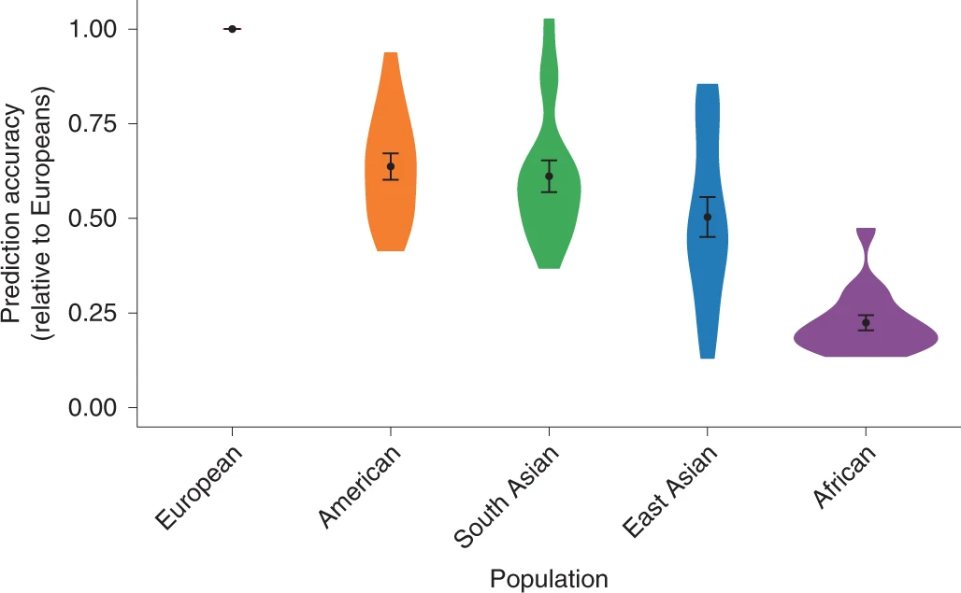
Diversity: genetic stratification bias
(Martin et al., ell, 2019, Nat. Genet.)

Slide 30
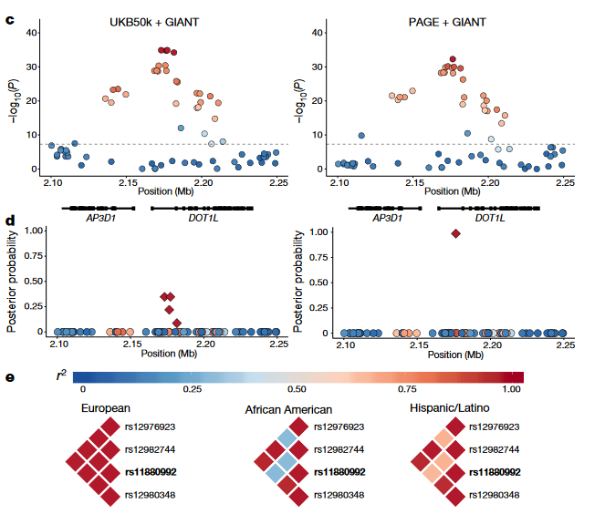
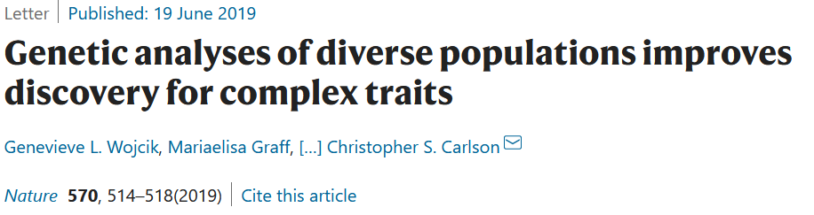
Diversity: improves power
(The Population Architecture using Genomics and Epidemiology (PAGE) Study, Nature, 2019)

Slide 31
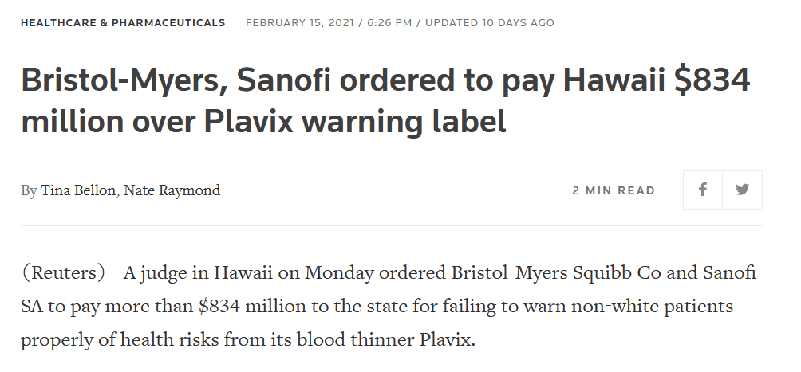
Diversity: what can go wrong

Slide 32
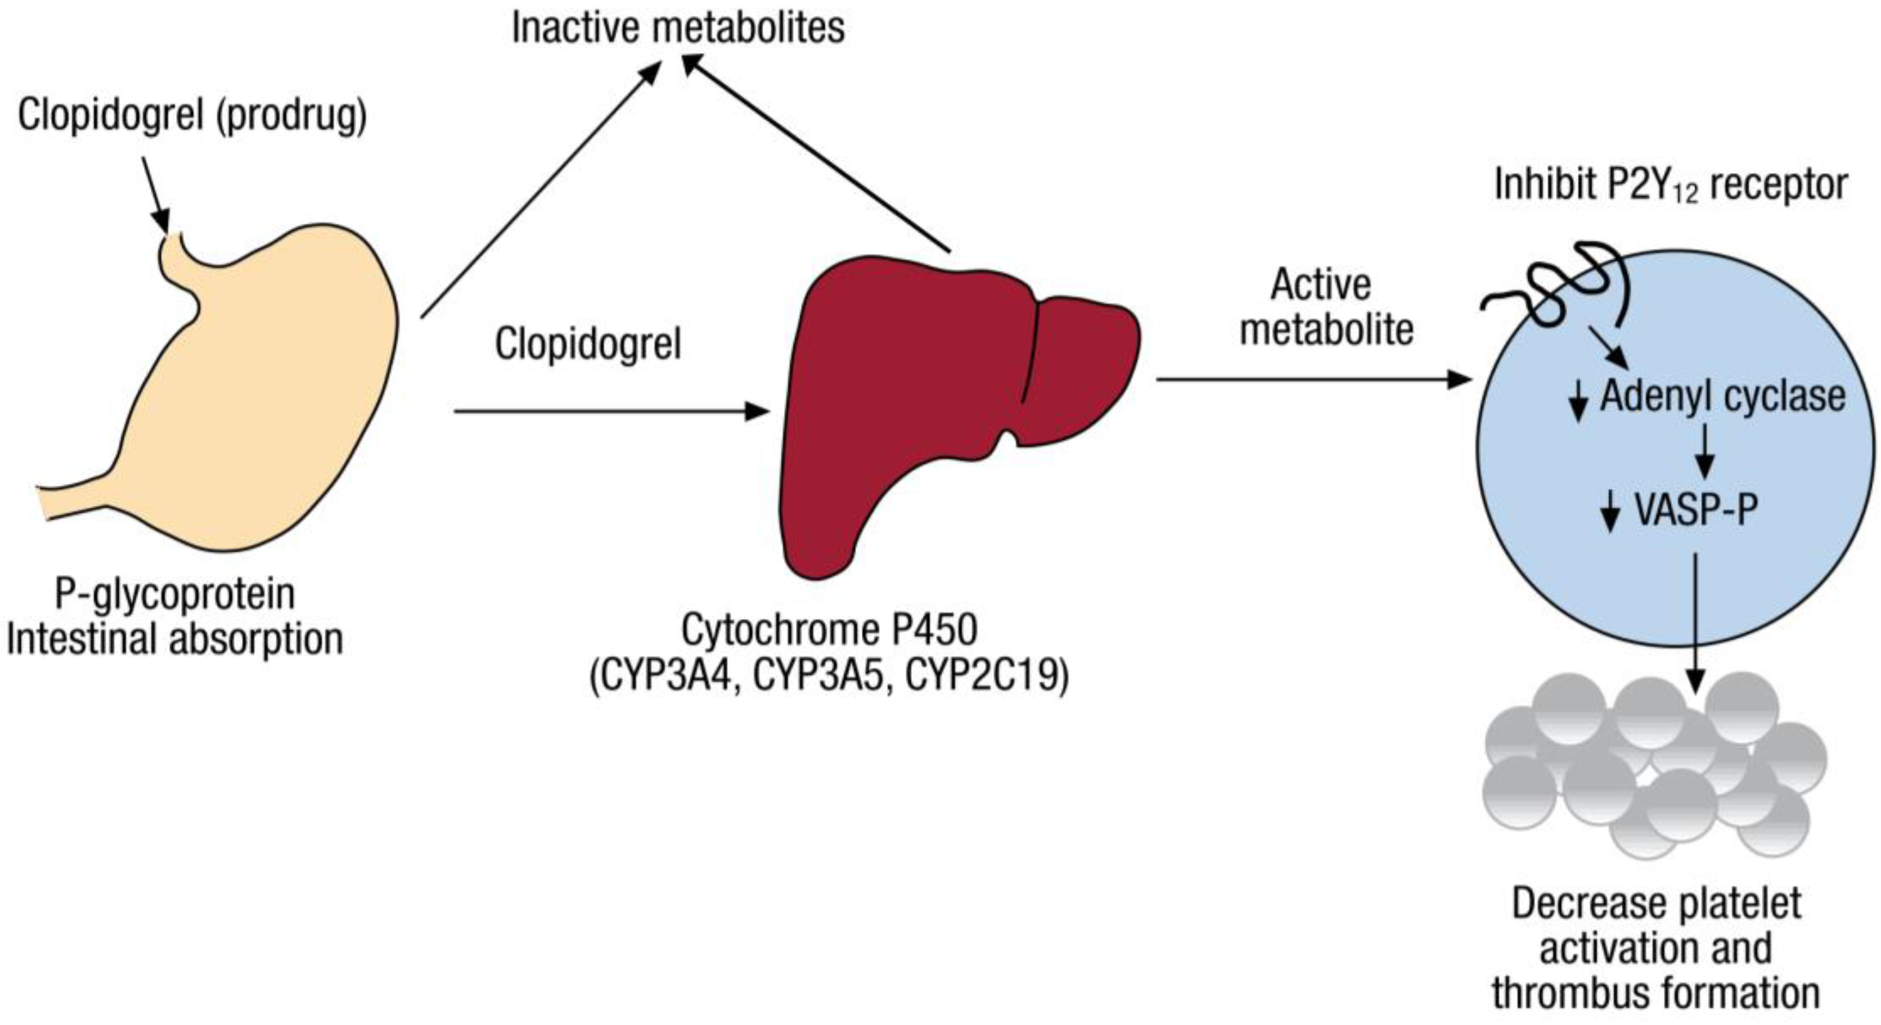
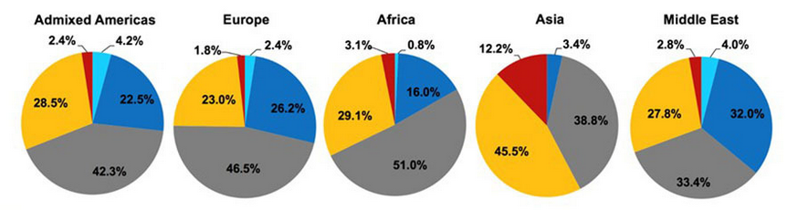
Diversity: what can go wrong
Plavix™ (Clopidogrel)
and
CYP2C19
CYP2C19 allele frequencies

Slide 33
Diversity: what can go wrong
Plavix™ (Clopidogrel)
and
CYP2C19
CYP2C19 allele frequencies

Slide 34
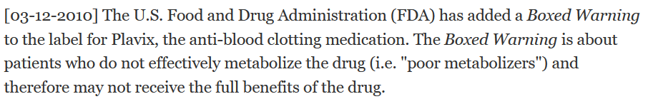
Diversity: what can go wrong

Slide 35
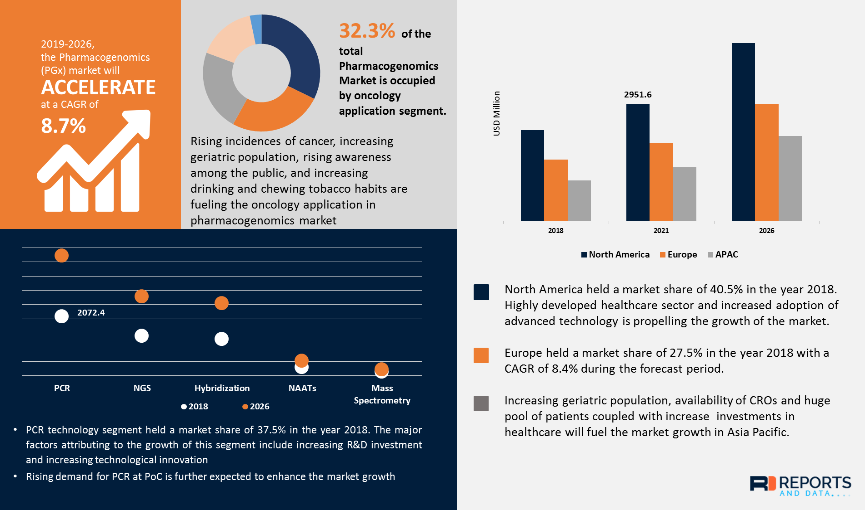
Economics: who pays?
Total $11.01B
(Reports and Data, 2020)

Slide 36
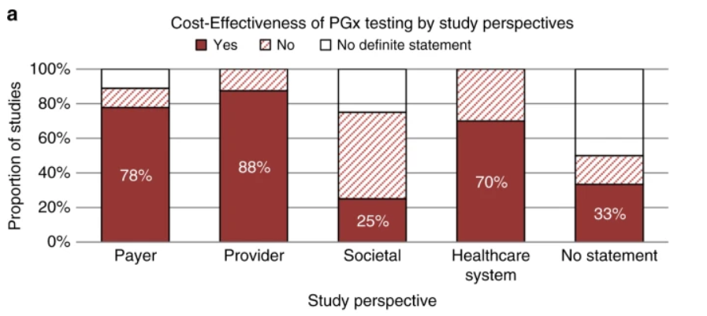
Economics: who pays?
Meta-analysis of 46 studies
(Zhu et al., Genetics in Medicine, 2019)

Slide 37
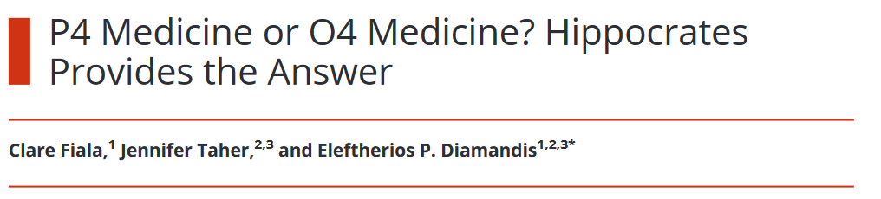
Economics: potential for misuse
JALM, 2019
“We introduce the concept of O4 medicine, which stresses overtesting, overdiagnosis, overtreatment, and overcharging. We hope that by moderating the enthusiasm of technology-driven testing we will help to facilitate optimal use of current resources, reap the benefits, and minimize harms.”

Slide 38


Privacy and non-discrimination
USA (2008)
(Belisle-Pipon et al., Nature Med., 2019)
Canada (2017)

Slide 39
Methods
Utility and Implementation

Slide 40
Assessing Clinical Utility
“...the value of information to the person being tested. If a test has utility, it means that the results provide information that is of the value to the person, because he or she can use the information to seek [or receive] an effective treatment or preventive strategy. Even if no intervention are available to treat or prevent a disease, there may be benefits associated with knowledge of a results” Lesko et al. 2010

Slide 41

Assessing Clinical Utility

Slide 42

Assessing Clinical Utility
“Why Most Clinical Research is Not Useful”
(Ioannidis, PLOS Med, 2016)

Slide 43

Clinical Trial Design
(Lenze, Rodebaugh & Nicol, 2020, JAMA Psychiatry)

Slide 44

Implementation Science
Consolidated Framework for Implementation Research (CFIR)
(Damschroder et al., 2009, Implement. Sci.)

Slide 45



Implementation Science

Slide 46




(Schiz Res, 2021)

Slide 47



Slide 48

How Can Implementation Fail?
(Damschroder et al., 2009, Implement. Sci.)

Slide 49


Slide 50
Methods
Introduction to Integrative Models

Slide 51
Perspectives on study design
What is “integrative research”?
Multivariate?
Pluralistic?
Multi-modal?
Cross-disciplinary?
Cross-species?
Biopsychosocial?
Collaborative?
Network-based?

Slide 52
Perspectives on study design
What is “integrative research”?
Multivariate?
Pluralistic?
Multi-modal?
Cross-disciplinary?
Cross-species?
Biopsychosocial?
Collaborative?
Network-based?
?

Slide 53

Perspectives on study design
What is “integrative research”?
within-group and pooled effects
(BMJ, 1904)

Slide 54


Perspectives on study design
What is “integrative research”?
within-group and pooled effects
(BMJ, 1904)
“...the analysis of analyses.”

Slide 55

Perspectives on study design
What is “integrative research”?
“IDA is the statistical analysis of a single data set that consists of two or more separate samples that have been pooled into one”

Slide 56


Perspectives on study design
What is “integrative research”?

Slide 57

Perspectives on study design
Data Science

Slide 58


Perspectives on study design
Univariate, bivariate, multivariate?
Can refer to specific statistical methods or study designs
Examples:
Univariate: One measurement is taken, and qualities of that measurement are observed
-mean, variance, one-sample t-test
Bivariate: Two measurements are taken, and their relationship is examined
-Correlation, two-sample t-test, chi-squared test of contingency table
Multivariate: EVERYTHING ELSE

Slide 59

Perspectives on study design
(Singh, 2007)

Slide 60




Perspectives on study design
Data types?
Can refer to data source or structure
Examples:
Multi-modal neuroimaging:
Data structure
practical elements
(form)
design elements
(bias, missingness, provenance)
(http://venus.ifca.unican.es/Rintro)

Slide 61
Perspectives on study design
Key aspects of designing an integrative study:
Identifying key outcome(s) of interest
  Sometimes the goal is to use a multitude of measures to discover new (or latent, unobserved) features of the data. However, even this requires a basis for interpreting results (i.e. reference variables).
Understanding the structure of your data
Identifying opportunities for analysis and internal & external validation

Slide 62
Variable vs. person-centered approaches
Variable-centered
Person-centered
“The variable-centered approach is the traditional and dominant approach in the social sciences, and its purpose is to explain relationships between variables of interest in a population”
“categorizing subjects into common subpopulations based on substantive variables and understanding the relations of these subpopulations with predictors, correlates, or outcomes”
(Howard et al., 2018, Org Res Methods)

Slide 63
Variable vs. person-centered approaches
Variable-centered
Person-centered
“The variable-centered approach is the traditional and dominant approach in the social sciences, and its purpose is to explain relationships between variables of interest in a population”
“categorizing subjects into common subpopulations based on substantive variables and understanding the relations of these subpopulations with predictors, correlates, or outcomes”
Person-specific
“an individual’s prior behaviors, genetic makeup, and contextual risk or protective factors operate as an integrated whole; taken in isolation, they may lose their meaning and consequence for that individual’s behavioral course”
- Sterba and Bauer, 2010
(Howard et al., 2018, Org Res Methods)

Slide 64

Variable vs. person-centric approaches
i.e. When each set of observations (e.g. for a person) is equally representative of the whole process. Or when the statistical properties of a distribution can be known from observing one person many times, or many people once
(Howard et al., 2018, Org Res Methods)

Slide 65

Bridging Data Domains
(Alyssa Cannitelli)

Slide 66
Tomorrow
Imaging-Genetics
Gene-Environment Interaction
Mixed and Latent Group Trajectory Models
Common Machine Learning Models
High-Dimensional ‘Omics Integration and Patient Subtyping

