Slide 1


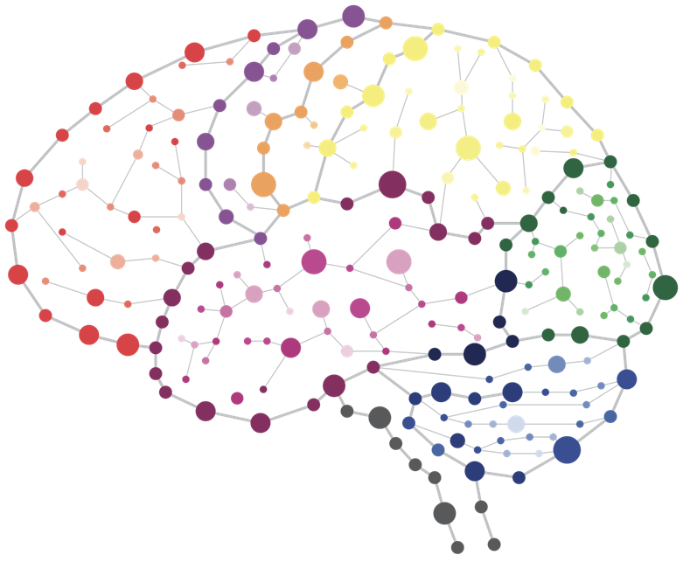
SUMMER SCHOOL 2020
Day 8 – Session 1-2
Integrative Research and Whole Person Modelling

Slide 2
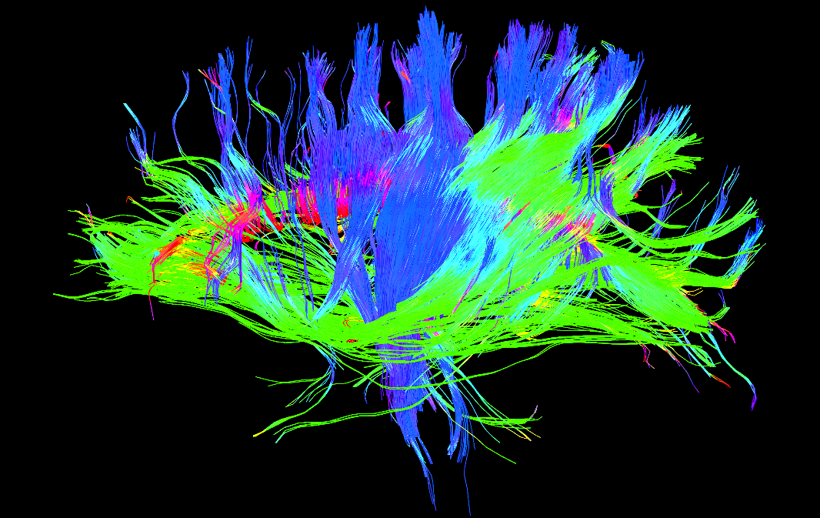


CAMH Land Acknowledgement
CAMH is situated on lands that have been occupied by First Nations for millennia; lands rich in civilizations with knowledge of medicine, architecture, technology, and extensive trade routes throughout the Americas. In 1860, the site of CAMH appeared in the Colonial Records Office of British Crown as the council grounds of the Mississaugas of the New Credit, as they were known at the time.
Today, Toronto is covered by the Toronto Purchase, treaty No. 13 of 1805 with the Mississaugas of the Credit.
Toronto is now home to a vast diversity of First Nations, Inuit, and Métis who enrich this city.
CAMH is committed to reconciliation. We will honour the land through programs and places that reflect and respect its heritage. We will embrace the healing traditions of the Ancestors, and weave them into our caring practices. We will create new relationships and partnerships with First Nations, Inuit, and Métis and share the land and protect it for future generations.

Slide 3
Code of Conduct
The KCNI Summer School is dedicated to providing a harassment-free learning experience for everyone, regardless of gender, gender identity and expression, sexual orientation, disability, physical appearance, body size, race, age or religion. We do not tolerate harassment of event participants in any form
Harassment includes, but is not limited to:
Verbal comments that reinforce social structures of domination related to gender, gender identity and expression, sexual orientation, disability, physical appearance, body size, race, age or religion.
Sexual images in public spaces
Deliberate intimidation, stalking, or following
Harassing photography or recording
Sustained disruption of talks or other events
Inappropriate physical contact
Unwelcome sexual attention
Advocating for, or encouraging, any of the above behaviour
Notes:
Also include note about note about not going all over the building.

Slide 4
Respectful Language
When discussing mental health, always remember that the person comes first and the diagnosis come second.
Please don’t say | Instead say
depressives | people with major depressive disorder
schizophrenics | people with schizophrenia
addict | person with substance use disorder
drug abusers | people who use drugs

Slide 5



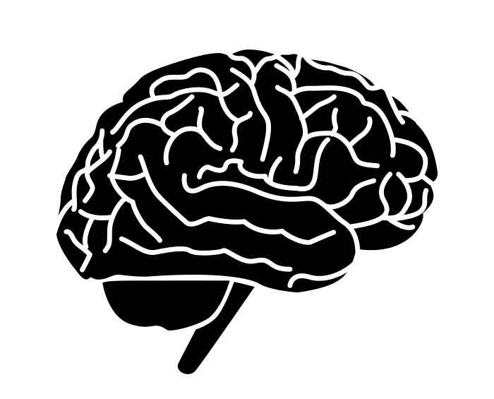

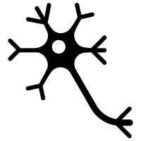

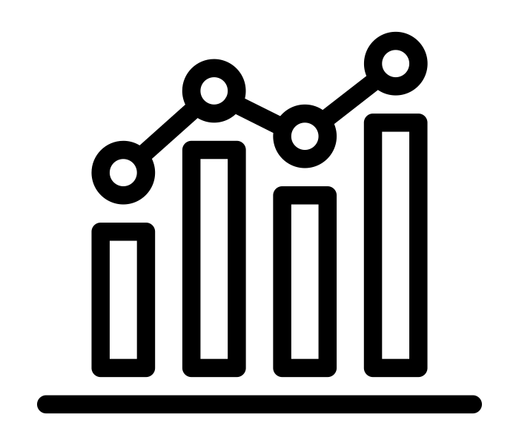
Summer School Schedule
Understanding clinical research questions and reproducible science.
Genetics and transcriptomics
.
Whole-Brain Modelling and Neuroimaging Connectomics
Digital Health and Population-based data resources
S. Hill & E. Dickie
B. Jones & V. Tang
S.Tripathy,& D. Felsky
J. Griffiths & E Dickie
A. Pratap, J Yu & D. Felsky
Mon 05/07
Tu 06/07
Wed 07/07
Wed 08/07
Fri 09/07
Mon 12/07
Tues 13/07
Wed 14/07
D. Buchman,L. Sikstrom & M Maslej
E. Hay & F. Mazza
A Diaconescu + Lab
D. Felsky
& Group Panel
Brain Microcircuit Simulations of Depression
Bayesian Models of Learning and Integration of Neuroimaging Data
Integrative research methods
Panel Discussion
Applied ethics in machine learning and mental health

Slide 6

Today’s Agenda
9:00 am - 10:30 am
Integrative Research and Whole Person Modelling
Dan Felsky
10:45 am
- 12:15 pm
WORKSHOP: Similarity Network Fusion (SNF) on integrative data types in RStudio
Day 7
Digital Health and Data Resources
1:00 pm -
2:30 pm
PANEL DISCUSSION / Q & A
2:45 pm -
4:15 pm
PANEL DISCUSSION / Q & A
Notes:
See last slides for outputs

Slide 7





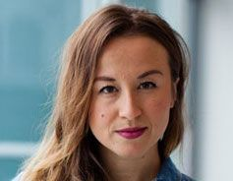
Day 3: Lead Instructor & TAs
Dr. Daniel Felsky
Independent Scientist and Head of Whole Person Modelling at KCNI
Assistant Professor in the Department of Psychiatry, University of Toronto.
Assistant Professor at the Dalla Lana School of Public Health, University of Toronto.
​PhD in neuroimaging and genetics of Alzheimer’s disease at U of T, Postdocs in computational neuroimmunology and bioinformatics at Broad Institute, Harvard Medical School & Columbia University.
Marta Maslej
Mohamed Abdelhack
Amin Kharaghani
Milos Milic
Earvin Tio

Slide 8
Integrative methods
Integrative Methods

Slide 9
Perspectives on study design
What is “integrative research”?
Multivariate?
Pluralistic?
Multi-modal?
Cross-disciplinary?
Cross-species?
Biopsychosocial?
Collaborative?
Network-based?

Slide 10
Perspectives on study design
What is “integrative research”?
Multivariate?
Pluralistic?
Multi-modal?
Cross-disciplinary?
Cross-species?
Biopsychosocial?
Collaborative?
Network-based?
?

Slide 11
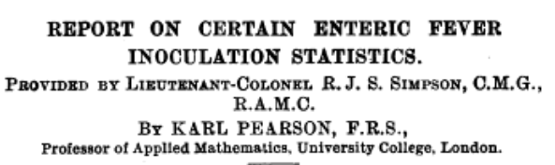
Perspectives on study design
What is “integrative research”?
within-group and pooled effects
(BMJ, 1904)

Slide 12
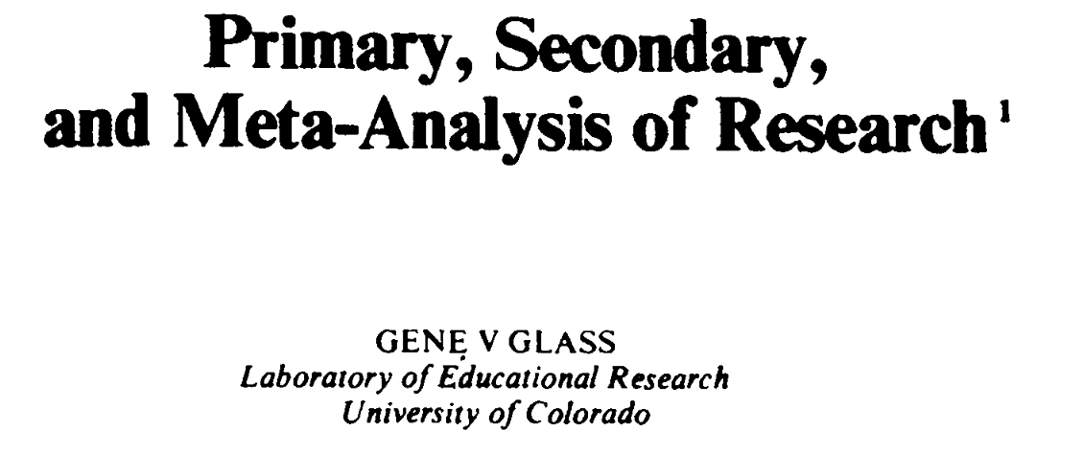

Perspectives on study design
What is “integrative research”?
within-group and pooled effects
(BMJ, 1904)
“...the analysis of analyses.”

Slide 13
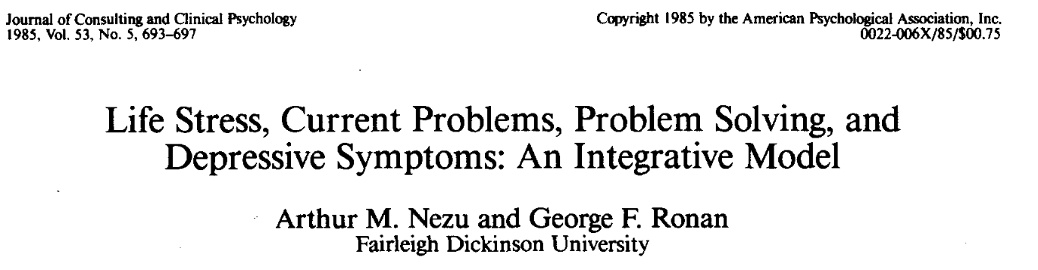
Perspectives on study design
What is “integrative research”?
“IDA is the statistical analysis of a single data set that consists of two or more separate samples that have been pooled into one”

Slide 14
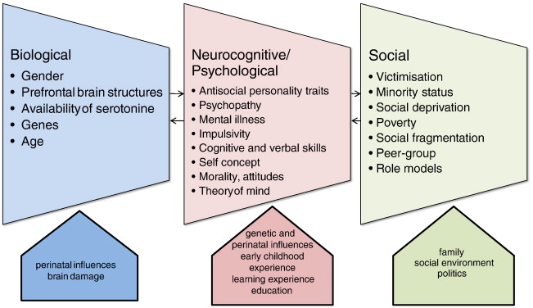
Perspectives on study design
What is “integrative research”?
(Steinert & Whittington, 2013)

Slide 15
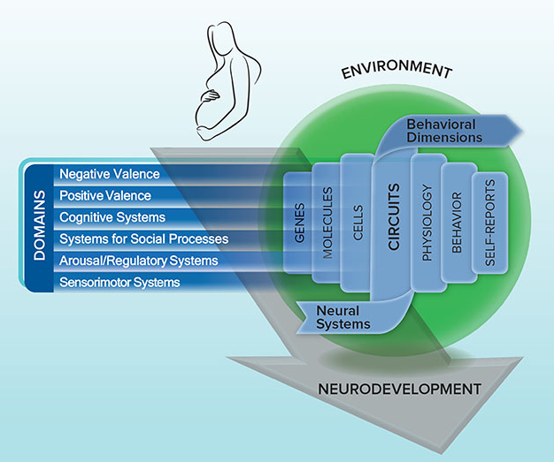
Research Domain Criteria - 2009
(NIH, RDoC)

Slide 16
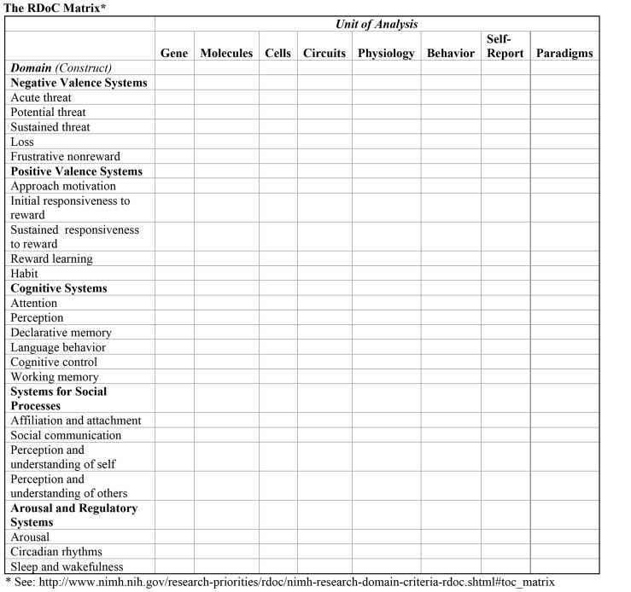
Research Domain Criteria - 2009
(NIH, RDoC)
(NIH, RDoC)

Slide 17
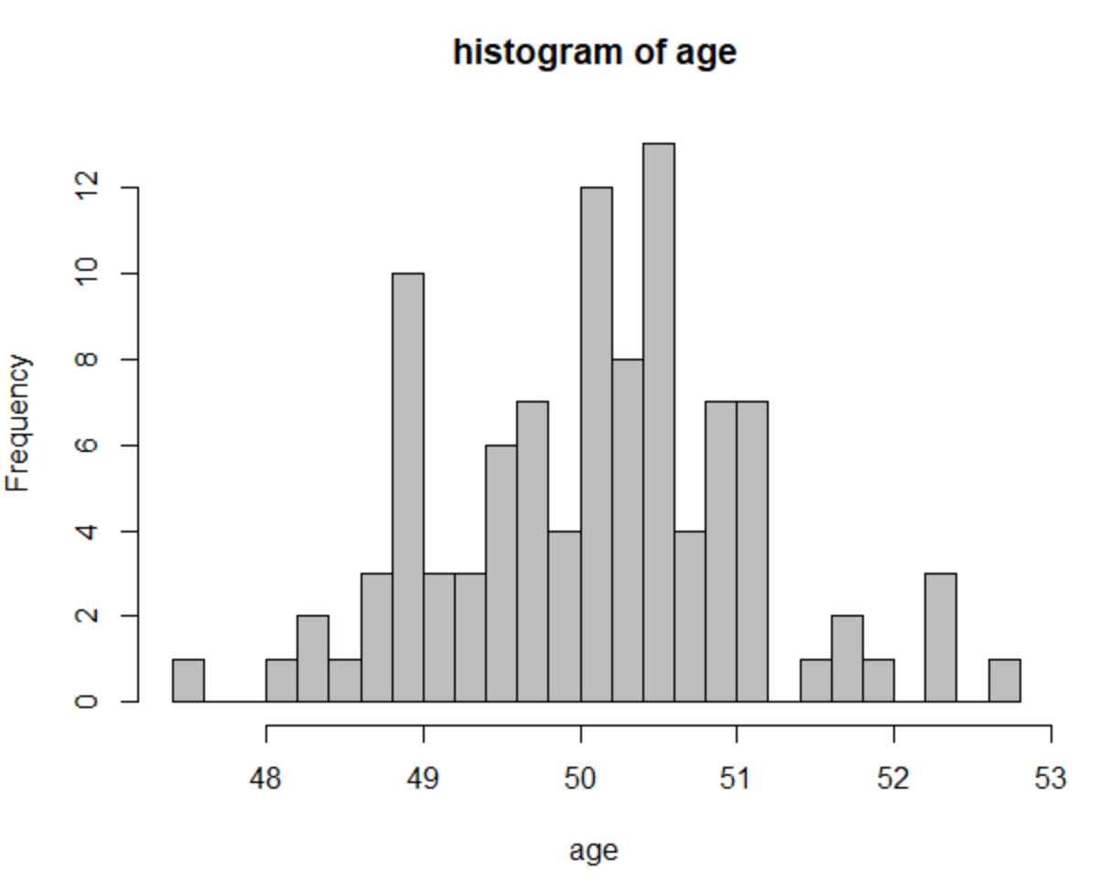
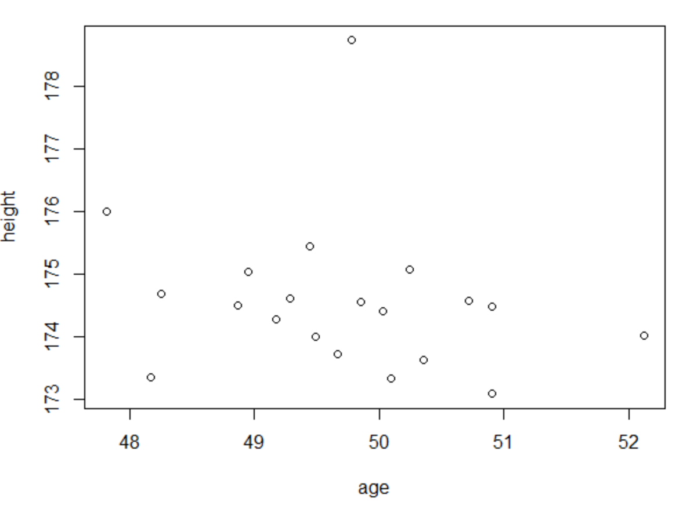
Perspectives on study design
Univariate, bivariate, multivariate?
Can refer to specific statistical methods or study designs
Examples:
Univariate: One measurement is taken, and qualities of that measurement are observed
-mean, variance, one-sample t-test
Bivariate: Two measurements are taken, and their relationship is examined
-Correlation, two-sample t-test, chi-squared test of contingency table
Multivariate: EVERYTHING ELSE

Slide 18
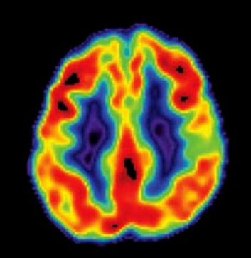
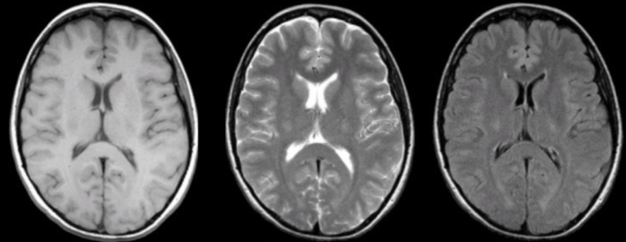
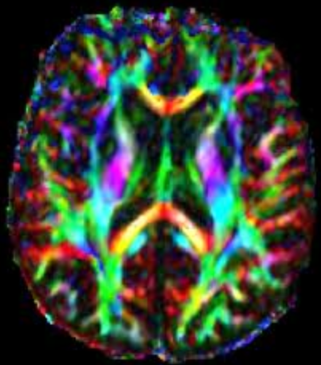
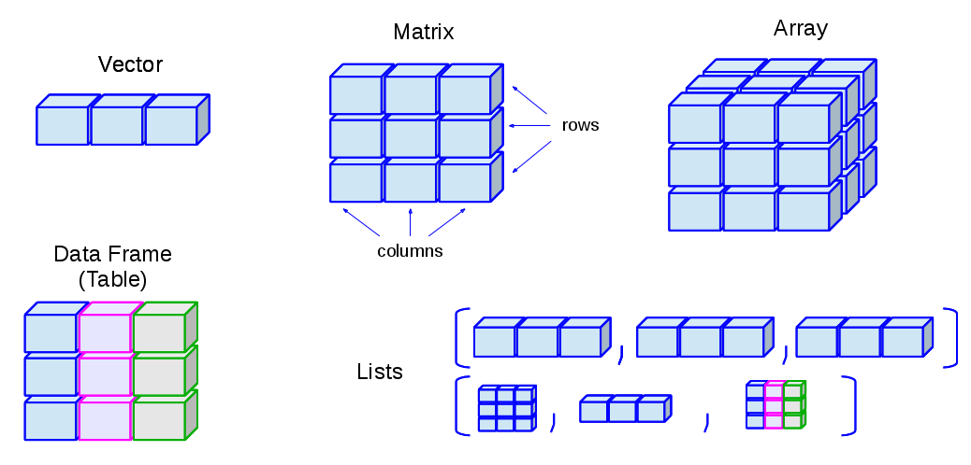
Perspectives on study design
Data types
Can refer to data source (e.g. RDoC paradigms) or structure
Examples:
Multi-modal neuroimaging:
Data structure
practical elements
(form)
design elements
(bias, missingness, provenance)
(http://venus.ifca.unican.es/Rintro)

Slide 19
Perspectives on study design
Key aspects of designing an integrative study:
Identifying key outcome(s) of interest
Sometimes the goal is to use a multitude of measures to discover new (or latent, unobserved) features of the data. However, even this requires a basis for interpreting results (i.e. reference variables).
Understanding the structure of your data
Identifying opportunities for analysis and modes of internal & external validation

Slide 20
Variable vs. person-centered approaches
Variable-centered
Person-centered
“The variable-centered approach is the traditional and dominant approach in the social sciences, and its purpose is to explain relationships between variables of interest in a population”
“categorizing subjects into common subpopulations based on substantive variables and understanding the relations of these subpopulations with predictors, correlates, or outcomes”
(Howard et al., 2018, Org Res Methods)

Slide 21
Variable vs. person-centered approaches
Variable-centered
Person-centered
“The variable-centered approach is the traditional and dominant approach in the social sciences, and its purpose is to explain relationships between variables of interest in a population”
“categorizing subjects into common subpopulations based on substantive variables and understanding the relations of these subpopulations with predictors, correlates, or outcomes”
Person-specific
“an individual’s prior behaviors, genetic makeup, and contextual risk or protective factors operate as an integrated whole; taken in isolation, they may lose their meaning and consequence for that individual’s behavioral course”
- Sterba and Bauer, 2010
(Howard et al., 2018, Org Res Methods)

Slide 22
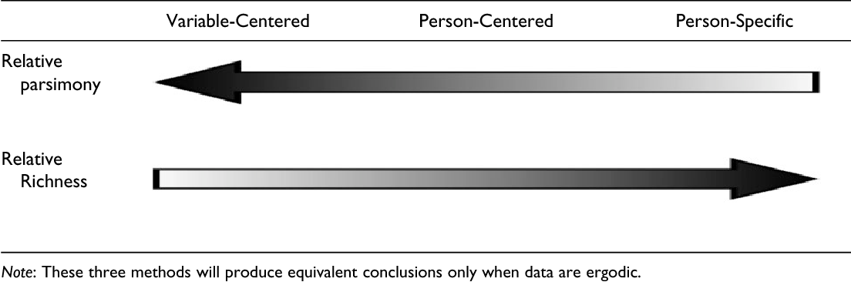
Variable vs. person-centric approaches
i.e. When each set of observations (e.g. for a person) is equally representative of the whole process. Or when the statistical properties of a distribution can be known from observing one person many times, or many people once
(Howard et al., 2018, Org Res Methods)

Slide 23
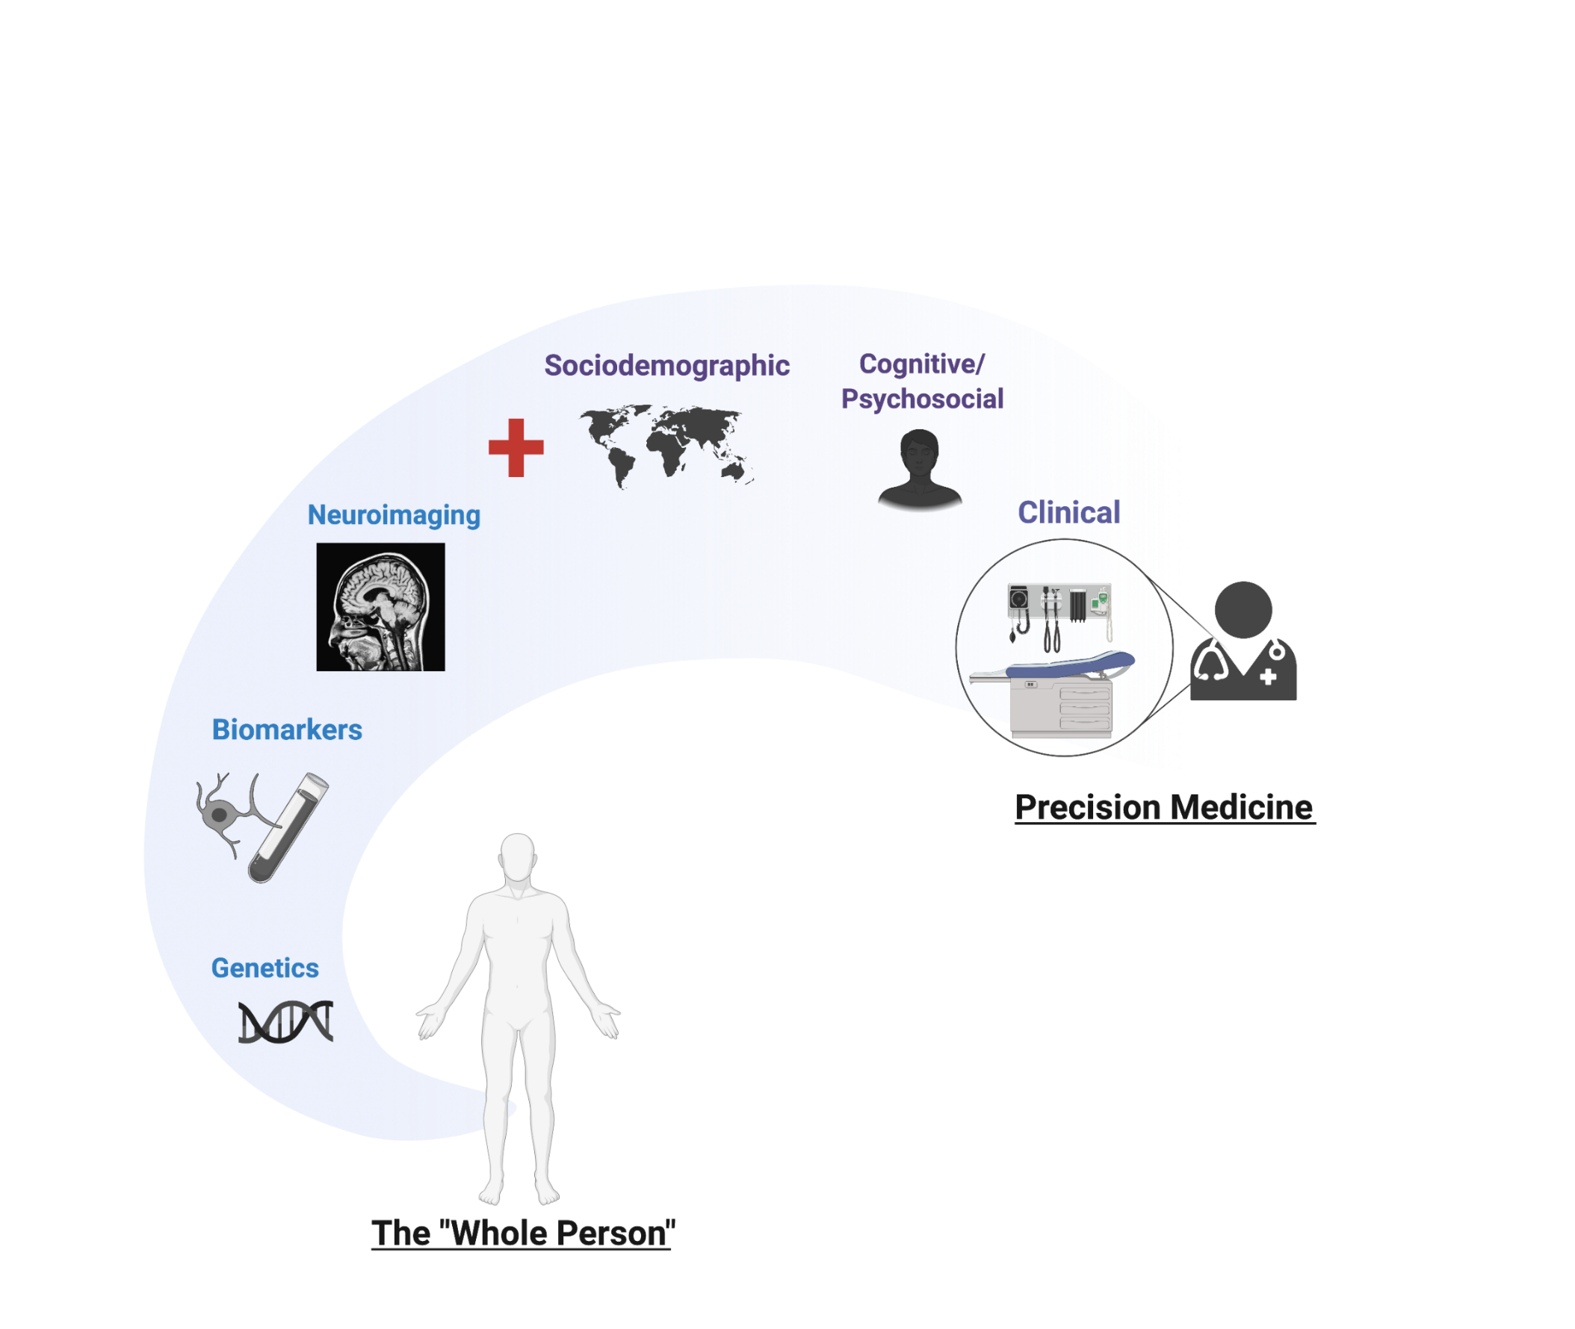
Bridging Data Domains
(Alyssa Cannitelli)

Slide 24
Some examples:
Imaging-Genetics
Gene-Environment Interaction
Mixed and Latent Group Trajectory Models
Common Machine Learning Models
High-Dimensional ‘Omics Integration and Patient Subtyping

Slide 25
Integrative methods
Imaging-genetics

Slide 26
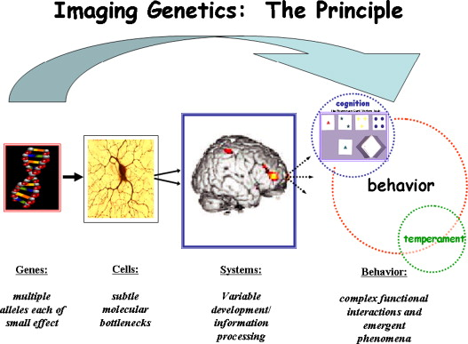
Early days: imaging-genetics
(Mattay et al., 2008)

Slide 27
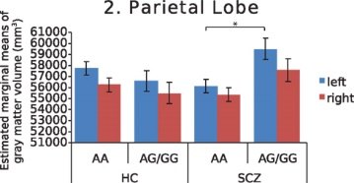
Early days: imaging-genetics
One SNP:
MAG rs720308
One modality:
Lobar volumes (MRI T1)
Two populations:
Control & Schizophrenia dx
(Felsky et al., 2012, Front. Psych.)

Slide 28
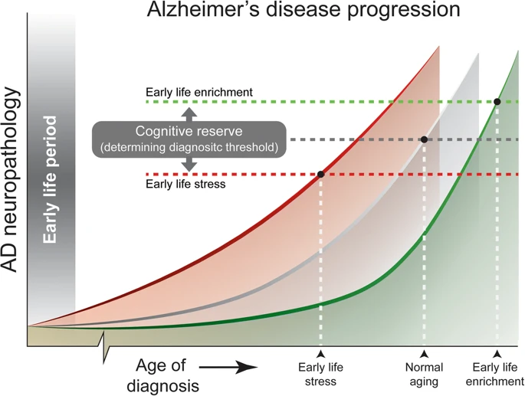
Resilience in aging
Example:
Early life stress
(Lesuis et al., 2018, Alz. Res & Therapy)

Slide 29
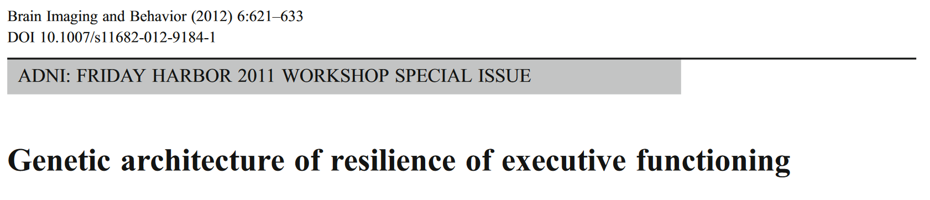
Regression-based approach: step 1
$${Cognition = β}_{age} + β_{sex} +β_{education} +β_{Hachinski} +β_{hippocampal volume} +β_{cortical volume} +β_{WMH} + ε$$
(Mukherjee et al., 2013, Brain Imaging and Behaviour)

Slide 30
Regression-based approach: step 1
$${Cognition = β}_{age} + β_{sex} +β_{education} +β_{Hachinski} +β_{hippocampal volume} +β_{cortical volume} +β_{WMH} + ε$$
demographics
general health
MRI (T1 + FLAIR)
vector of X_{m} (independent variables) = Brain health?
(Mukherjee et al., 2013, Brain Imaging and Behaviour)

Slide 31
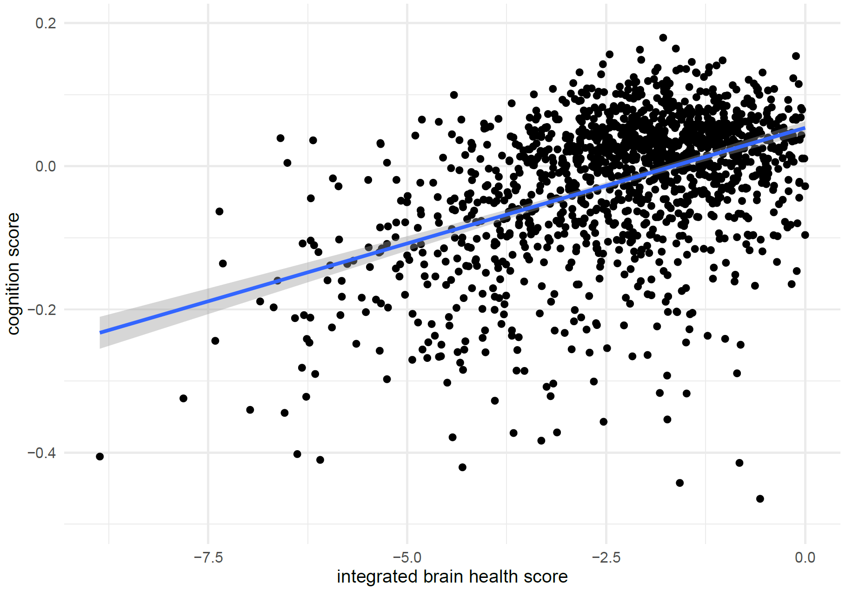
Regression-based approach: step 1

Slide 32
Regression-based approach: step 1
better cognition than expected (resid<0)
as expected (resid~0)
poorer cognition than expected (resid>0)

Slide 33
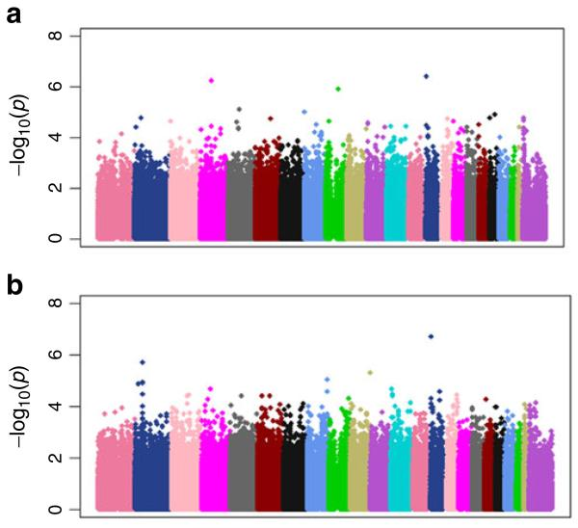
Regression-based approach: step 2
Genome-wide association study on “resilience” (residual cognition)
$${Resilience = β}_{SNP} + covs+ ε$$
(Mukherjee et al., 2013, Brain Imaging and Behavior)

Slide 34
Integrative methods
Gene-environment interaction

Slide 35
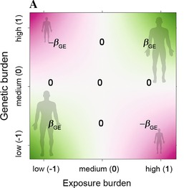
Gene-environment interaction
Centered
(Aschard, 2016, Genet Epidemiol)

Slide 36
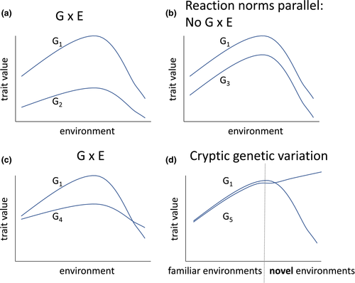
Gene-environment interaction
Centered
(Aschard, 2016, Genet Epidemiol)
(Saltz et al., 2018, Ecol. and Evolution)

Slide 37
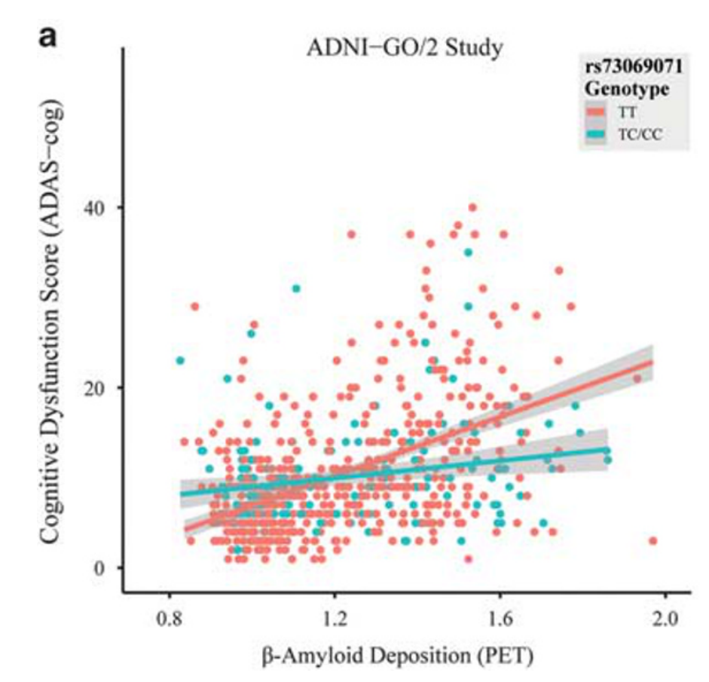
Gene-environment interaction
The basic concept: is the relationship between an exposure and a trait modified by genotype?
(Roostaei et al., 2017, Mol Psych)

Slide 38
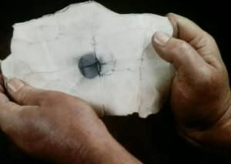
Dimensionality
How do we move toward methods capable of handling high-dimensional data in an integrative framework?
What is high-dimensional data?
LOTS OF MEASUREMENTS → LOTS OF VARIABLES
LOTS OF VARIABLES →

Slide 39
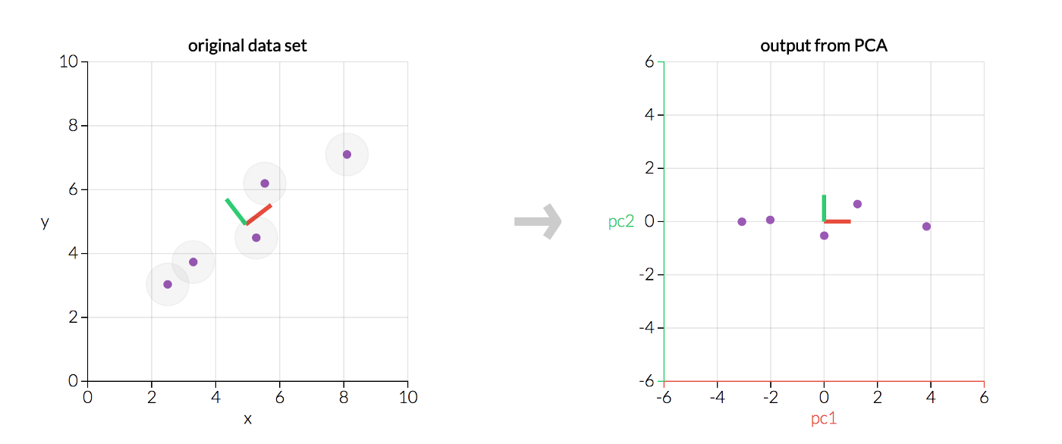
Principal component analysis
(Matt Brems, 2017)

Slide 40
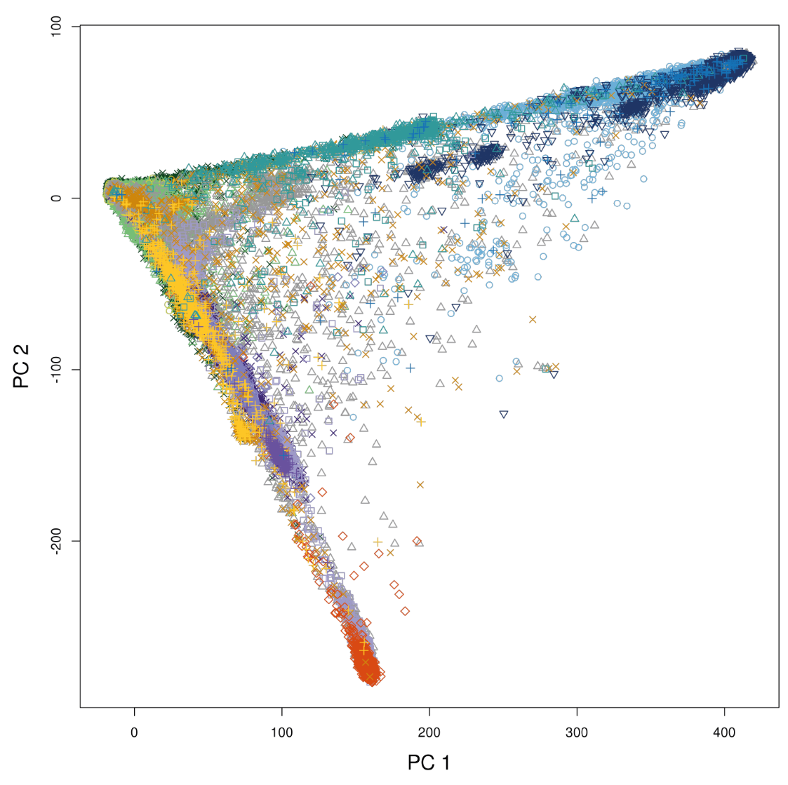
Principal component analysis
UK Biobank
n= 407,219
k= 147,604
(Bycroft et al., 2017, BioRxiv)

Slide 41
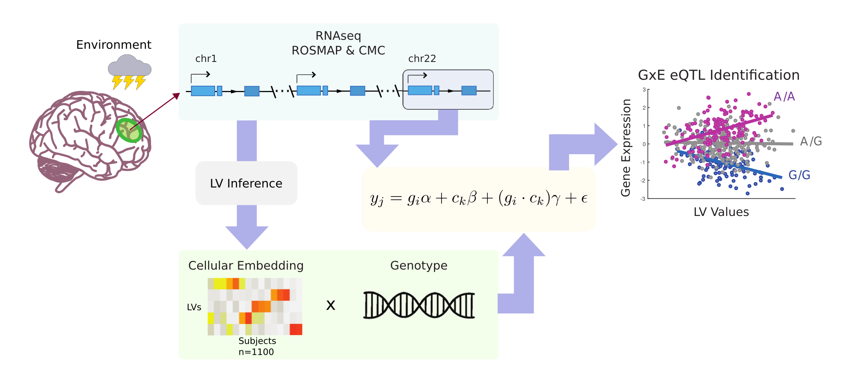
Latent features for GxE
(Ng et al., 2019, AJHG)

Slide 42
Latent features for GxE
(Ng et al., 2019, AJHG)

Slide 43
Latent features for GxE
(Ng et al., 2019, AJHG)

Slide 44
Latent features for GxE
(Ng et al., 2019, AJHG)

Slide 45
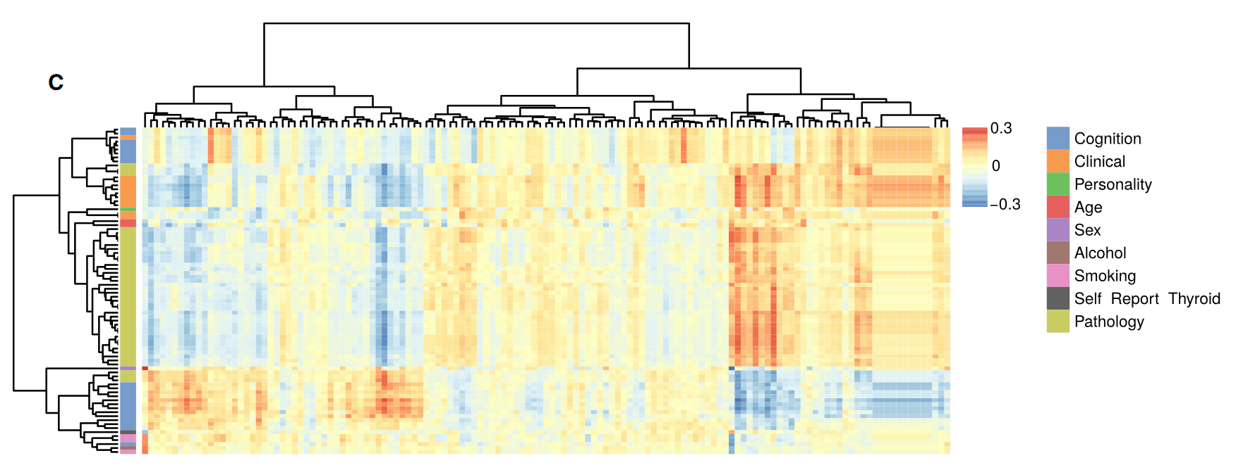
Latent features for GxE
phenotype data
Latent features (environment)
(Ng et al., 2019, AJHG)

Slide 46
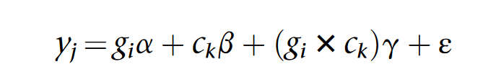
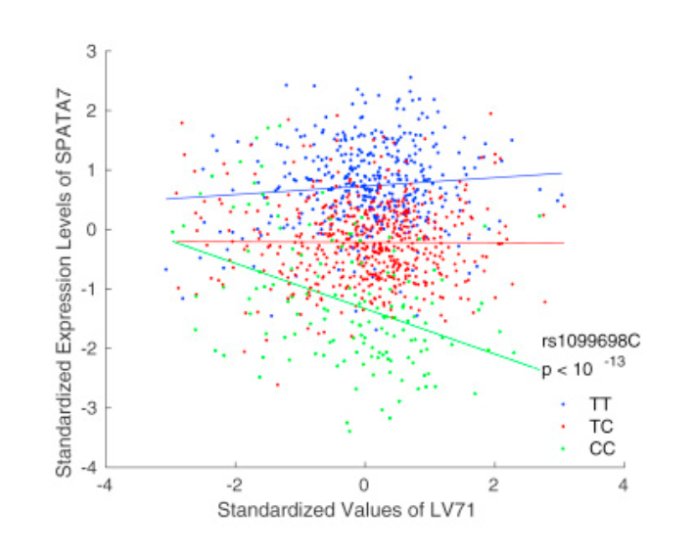
Latent features for GxE
effect of LV71 is dependent on genotype

Slide 47
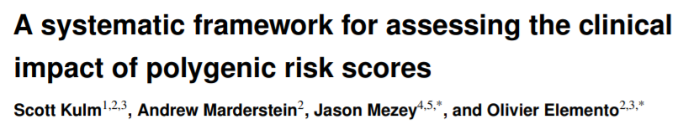

2021

Slide 48
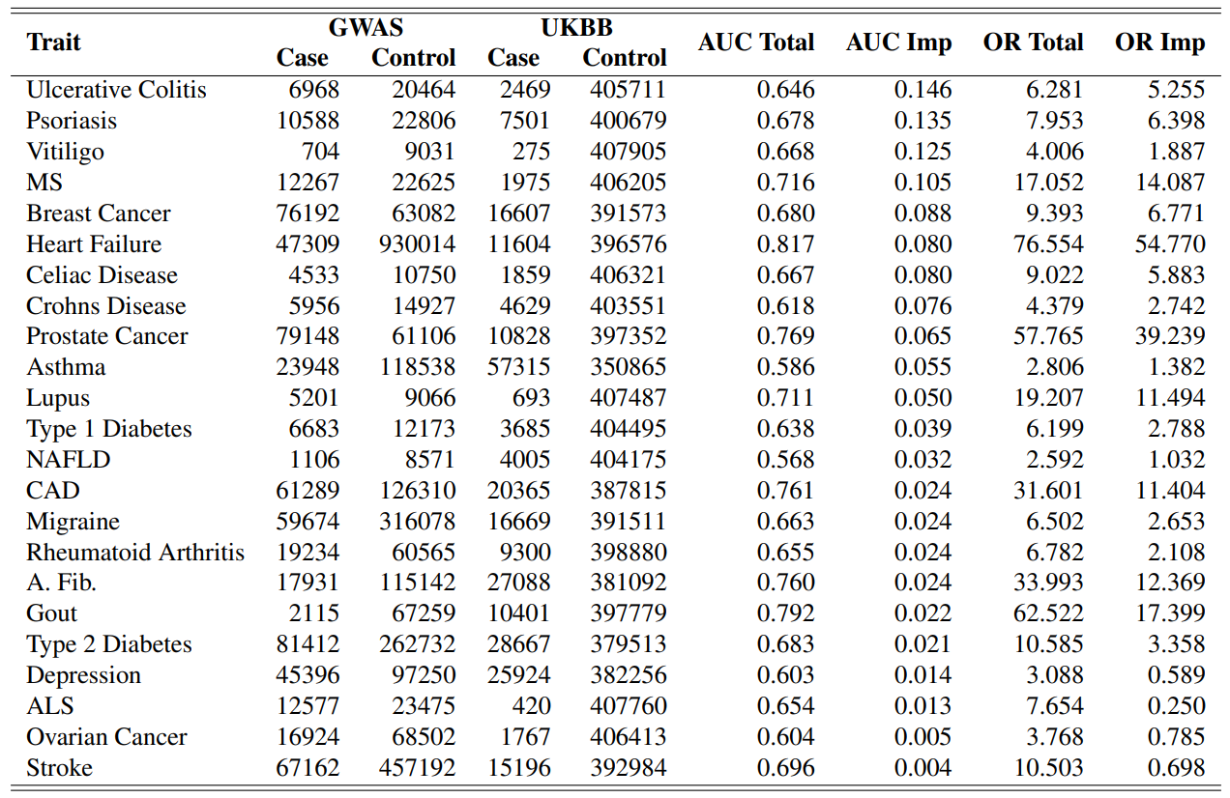
2021

Slide 49
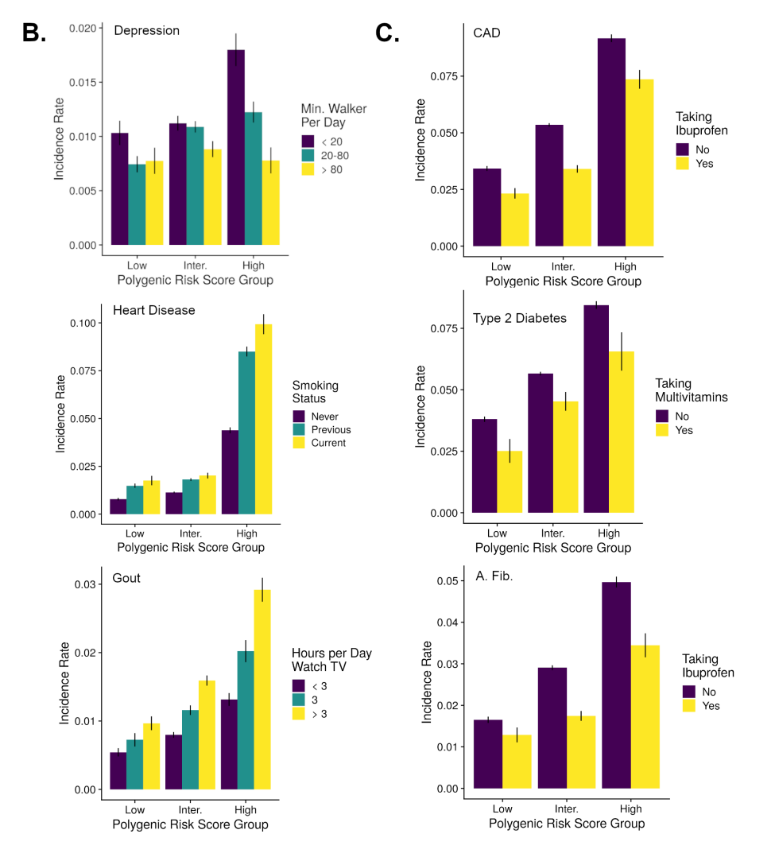

Slide 50

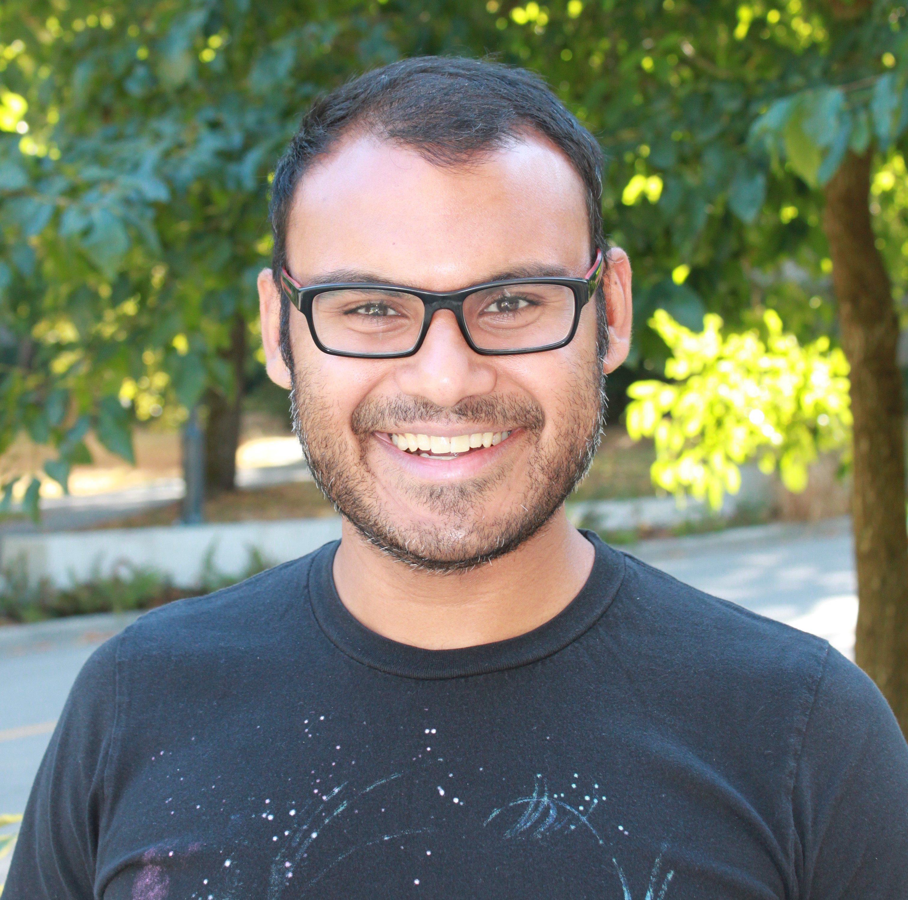
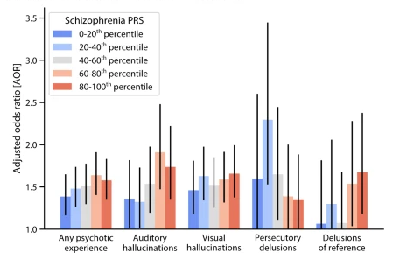
(Wainberg et al., 2021, Transl. Psych)

Slide 51
Integrative methods
Longitudinal Analysis

Slide 52
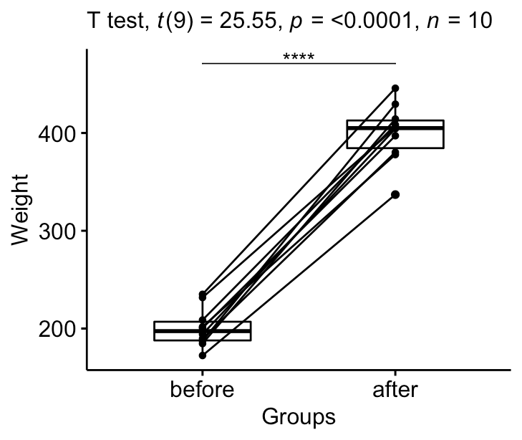
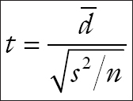
Paired t-test
Longitudinal data require additional complexity to analyze.
In the simplest case, we have two time-points of observation of our outcome of interest and can use a paired t-test or compute change.
(Alboukadel Kassambara, Datanovia)

Slide 53
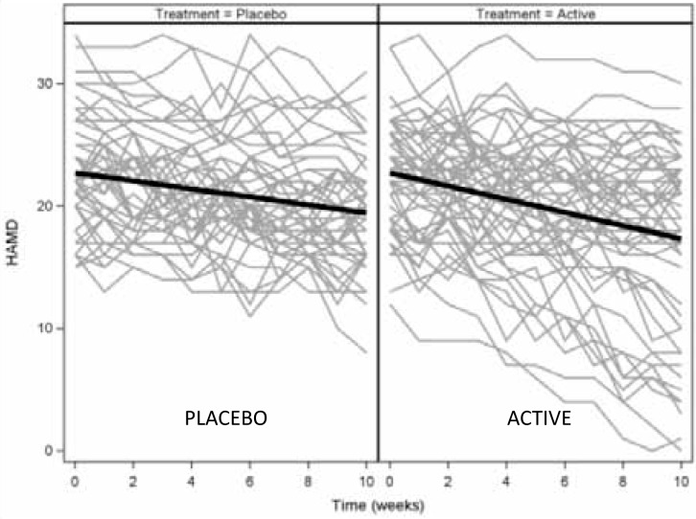
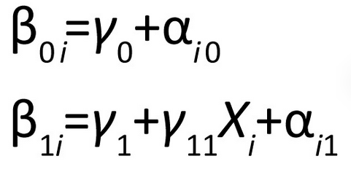
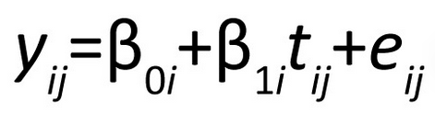
Linear mixed models
With >2 time points, linear mixed models are popular choices:
subject-level
sample-level
i = subject, j = time
α allows each subject’s slope₁ and intercept₀ to vary across the sample averages (γ)
(Leiby, 2012, SHARP)

Slide 54
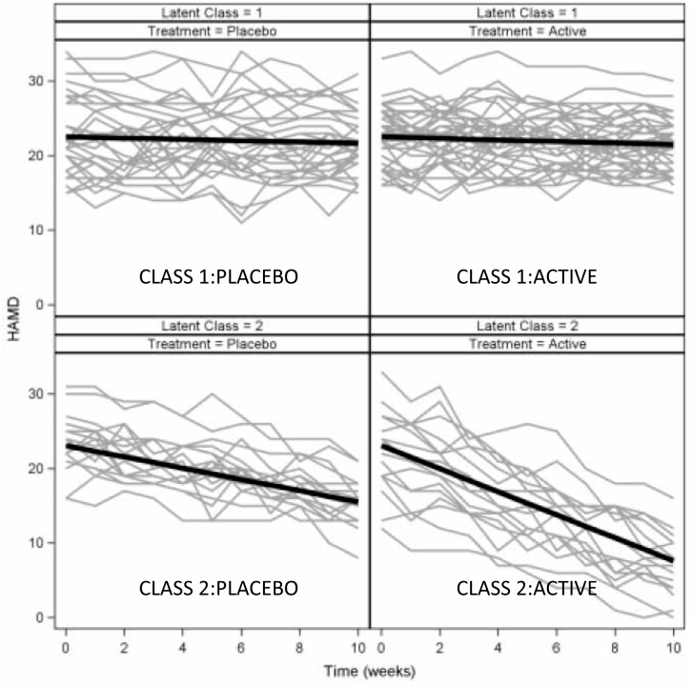
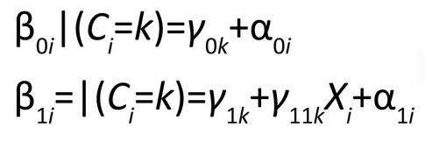
Growth mixture modeling
Now there is not a single sample average γ
There are multiple γ_{k}

Slide 55
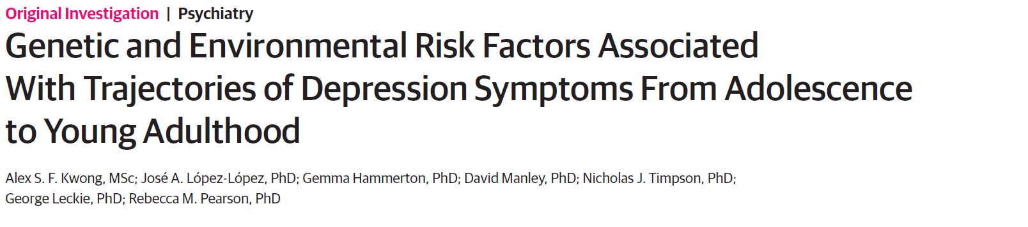
Growth mixture modeling
Short Mood and Feelings Questionnaire at 9 occasions from ages 10 to 24 years.
Risk factors included sex, a polygenic risk score taken from a recent genome-wide association study of depression symptoms, maternal postnatal depression, partner cruelty to the offspring’s mother when the child was aged 2 to 4 years, childhood anxiety at age 8 years, and being bullied at age 10 years.
n=3 525

Slide 56
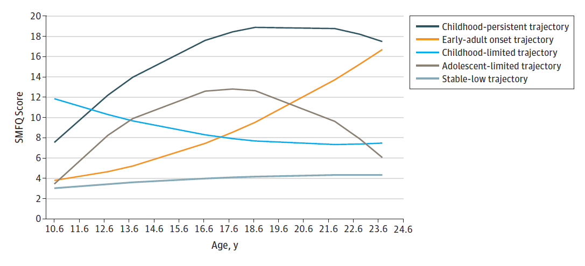
Growth mixture modeling
SMFQ = short mood and feelings questionnaire
(Kwong et al., 2019, JAMA Psych.)

Slide 57

Growth mixture modeling
(Kwong et al., 2019, JAMA Psych.)

Slide 58
Growth mixture modeling
(Kwong et al., 2019, JAMA Psych.)

Slide 59

Integrative methods
Machine Learning
(Omolog, 2021)

Slide 60


(Webb et al., J Consult and Clin Psy, 2020)

Slide 61


R²=0.39
(Webb et al., J Consult and Clin Psy, 2020)

Slide 62
Tree-based modelling
Decision Tree Models:
Splits data into subsets based on decision rules at each node
Flexible and easy to understand, but a “weak learner” on its own
Four Legs
Yes
No
Wags tail when happy
Not a dog
Yes
No
Dog
Not a dog

Slide 63
XGboost + SHAP
Boosting:
Iteratively fits new models on the residuals of the previous model, to compensate for prediction error
Implemented through eXtreme Gradient Boosting (XGBoost)
Interpretation: SHAP values
Measures the relative contribution of a feature to an individual predicted value, compared to the average prediction for the dataset
Boosting
Error
+
Prediction Error
+
+
Number of Iterations
Iterations
(Johansson, n.d.)

Slide 64


SHapley Additive exPlanations
Local interpretability → can identify how different variables influence the predictions for a single observation (i.e. person)
Global interpretability → in aggregate
Based on marginal contributions of each feature in the full model

Slide 65

SHapley Additive exPlanations
(S Mazzanti, 2020)

Slide 66




SHapley Additive exPlanations
(S Mazzanti, 2020)

Slide 67






XGBoost and SHAP for Mental Health Policy

Slide 68


XGBoost and SHAP for Mental Health Policy

Slide 69

XGBoost and SHAP for Mental Health Policy

Slide 70

XGBoost and SHAP for Mental Health Policy

Slide 71
Integrative methods
High-Dimensional Integration

Slide 72

(Zitnik et al., 2019, Inf Fusion)

Slide 73
Similarity Network Fusion
Subject-centered approach
Relies on subject similarity, rather than variable similarity
Affinity (similarity) matrices are calculated separately for many data types
A matrix can also be represented as a network
Fusion is an iterative process reinforcing strong connections and pruning weak connections across multiple networks

Slide 74

Similarity Network Fusion
Basic approach
Variables (n=7)
Subjects (n=30)

Slide 75
Similarity Network Fusion
Basic approach
Variables (n=7)
Subjects (n=30)

Slide 76


Similarity Network Fusion
Basic approach
Variables (n=7)
Distance metric
Distance
Affinity/
Similarity
Subjects (n=30)
Subjects (n=30)
Subjects (n=30)

Slide 77
Similarity Network Fusion
Basic approach
Variables (n=7)
Distance metric
(correlation)
(Euclidean?)
(Manhattan)
Distance
Affinity/
Similarity
Subjects (n=30)
Subjects (n=30)
Subjects (n=30)

Slide 78

Similarity Network Fusion
(Wang et al., 2014, Nat. Meth.)

Slide 79

(Wang et al., 2014, Nat. Meth.)

Slide 80

Similarity Network Fusion
Breast cancer subtyping
(Wang et al., 2014, Nat. Meth.)

Slide 81

Similarity Network Fusion
(Stefanik et al., 2017, Neuropsychopharmacology)

Slide 82


Slide 83





WORKSHOP

Slide 84

WORKSHOP

