Slide 1


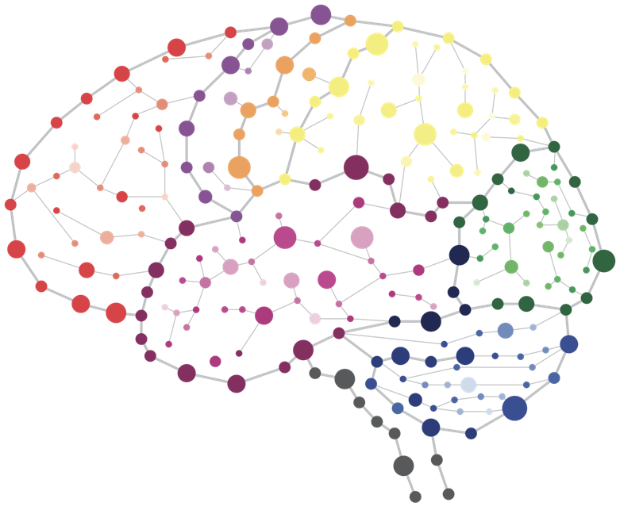
SUMMER SCHOOL 2022
Considering population stratification and admixture in modern GWAS; concepts and tools

Slide 2
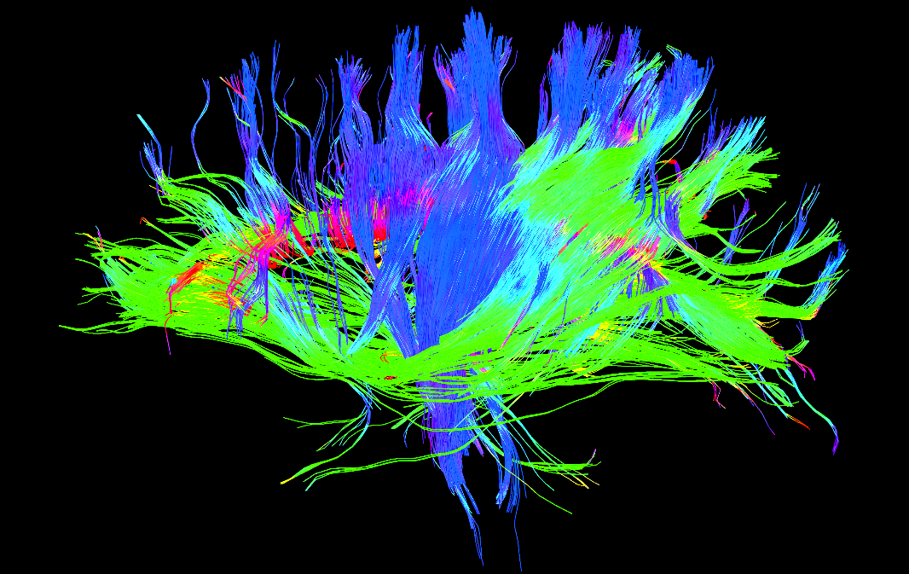


CAMH Land Acknowledgement
CAMH is situated on lands that have been occupied by First Nations for millennia; lands rich in civilizations with knowledge of medicine, architecture, technology, and extensive trade routes throughout the Americas. In 1860, the site of CAMH appeared in the Colonial Records Office of British Crown as the council grounds of the Mississaugas of the New Credit, as they were known at the time.
Today, Toronto is covered by the Toronto Purchase, treaty No. 13 of 1805 with the Mississaugas of the Credit.
Toronto is now home to a vast diversity of First Nations, Inuit, and Métis who enrich this city.
CAMH is committed to reconciliation. We will honour the land through programs and places that reflect and respect its heritage. We will embrace the healing traditions of the Ancestors, and weave them into our caring practices. We will create new relationships and partnerships with First Nations, Inuit, and Métis and share the land and protect it for future generations.

Slide 3
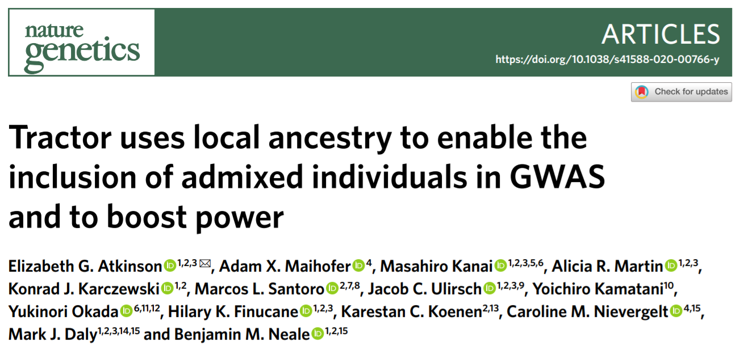


Slide 4

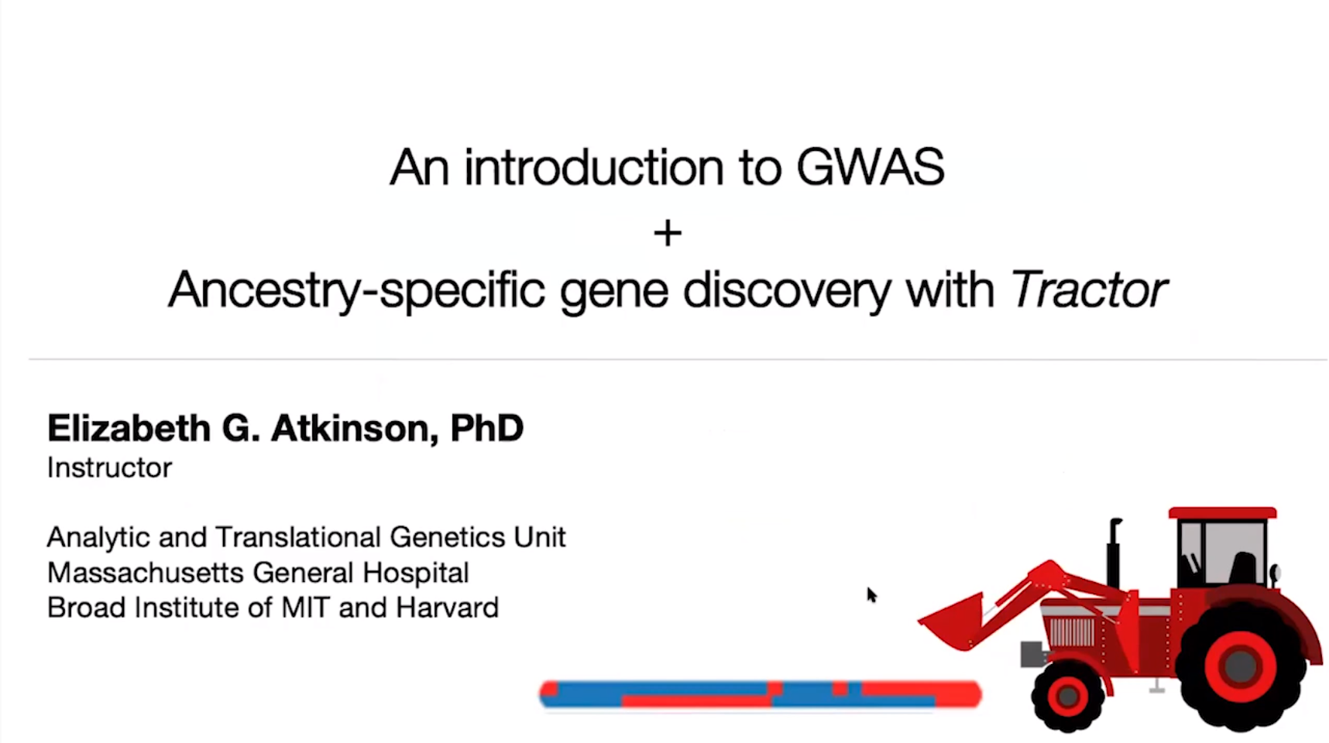



“Stanley Center Primer: An Introduction to GWAS + ancestry-specific gene discovery with Tractor” Oct 6, 2020
“John Novembre - Methods for the analysis of population structure and admixture”
Feb 15, 2014

Slide 5
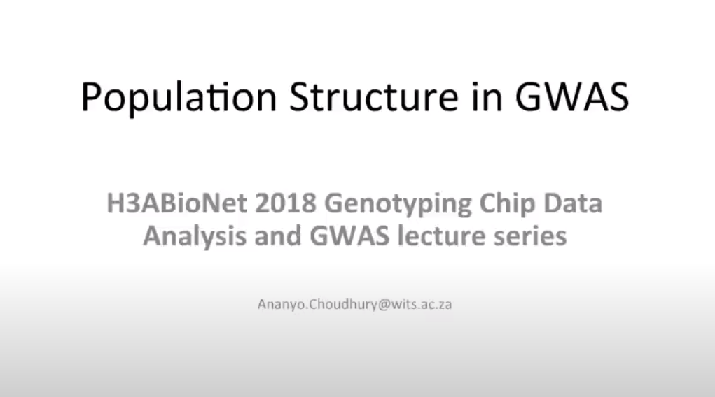


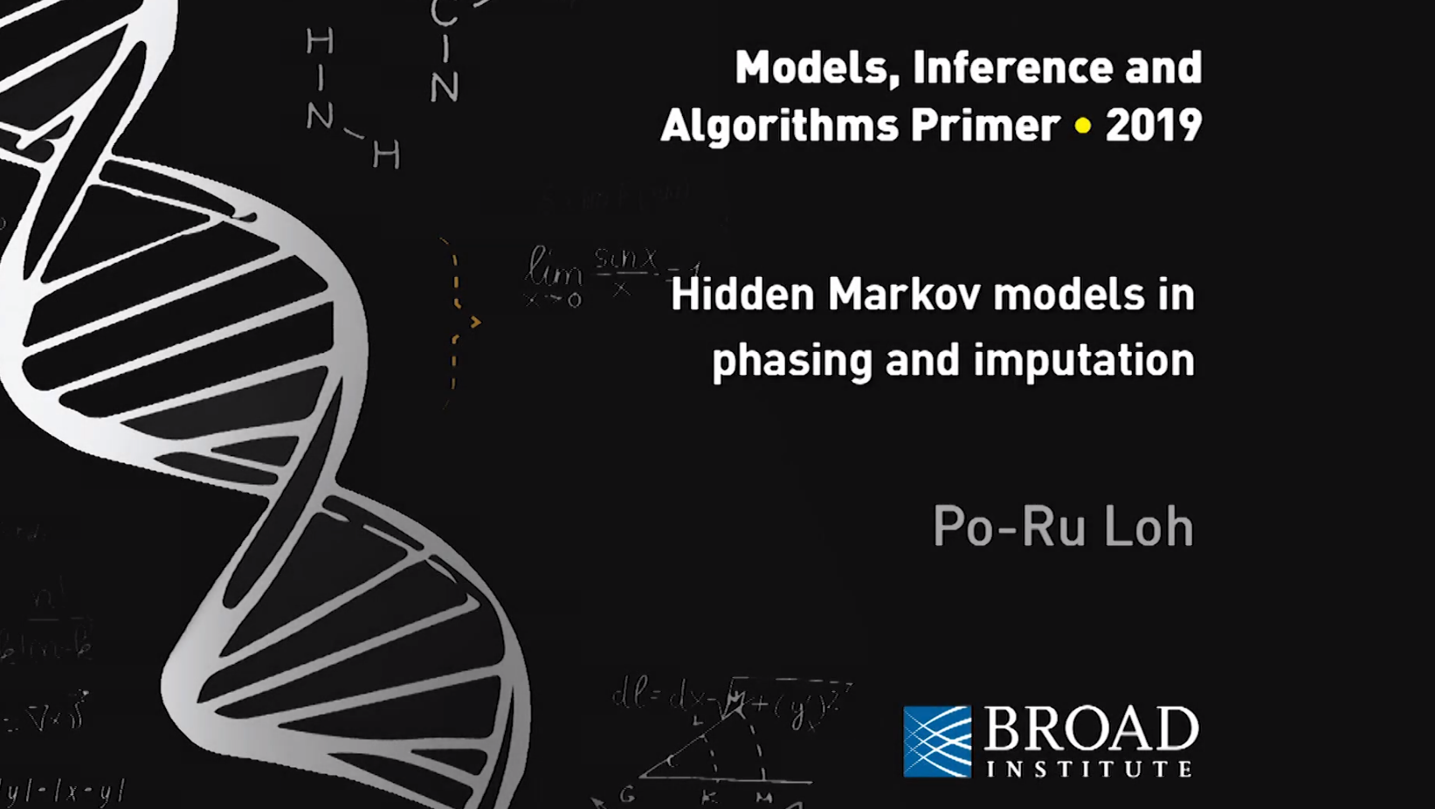
“Population structure in GWAS (Lecture 5)”
Sept 12, 2018
“Phasing and imputing repeat variants across the genome; Po-Ru Loh”
May 3, 2019

Slide 6
Questions answered by this talk
What is population structure and admixture?
What are local and global ancestry, and how are they estimated?
Why do we care about population structure in GWAS (population stratification)?
What are some methods for dealing with population stratification in GWAS?
What is Tractor and what does it accomplish?

Slide 7
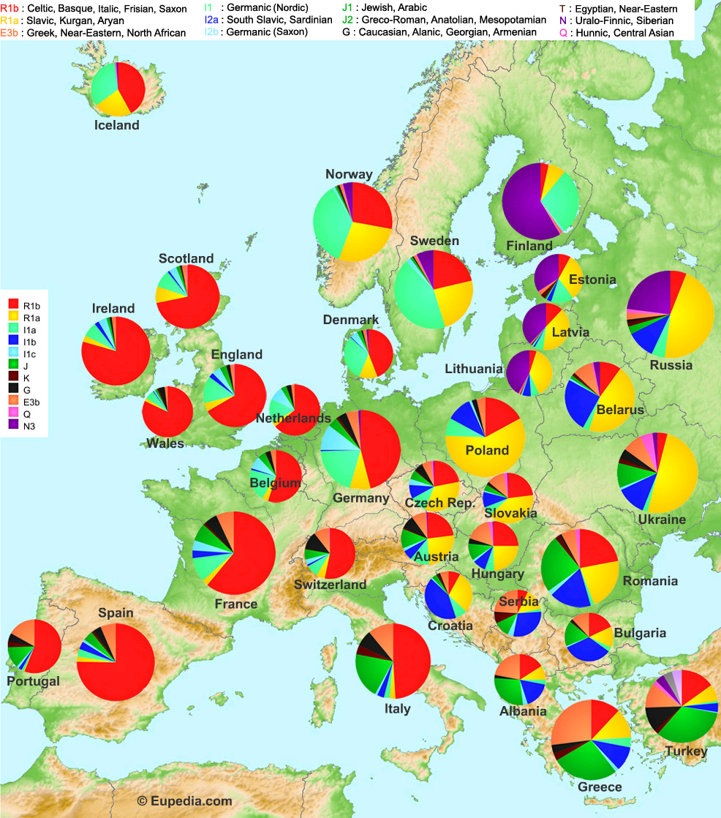
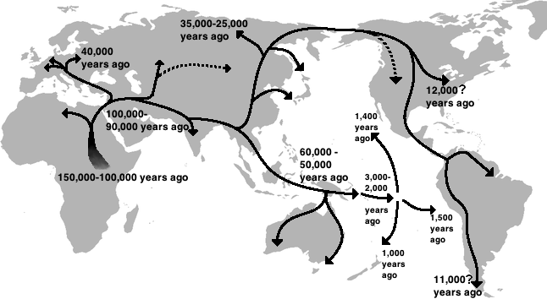
(Naruya, 2011)

Slide 8
Definition of population structure
Intuitively, we all have different genetic backgrounds in non-random distributions.
Patterns in genetic variation that result from the past or present departure from panmixia of a population
systematic differences in allele frequencies and linkage
Influenced by mutation, genetic drift, recombination, selection, gene flow

Slide 9
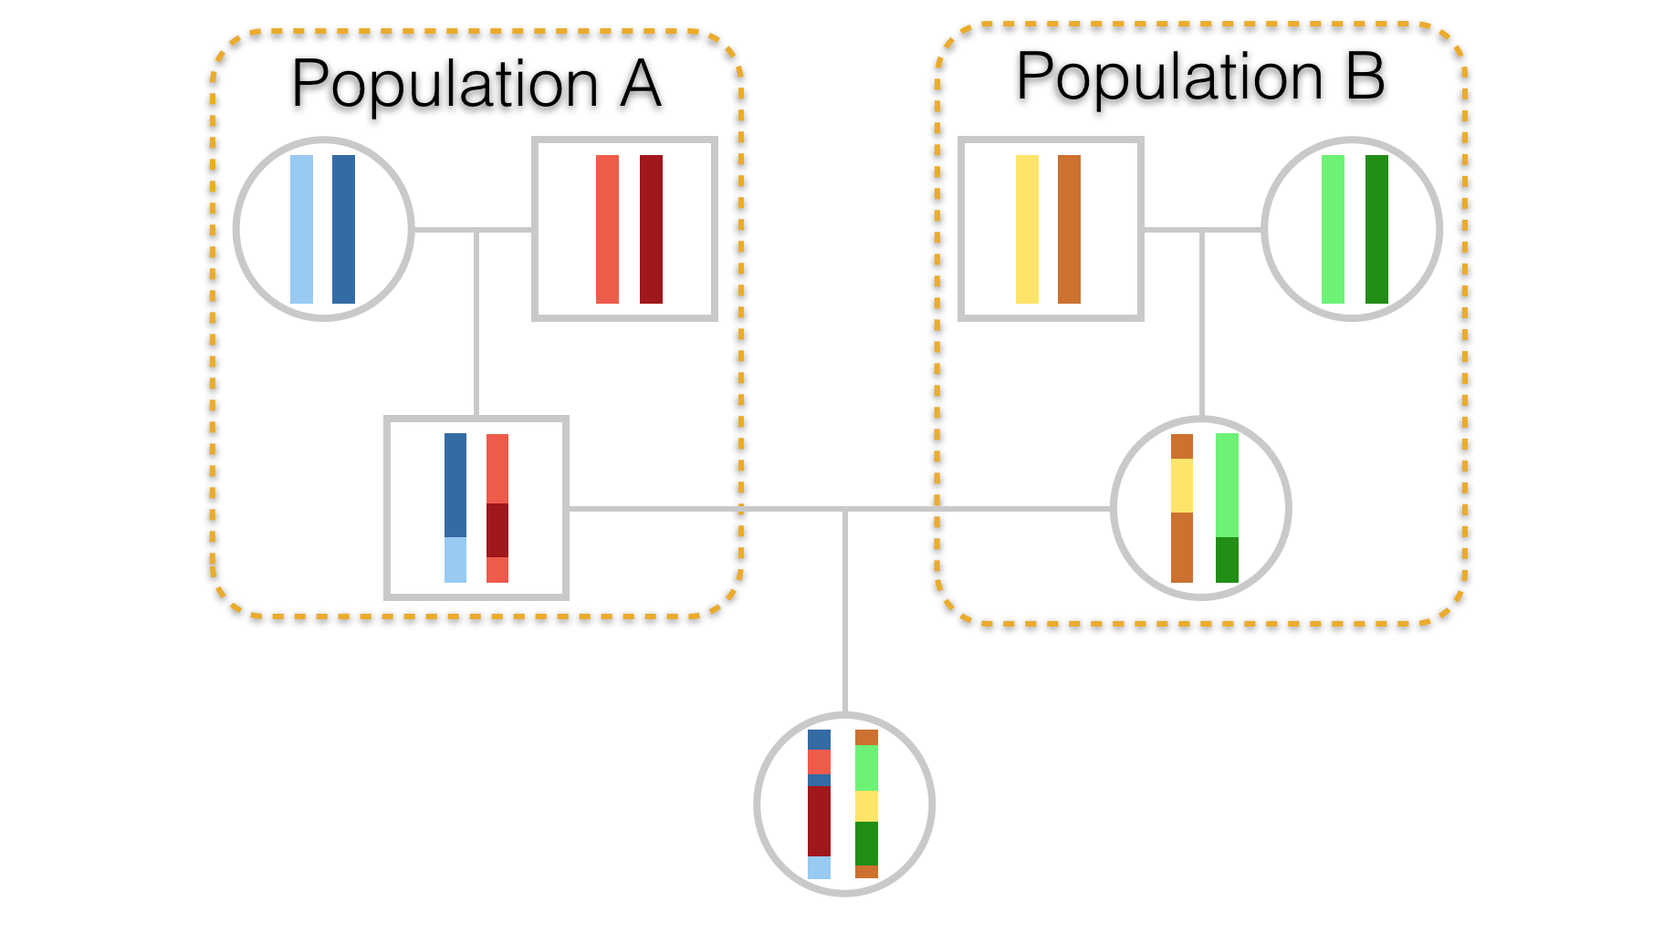
Admixture
Within-population diversity
Within-individual + within-population diversity
(Dyer, 2017)

Slide 10
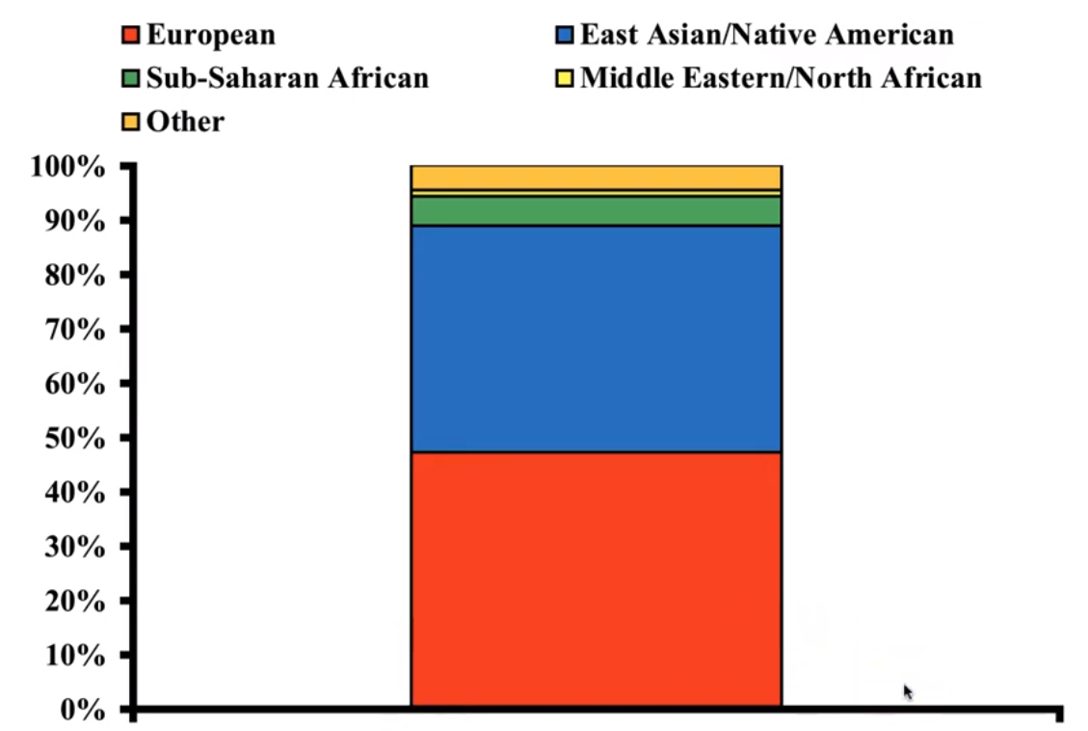
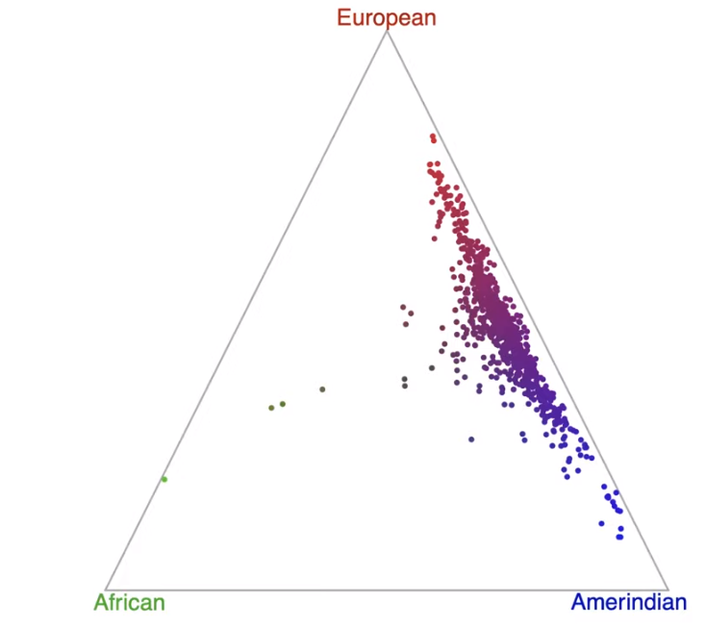
Global and local ancestry
Ancestry of:
Individuals (global)
(Shriner et al., 2011)

Slide 11
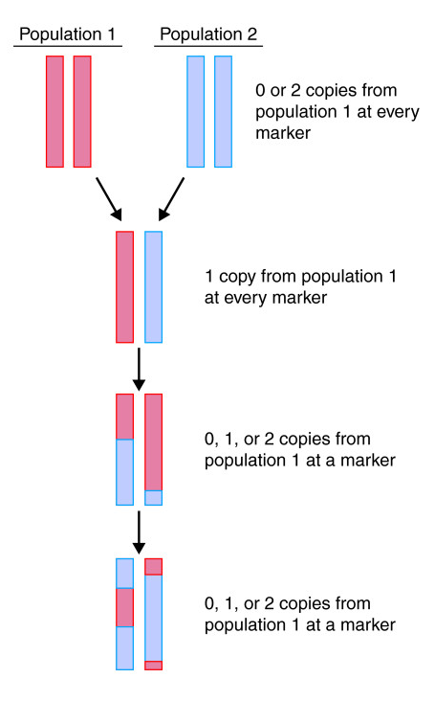
Global and local ancestry
Ancestry of:
Individuals (global)
Loci (local)
(Shriner et al., 2011)

Slide 12
Why do we care in the context of GWAS?
Unaccounted-for heterogeneity = risk of false positive associations
Power for discovery
Homogeneous populations = variation left on the table (fine mapping)
Ancestry-specific effects

Slide 13
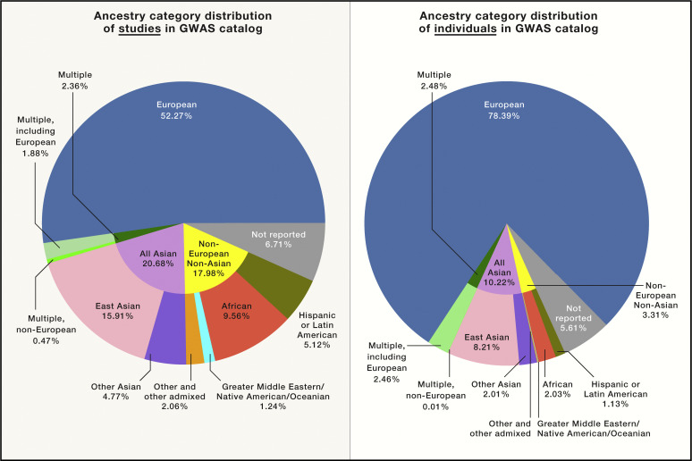
Historical perspective
(Sirugo, Williams, Tishkoff, 2019, Cell)

Slide 14
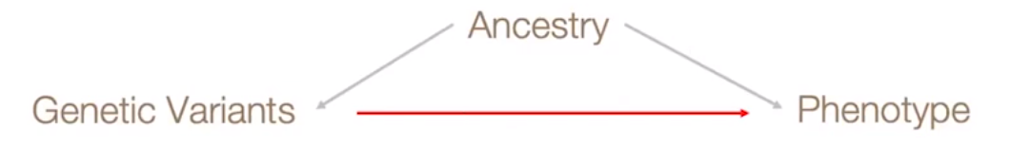
Risk of false positives
Population stratification in GWAS

Slide 15
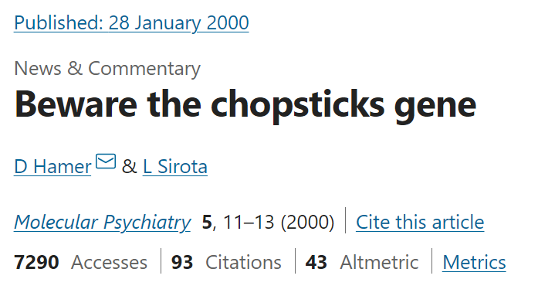
Risk of false positives
Population stratification in GWAS

Slide 16
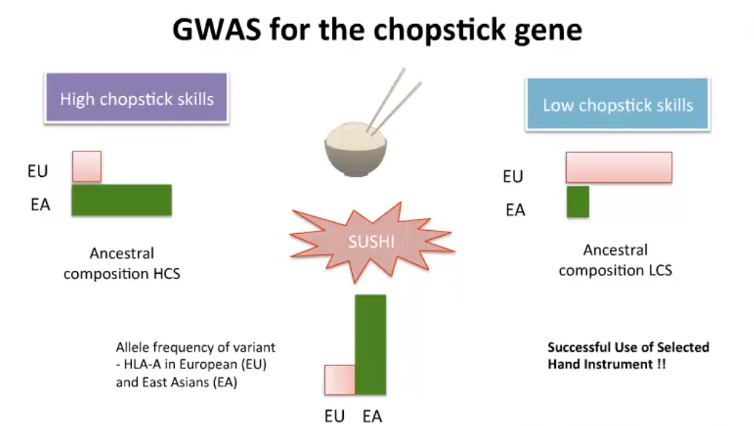
Risk of false positives - population stratification
(adapted from Choudhury, 2018)

Slide 17
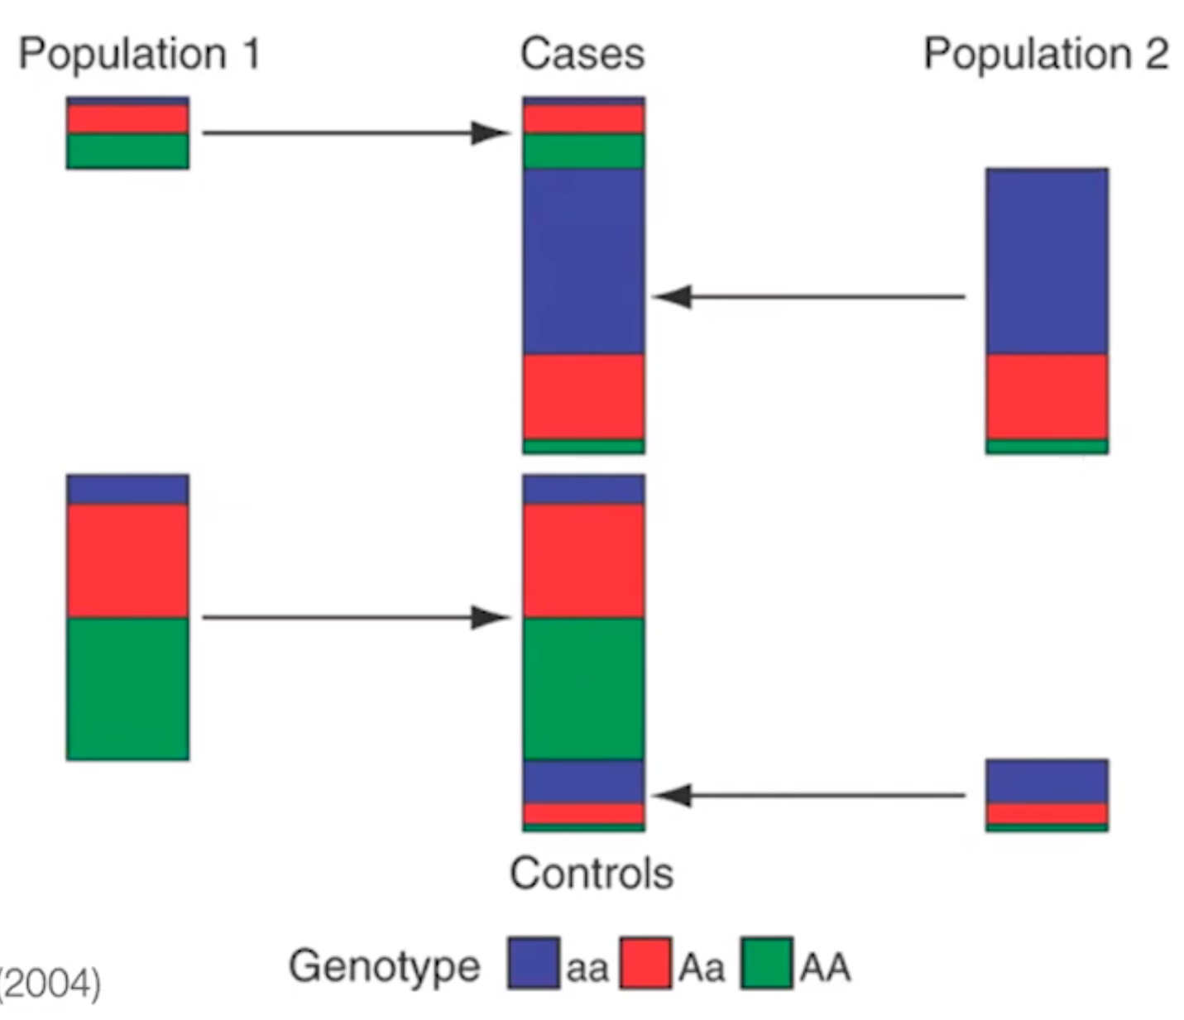
Risk of false positives – population stratification
(Marchini et al., 2004)

Slide 18
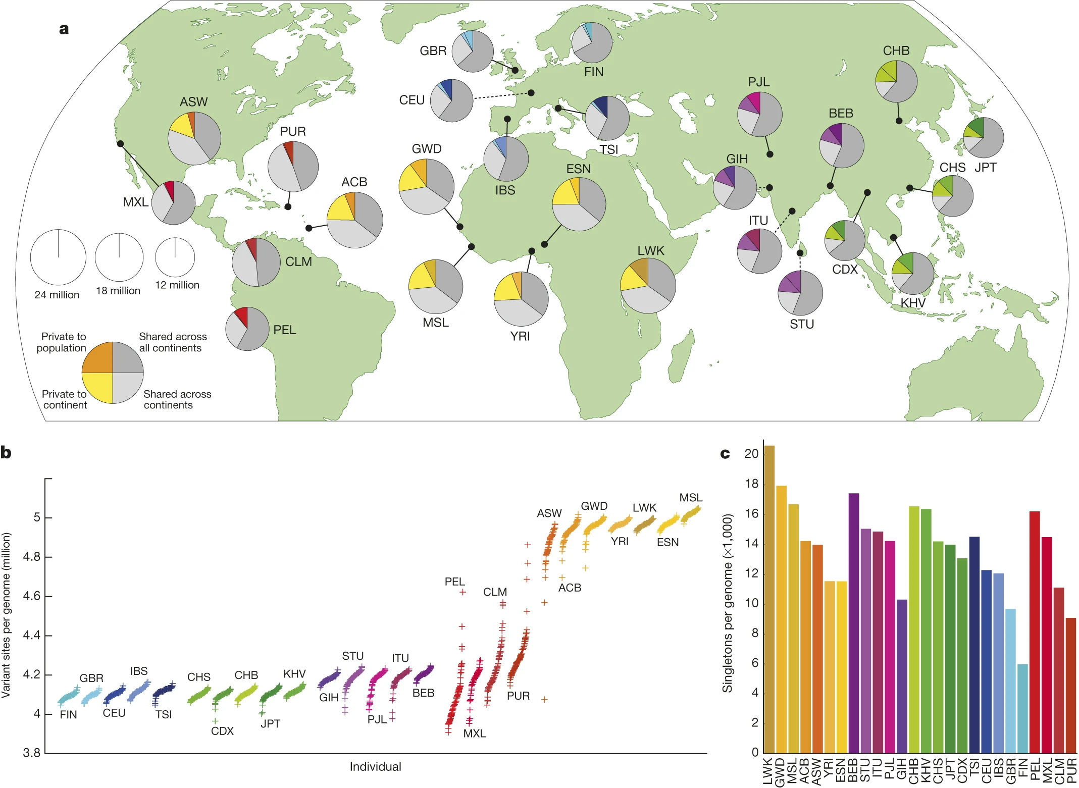
(1000GPC, 2015, Nature)

Slide 19
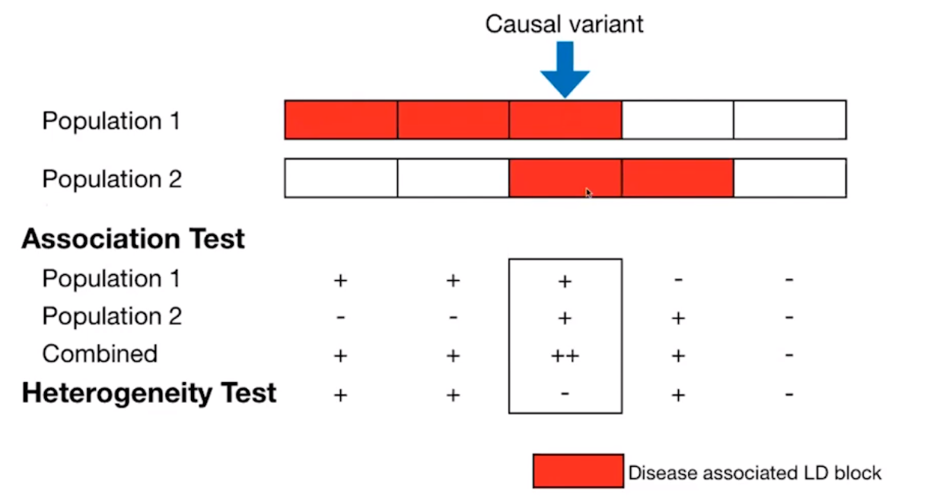
Increased power for discovery - fine mapping
(H. Huang; Atkinson, 2018)

Slide 20
Ancestry-specific effects
Example: Cystic fibrosis
Caused by ΔF508 in CTFR gene in EUR (>70% of cases)
Only 29% caused by ΔF508 in African diaspora
3120+1G→A (15%-65% in South Africans)
Treatments (Ivacaftor) selectively target mechanisms of specific mutations (receptor gating of CFTR).

Slide 21
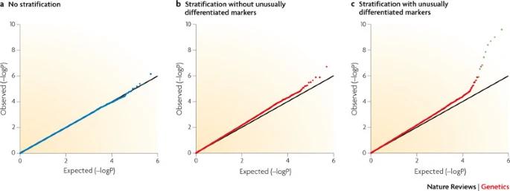
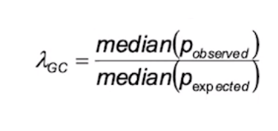
Common approaches to handling stratification
Genomic control (λ_{GC})
PCA-based correction
Arbitrary # of PCs used, global ancestry only
Linear Mixed Models
global ancestry only
Developed for inbred model organisms (Kang et al., 2008)
Can account for different levels of structure (cryptic relatedness, inbreeding)

Slide 22
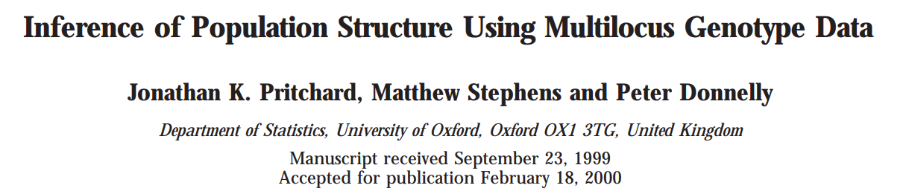
STRUCTURE (2000) – Global ancestry
“Prichard-Stephens-Donnelly model”
Bayesian model-based clustering using Markov Chain Monte Carlo estimation.
K = number of assumed underlying populations (unobserved source demes)

Slide 23
STRUCTURE (2000) – Global ancestry
“The model accounts for the presence of Hardy-Weinberg or linkage disequilibrium by introducing population structure and attempts to find population groupings that (as far as possible) are not in disequilibrium.”

Slide 24

STRUCTURE (2000) – Global ancestry
Quantities:
X; genotype data (n x SNPs) (observed)
P; allele frequencies for each source population (SNPs x K) (unknown)
Z; population of origin for each individual (1d vector of n length) (unknown)
optional (admixture)
Q; admixture proportions for each individual (n x K) (unknown)
Assumptions: Hardy Weinberg Equilibrium in all subpopulations

Slide 25
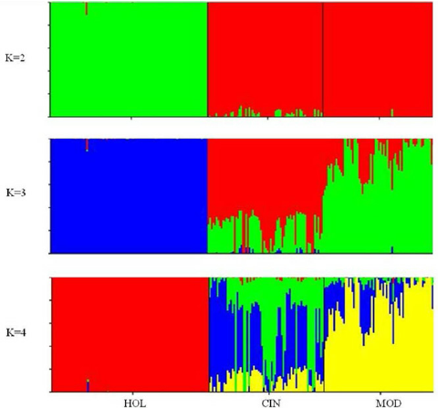
STRUCTURE (2000) – Global ancestry
Individuals (N)

Slide 26
STRUCTURE (2000) – Global ancestry
Benefits:
No reference data required
Model-based method is accurate with few loci
accuracy depends on N (to estimate P allele frequencies)
Bayesian framework can incorporate partial information if available
Caveats:
Inference of K is challenging and often unstable
No use of haplotype information (were just being discovered!)
Computationally challenging for large datasets (extensions fix this)
Not informative of local ancestry

Slide 27
PCA-based approach – Global ancestry
j SNPs
G
1002010001101202010120201
1021021021201201201202002
1201022102102101022101012
1110200020201200200021020
0101001200010102010102202
2101021020202010210102020
1202101202020101011101011
1212212021120120021012010
1201200202010202022011020
1212012021022102210110000
0120120210210102102102101
0100020120120120102102000
0020020210100101012001000
0102010020020111201001212
1202121012101202120101010
0120121210101101012020222
...
n individuals
...

Slide 28
PCA-based approach – Global ancestry
j SNPs
...
G
PC2
PC1
j
1002010001101202010120201
1021021021201201201202002
1201022102102101022101012
1110200020201200200021020
0101001200010102010102202
2101021020202010210102020
1202101202020101011101011
1212212021120120021012010
1201200202010202022011020
1212012021022102210110000
0120120210210102102102101
0100020120120120102102000
0020020210100101012001000
0102010020020111201001212
1202121012101202120101010
0120121210101101012020222
1
0
1
1
2
1
0
0
1
2
2
1
0
1
0
2
2
2
2
1
2
1
2
0
1
1
0
0
0
0
1
1
PCs constructed (latent) to maximize the variance explained in the data
SVD
...
n individuals
...

Slide 29
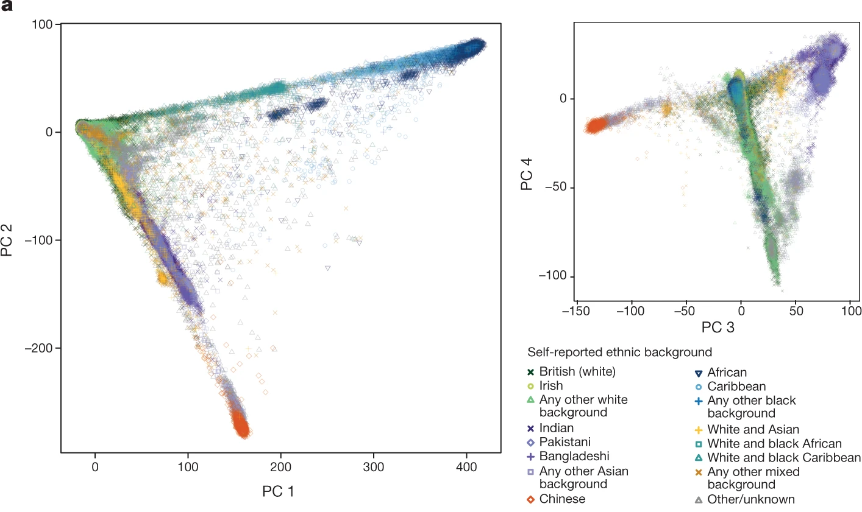
PCA-based approach – Global ancestry
(Bycroft, 2018, Nature)

Slide 30
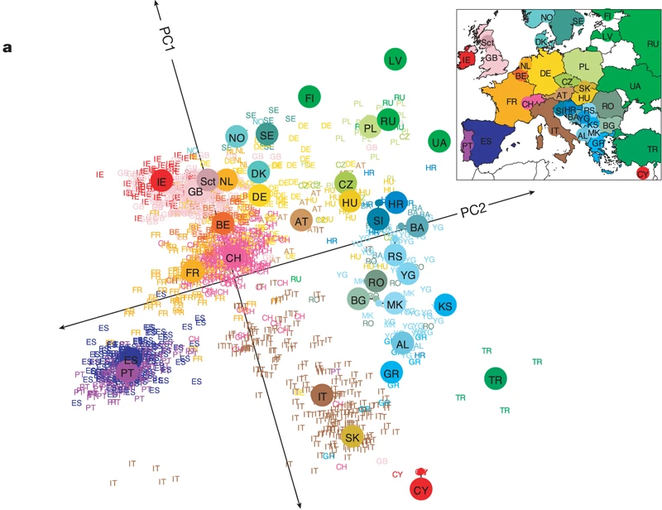
Subcontinental PCA – Global ancestry
PC1 = 0.3%
PC2 = 0.15%
1,387 Europeans, 138,000 SNPs
Labelled by grandparental ancestry
POPRES data (Nelson et al., 2008)
(Novembre et al., 2008, Nature)

Slide 31
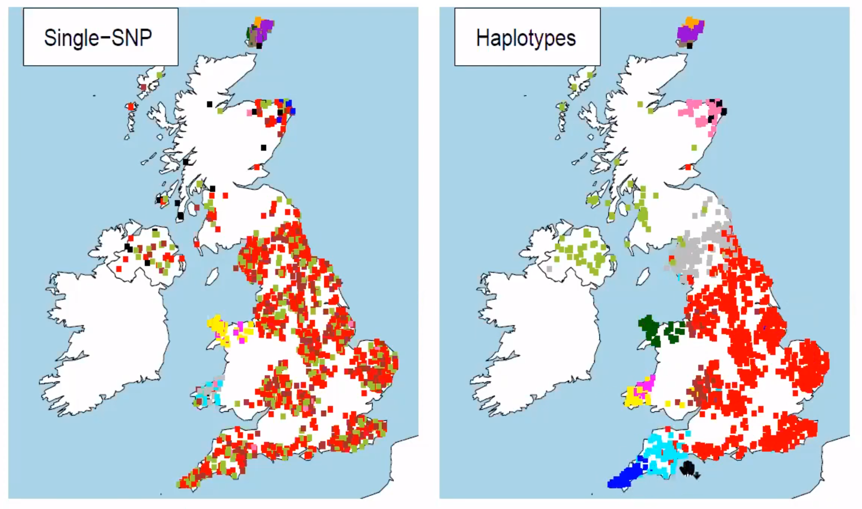
Local Ancestry Inference (LAI)
Common variant PCA
Chromopainter
(Leslie et al., 2015, Nature)
(G. Hellenthal, 2021)

Slide 32
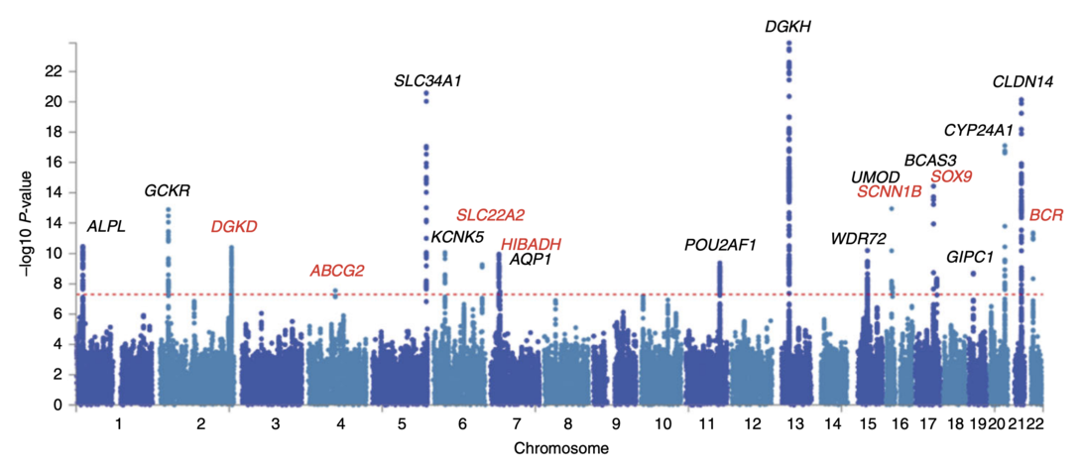
Can we used LAI in GWAS?

Slide 33
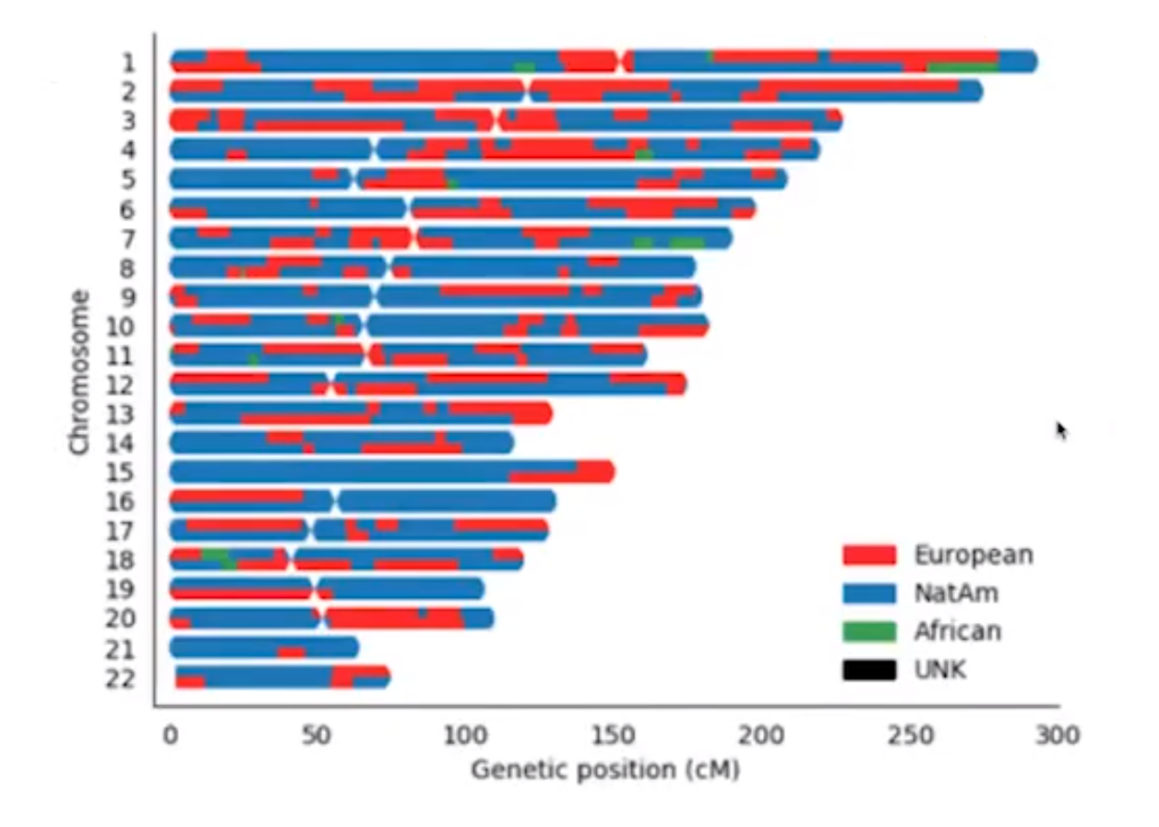
Tractor
Directly uses LAI estimates

Slide 34
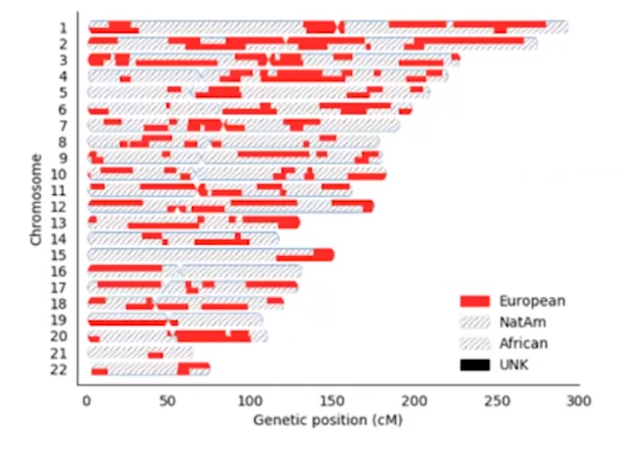
Tractor
Directly uses LAI estimates

Slide 35
Phasing
SHAPEIT2 : statistical phasing (has been replaced by SHAPEIT4)
Need: genotype data + genetic map
Phasing?
1 0 1 2 2 0 1
Diplotype
How?
0 0 0 1 1 0 1
Haplotypes
1 0 1 1 1 0 0

Slide 36
Phasing
Hidden Markov Model-based Phasing; Li-Stephens HMM (2003)
States: reference haplotypes
Transitions: recombination event
Emission: observed allele
0 1 1 0 1 0 1 0 1 1 1 0 0 0 0 1 1 0
sample
1 1 1 0
0 1 1 0
AFR
EUR
CN
NI
AUS
reference haplotypes
1 0 1 0
0 0 0 1 1 0

Slide 37
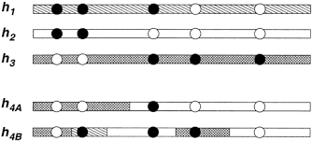
Phasing
Hidden Markov Model-based Phasing; Li-Stephens HMM (2003)
States: reference haplotypes
Transitions: recombination event
Emission: observed allele
0 1 1 0 1 0 1 0 1 1 1 0 0 0 0 1 1 0
sample
1 1 1 0
0 1 1 0
AFR
EUR
CN
NI
AUS
reference haplotypes
1 0 1 0
0 0 0 1 1 0

Slide 38
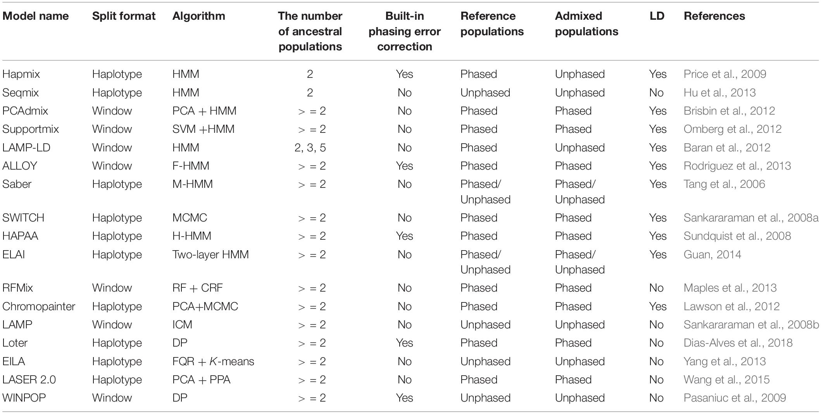
Local ancestry inference methods
(Systematic Review on Local Ancestor Inference From a Mathematical and Algorithmic Perspective; Wu, Liu, Zhao, 2021, Front. Genet.)

Slide 39
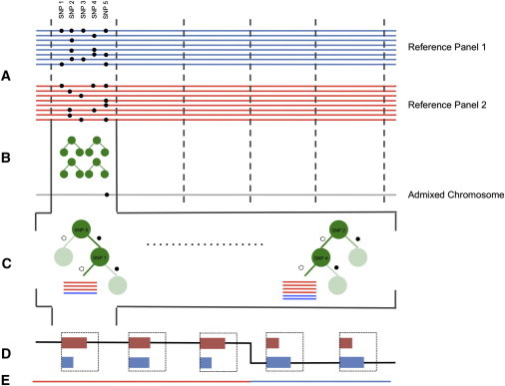
Local ancestry inference – RFMix2
Chr. divided into windows based on genetic dist.
RF is trained to distinguish ancestry
Predict new admixed chromosome

Slide 40
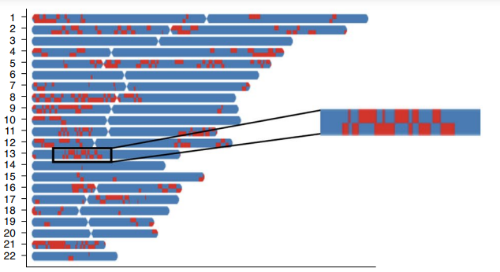
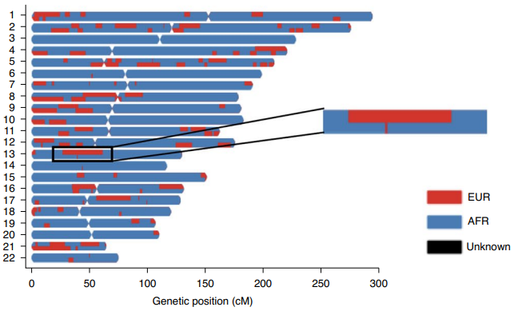
With phasing errors
Recovered

Slide 41
Recover tract lengths
Authors wanted to address the issue of phasing error, which can disrupt tracts in local ancestry inference.
Modelled expected distribution of EUR tracts within AA individuals as a Poisson process; time until recombination disrupts a tract.
“Tractor detects and fixes phase switches, which we define as a swap of ancestry across a chromosome within a 1-cM window at a region with heterozygous ancestry dosage, using local ancestry.”

Slide 42
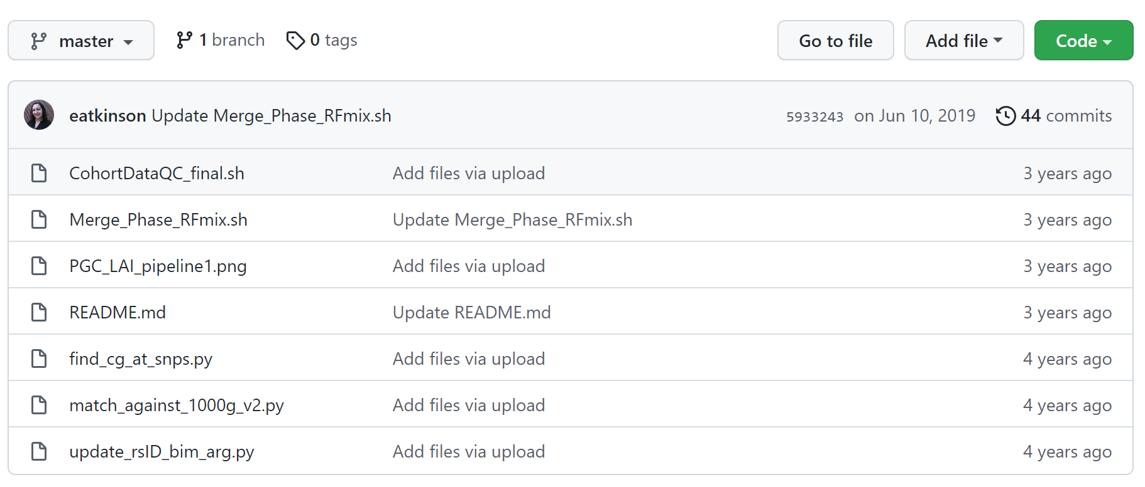
https://github.com/Atkinson-Lab/Post-QC

Slide 43
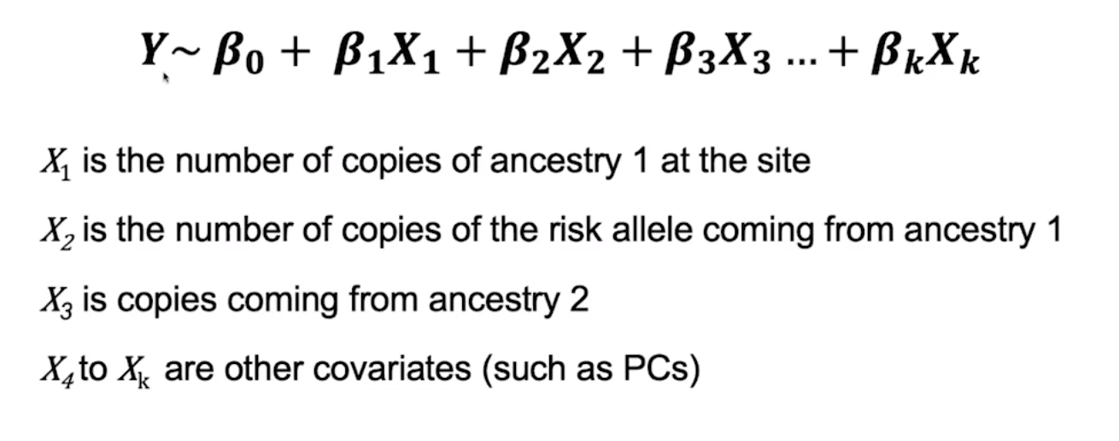
Tractor – association test
Requires prior estimation of LAI (but is robust to varying quality)
Uses regression framework for ancestry-specific effects

Slide 44
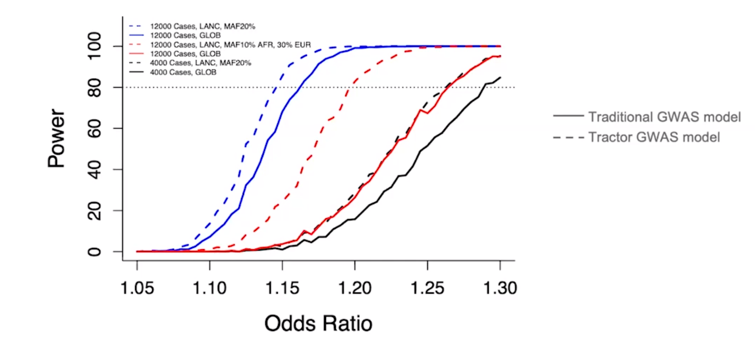
Improved statistical power

Slide 45
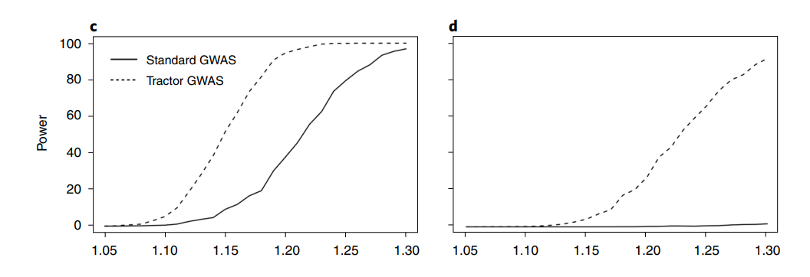
Improved statistical power
Effect only present in minority sample (here EUR)
Admixture 50/50

Slide 46
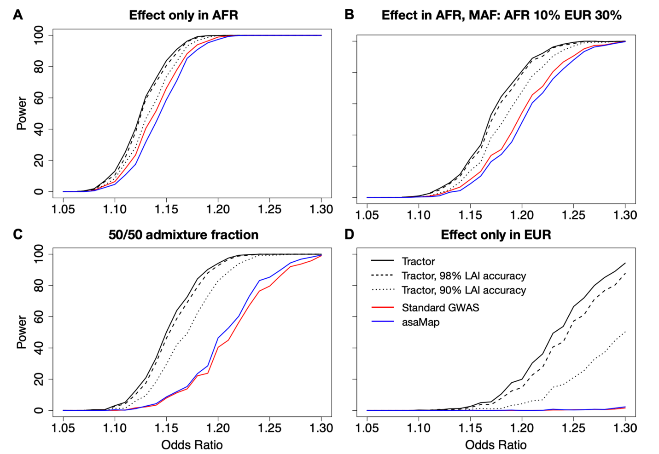
Improved statistical power

Slide 47
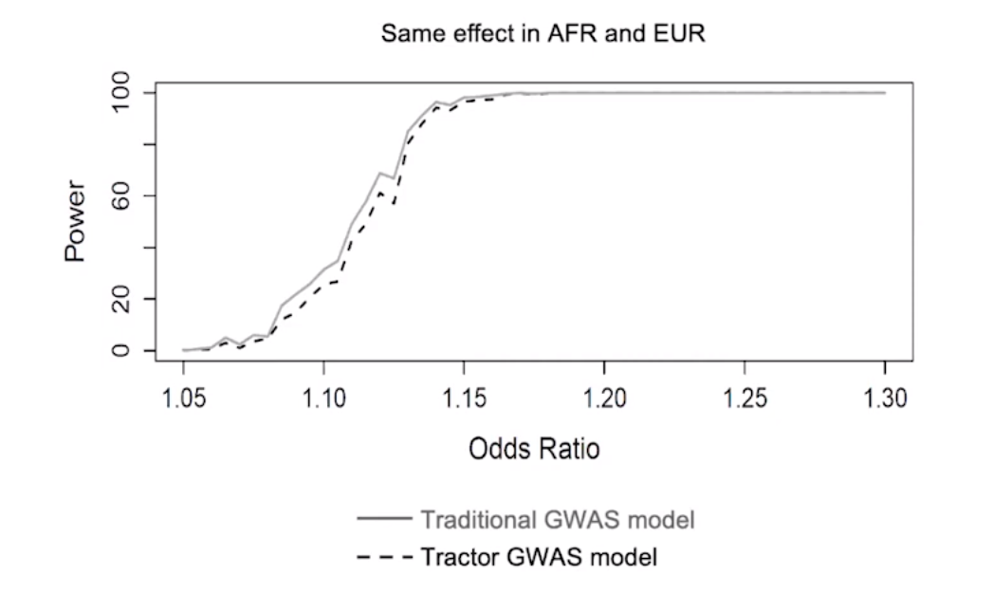
No major power loss when all params equal

Slide 48
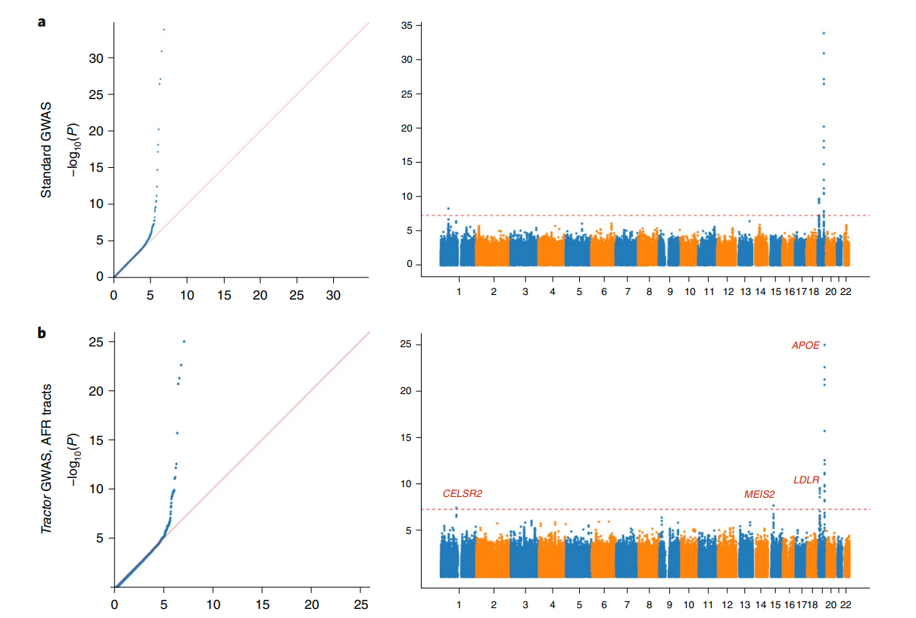
Total cholesterol
UKB Pseudo-cohort
4,309 2-way admixed African-European individuals

Slide 49
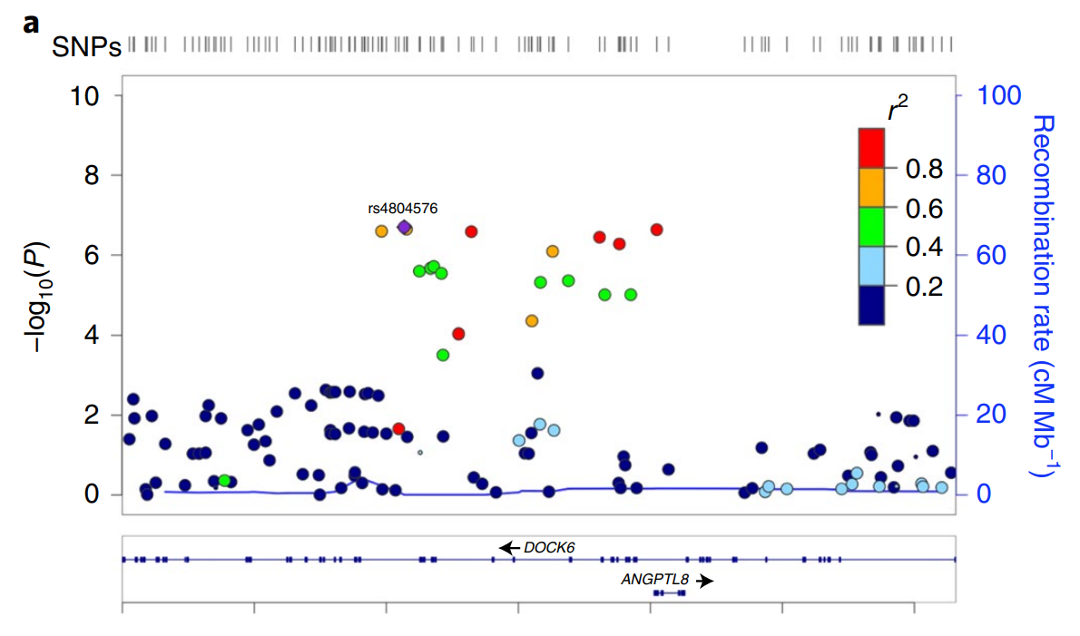
Standard GWAS – UK Biobank

Slide 50
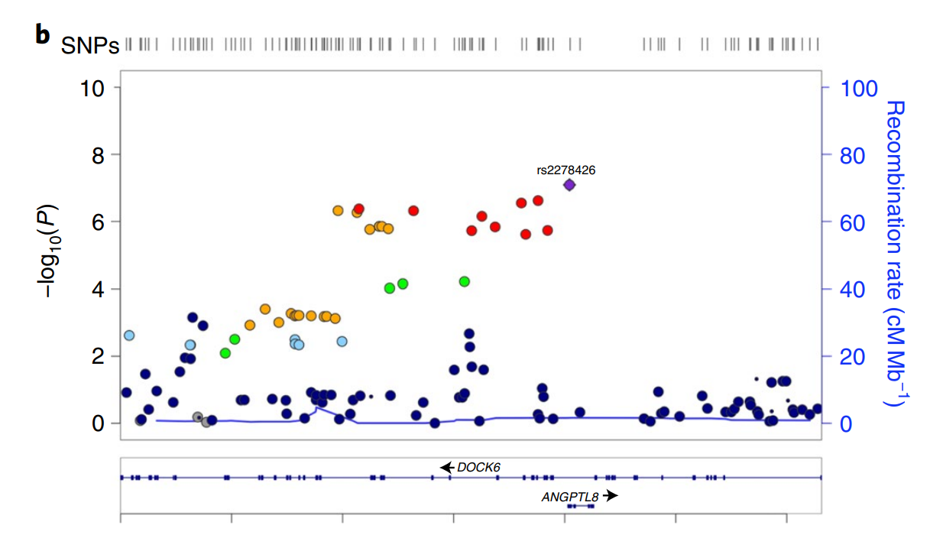
Tractor GWAS – UK Biobank

Slide 51

Take-home messages
Population stratification inflates false positives and reduces power of GWAS.
Controlling for global ancestry is not sufficient to avoid these pitfalls when admixed populations are being studied.
The tractor method uses local ancestry inference and improves upon existing methods for analyzing admixed groups – better power and better localization.
No real caveats provided.

Slide 52
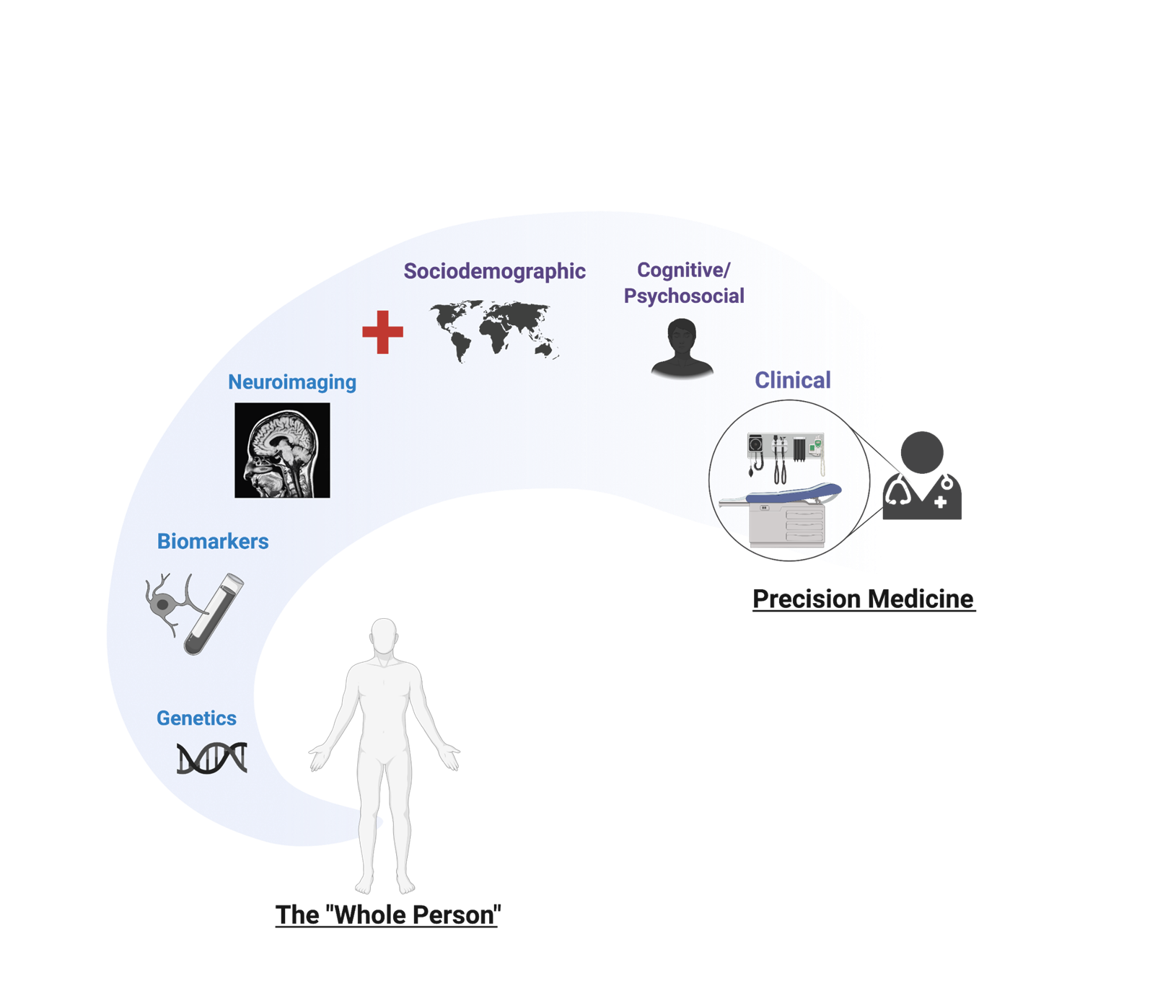

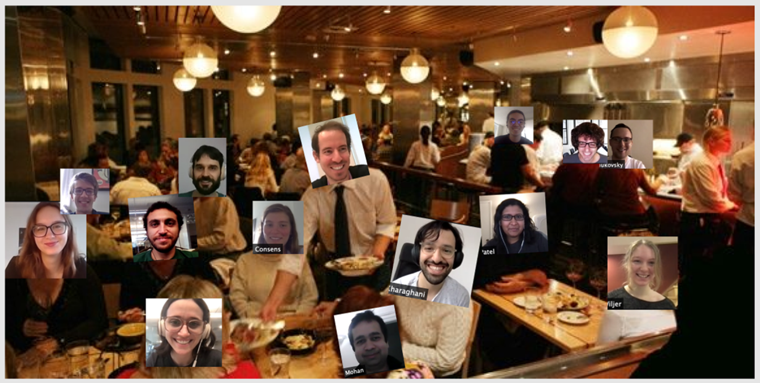

Slide 53
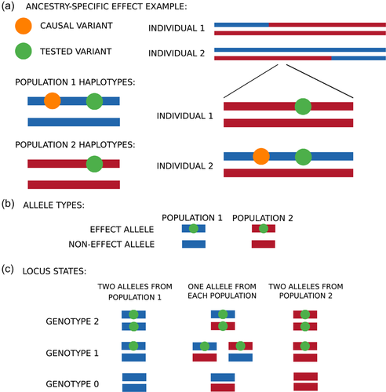
Accounting for local ancestry in genetic association
AsaMap
No prior local ancestry estimation is required.
Generates ancestry-specific SNP effect sizes.
Does not map admixture, just tests association with phenotype
(Skotte et al., 2019, Genet Epi)

Slide 54
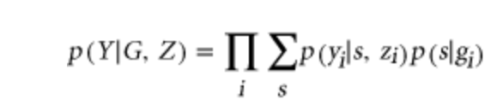
More asaMap
Likelihood function of measures (Y) =
G = (g₁,g₂,...,g_{N}) ; genotype data
Z = (z₁,z₂,...,z_{N}) ; covariates
s = allele state ; (unobserved)
(Skotte et al., 2019, Genet Epi)
Notes:
Assume only 2 populations

Slide 55
More asaMap
Likelihood function of measures (Y) =
G = (g₁,g₂,...,g_{N}) ; genotype data
Z = (z₁,z₂,...,z_{N}) ; covariates
s = allele state ; (unobserved)
mixture weight; probability of locus state (ancestry + allele)
mixture component
(Skotte et al., 2019, Genet Epi)
Notes:
Assume only 2 populations

Slide 56
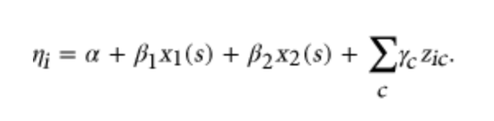
More asaMap
Likelihood function of measures (Y) =
G = (g₁,g₂,...,g_{N}) ; genotype data
Z = (z₁,z₂,...,z_{N}) ; covariates
s = allele state ; (unobserved)
mixture weight; probability of locus state (ancestry)
mixture component
covariates
(Skotte et al., 2019, Genet Epi)
Notes:
Assume only 2 populations

Slide 57
More asaMap
Likelihood function of measures (Y) =
G = (g₁,g₂,...,g_{N}) ; genotype data
Z = (z₁,z₂,...,z_{N}) ; covariates
s = allele state ; (unobserved)
mixture weight; probability of locus state (ancestry)
mixture component
covariates
count of effect allele in population 1
count of effect allele in population 2
estimated per SNP using global ancestry proportion and population-specific allele frequencies
(Skotte et al., 2019, Genet Epi)
Notes:
Assume only 2 populations

Slide 58
Limitations
Gain in power depends strongly on the allele frequencies in the ancestral populations.
lower frequency in the population with greater effect → substantial power gain.
If higher freq. → negligible power gain.
Power gain depends on the underlying ancestry distribution.
When SNP effects are not ancestry-specific, asaMap is less powerful than the commonly used GLM-based tests.

Slide 59
Measurement of population structure
Fixation index: F_{ST}
Differences in expected heterozygosity across populations under Hardy-Weinberg Equilibrium.
Loss of heterozygosity (drift toward fixation) expected in isolated groups (Wahlund effect; 1928)
0–0.05= little differentiation
0.05–0.15 = moderate differentiation
0.15–0.25 = great differentiation
> 0.25 = very great differentiation.

Slide 60
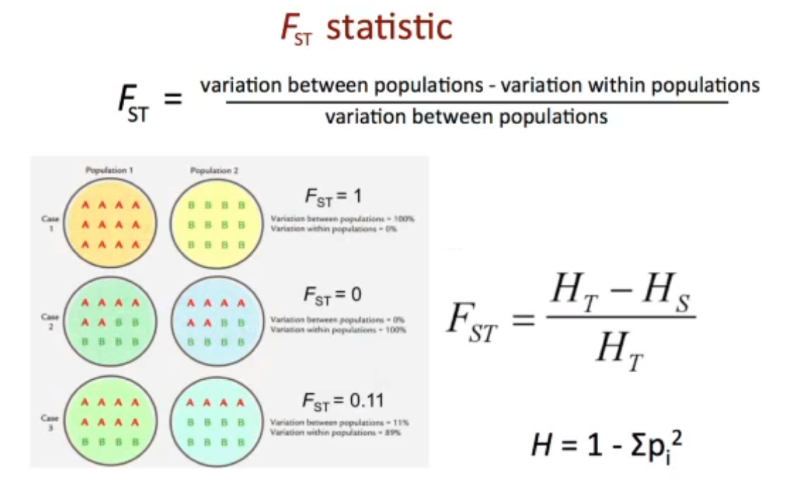
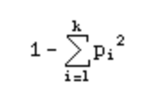
Measurement of population structure
total (meta) population
sub-population
(Actually H_{E}: expected heterozygosity”, or D: “gene diversity”)
H =
(Sarah Tishkoff, 2014)
Notes:
Can be done per locus or average across genome. FST can be tested using permutation by shuffling sub-pop labels

Slide 61


Slide 62

Tractor
Example: Latino/Admixed American sample (gnomAD)
(Wilson M, Tiao G, Atkinson E, 2021)

Slide 63

Using haplotypes instead of independent variants
Extension of STRUCTURE (Falush et al., 2003) HMM

Slide 64

Need for LAI
(badMIXTURE: Lawson, van Drop, Falush, 2018, Nat Commun)

Slide 65


LAI methods - HAPMIX
Two admixed populations
Uses Hidden Markov Models
chr. location
(Price et al., 2009)

Slide 66

Maybe not
(adapted from Choudhury, 2018)

